Slide 1
Mésurer les migrations internationales en 12 étapes : Sahel – Algérie- Europe
Dr. Mohamed Saib MUSETTE
Research Director – CREAD . Algiers (Algeria)
17th Jun 2021

Slide 2
Plan
Introduction
Les 12 étapes en trois séquences
Entrée/Départ
Boite noire
Exit/Retour
Conclusion

Slide 3
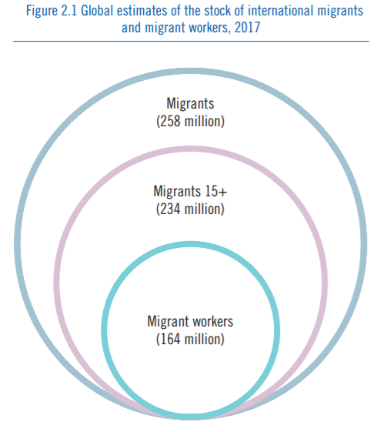
International Migrations
Recommendations on Statistics Migration Flows (UNDESA, 1998)
“An international migrant is defined as any person who changes his or her country of usual residence” (p9)
The latest highlights of UNDESA (2020) of migration stock.
“The number of persons living outside their country of birth or citizenship reached 281 million in 2020, up from 173 million in 2000 and 221 million in 2010… “
Labour migration most important forms of migrations, according to ILO (2017).
Source : ILO (2018)

Slide 4
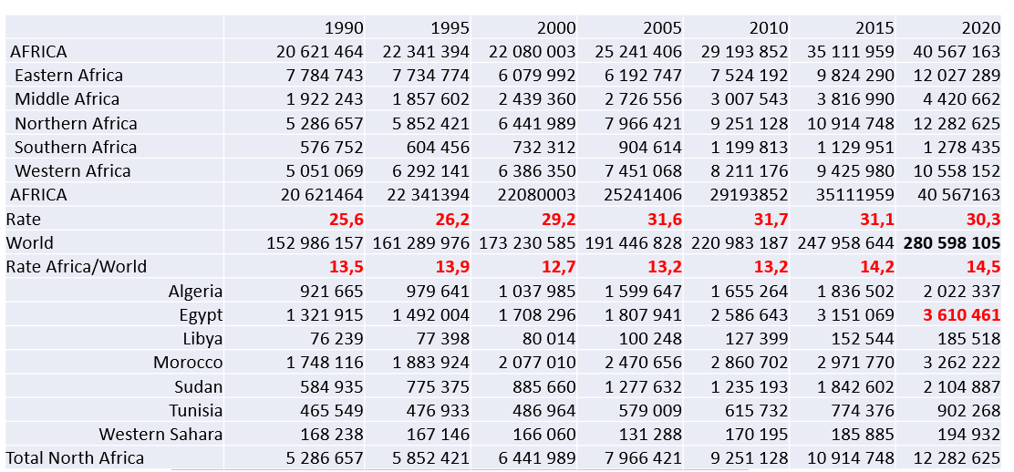
Evolution - Stock of Migrants from Africa and countries of North Africa: 1990/2020
Source : extracted UNDESA 2021

Slide 5
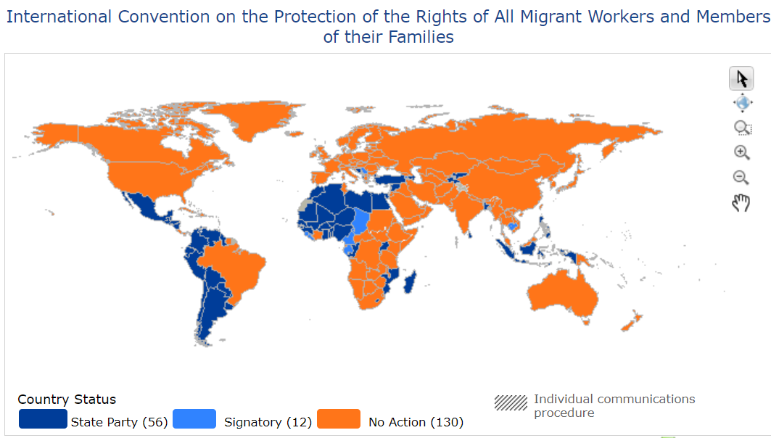
Irregular Migrations
Article 2. Each Member for which this Convention is in force shall systematically seek to determine whether there are illegally employed migrant workers on its territory and whether there depart from, pass through or arrive in its territory any movements of migrants for employment in which the migrants are subjected during their journey, on arrival or during their period of residence and employment to conditions contravening relevant international multilateral or bilateral instruments or agreements, or national laws or regulations.
Convention No 143 (ILO, 1975)
Human Rights of Migrants in irregular situation are protected by the UN Convention 1990
Smuggling of migrants is a transnational crime UN Convention 2000
Smuggling of migrants means
“the procurement, in order to obtain, directly or indirectly, a financial or other material benefit, of the illegal entry of a person into a State Party of which the person is not a national or a permanent resident”
Article 3 of the Protocol against the Smuggling of Migrants by Land, Sea and Air, supplementing the United Nations Convention against Transnational Organized Crime
Source : OHCHR, 2021

Slide 6
European definition
Defining irregular migration has been the subject of considerable debate.
Terms such as illegal, undocumented, non-documented, and unauthorised migration can have different connotations in national policy debates.
Due to this and the association with criminality the term 'illegal migration" should be avoided, as most irregular migrants are not criminals. Being in a country without the required papers is, in most countries, not a criminal offence but an administrative infringement.
Source : EU, Home Affairs
Illegal migration is common use in USA … illegal entry in the country

Slide 7
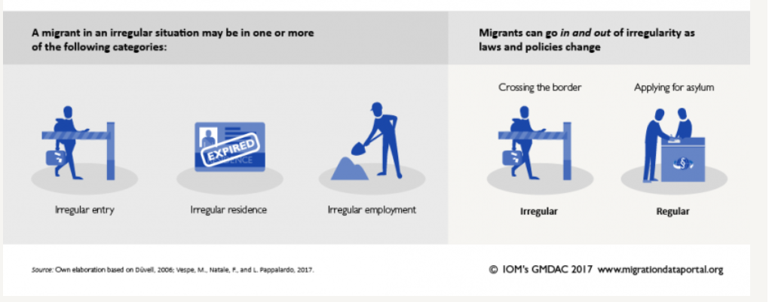
Difference between regular and irregular migration
Source : https://migrationdataportal.org/fr/themes/migration-irreguliere

Slide 8
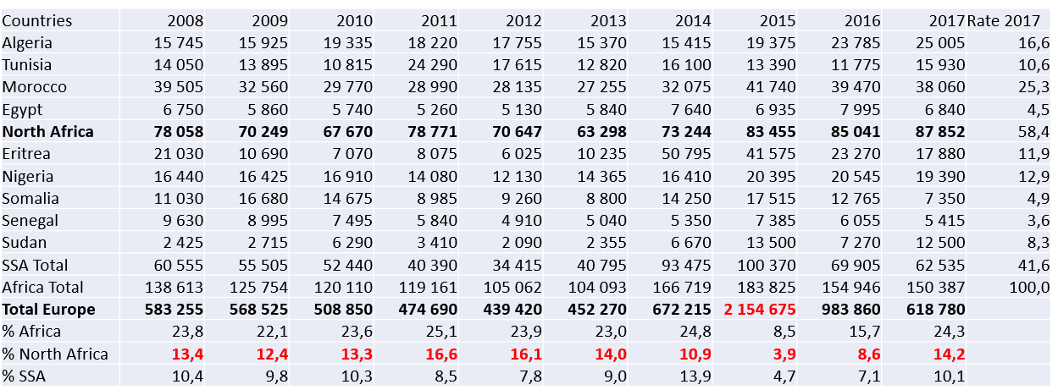
What about irregular Migrations ? No World Data African in Europe : from 2008-2017 (Eurostat)
Source : extracted from Eurostat (2020)

Slide 9
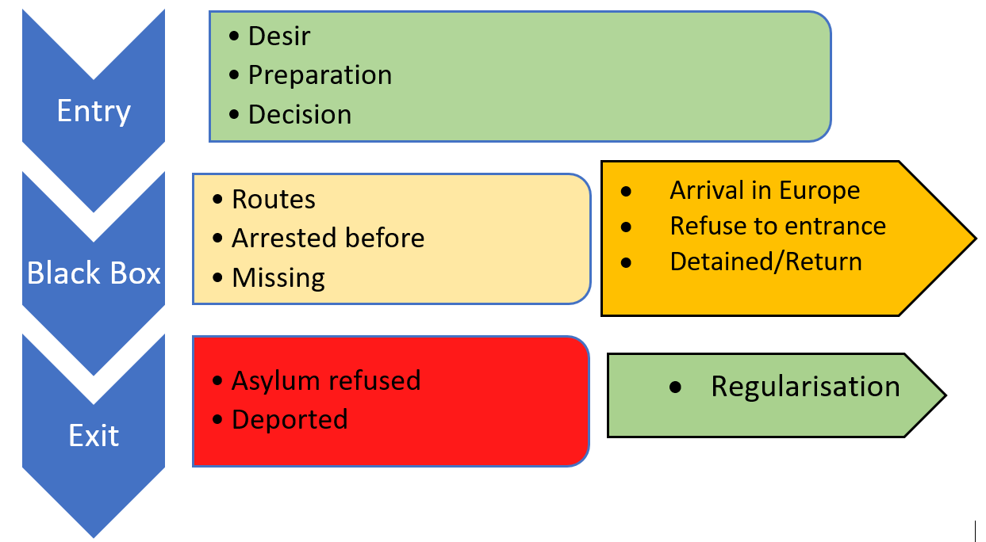
Mapping the Process of irregular migration in twelve steps Migration from Algeria to Europe

Slide 10
Mapping the Process of irregular migration in twelve steps Migration from Sahel to Algeria

Slide 11
Step 1. Desire to Migration, even irregularly
The Afro barometer survey on 34 African countries reveal that an average of 37% has a plan to migrate.
An average of 29 percent of North African expressed their intention to migration

Slide 12
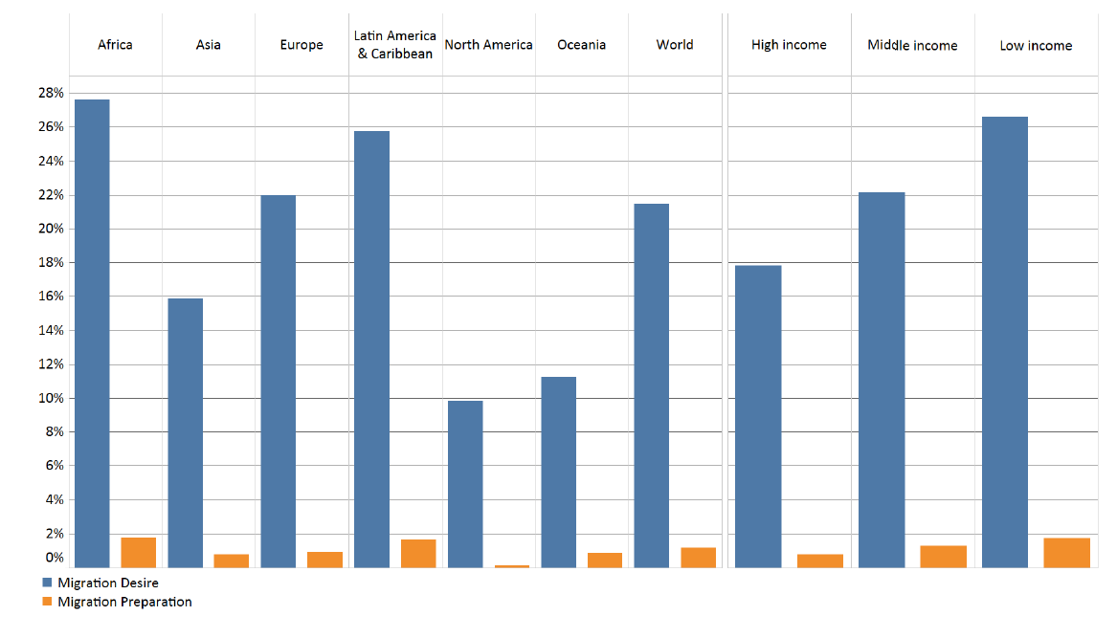
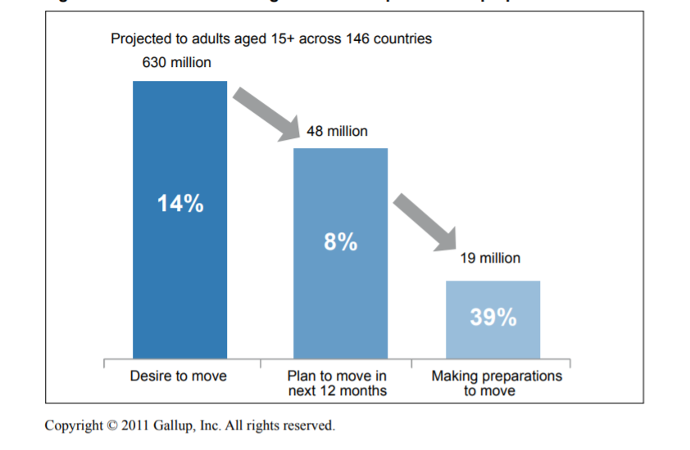
Step 2. Preparation
 | DZA | MOR | TUN
FRA | 33,3 | 28,8 | 26,6
CAN | 28,8 | 21,7 | 10,2
GER | 20,5 | 21,5 | 9,6
SPA | 18,5 | 21,9 | 1,1
ITA | 16,0 | 22,7 | 11,9
Source. Arab Barometer, 2020
Source: EU (2018)
Most Africans migrants in Europe are from North Africa, due to a long history if colonization and geographical proximity. Social Networks are very important…
Source: Gallup, 2011

Slide 13
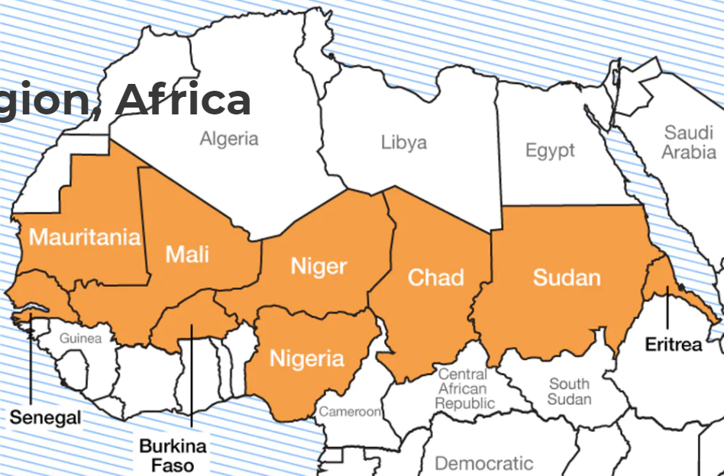
Step 3. Decision Making
Source : The conversation website
North African people are subjected to visa. Latest trends show around 25% of visa application were refused (2019), top Maghreban country Algeria (40%). Une Moyenne de 20% pour les 5 pays du Sahel, don’t le Tchad avec le maximum, 30%
Source : EU (2019)

Slide 14
Step 4 Routes : Air, land and Sea : Refuse at entry in EU28
Routes | 2013 | 2014 | 2015 | 2016 | 2017 | 2018 | 2019
Land | 83,9 | 81,4 | 80,7 | 82,2 | 81,5 | 82,5 | 87,9
Sea | 2,3 | 2,7 | 2,7 | 3,1 | 3,3 | 2,4 | 1,7
Air | 13,8 | 16,0 | 16,6 | 14,7 | 15,2 | 15,1 | 10,4
Total | 100 | 100 | 100 | 100 | 100 | 100 | 100
Source. Eurostat, 2019

Slide 15
Step 5. Migrants “to be” arrested before and on departure form North Africa
Irregular Migration is a hot issue for North African countries. High level meetings are organised to discuss ways and means to combat this phenomenon since the 1990s- Recent Statistics revealed from different sources
Morocco detected 27 000 irregular migrants and dismantled more than 60 smuggling networks in 2019
Algeria : 8184 Algerian Haraga and 619 smugglers arrested (GN, mars 21)
From Tunisia :no recent data available : from 2011 up to 2016, Police arrested some 14 000 persons trying to migrate.

Slide 16
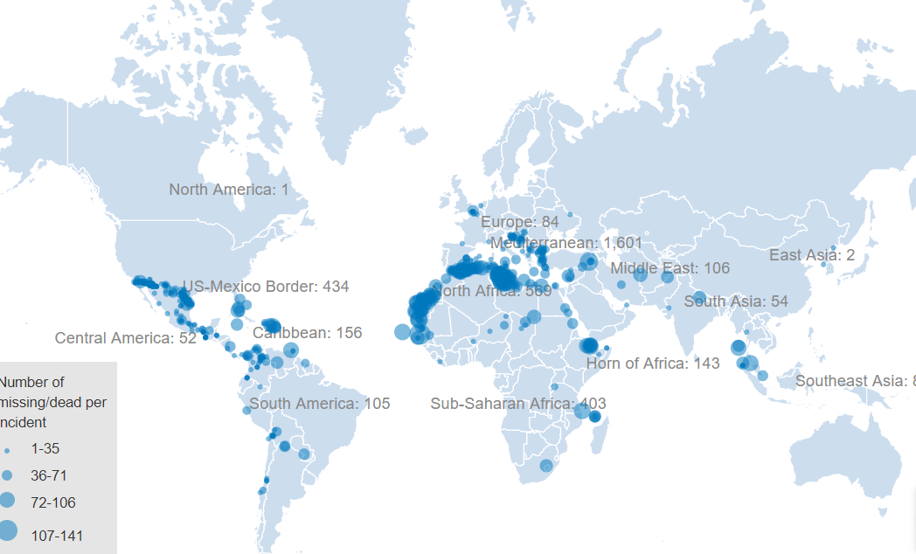
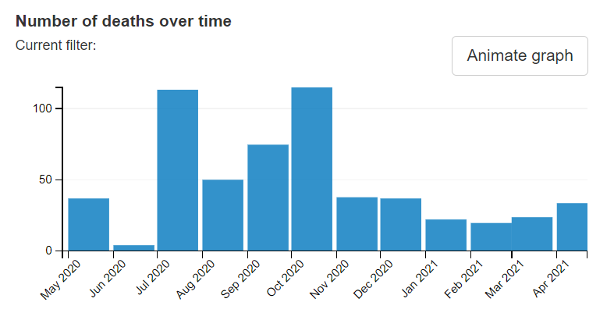
Step 6. World Missing Migrants (IOM)
Rescue ships owned by non-governmental organizations (NGOs) have saved nearly 400 irregular migrants from drowning in the Mediterranean region.
https://data.humdata.org/visualization/missing-migrants/

Slide 17
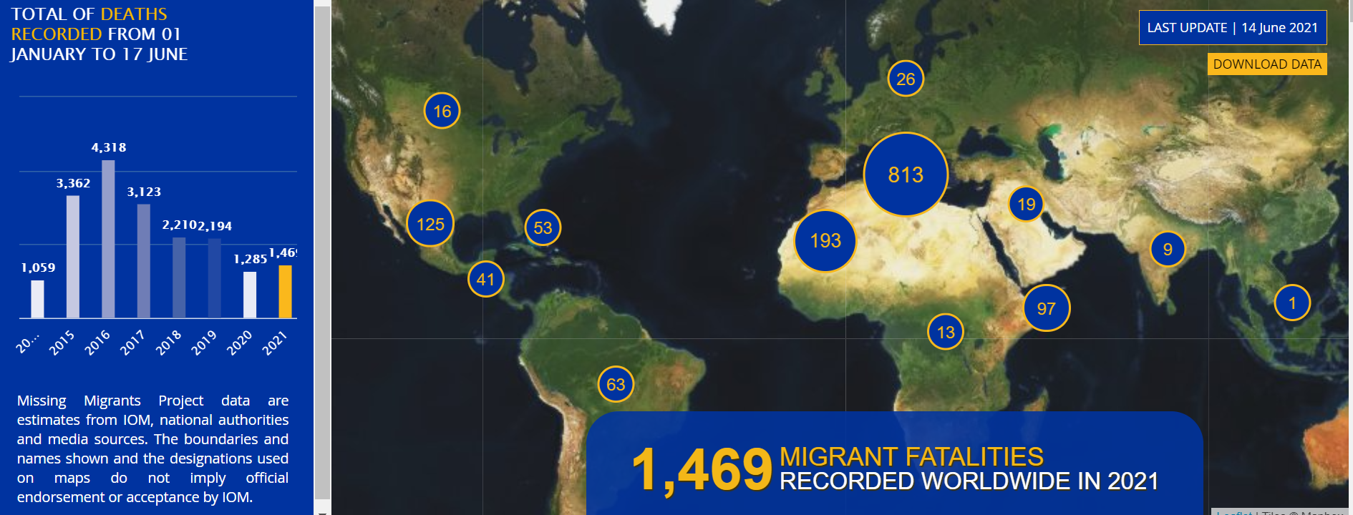
Step 6 . Missing Migrants Mediterranean Sea
Source. IOM, 2021

Slide 18
Deaths and Attempted crossings

Slide 19
Step 7. Focus on Sea border: Irregular Migration from Maghreb countries (2010-2019)
Source: FRONTEX (2021)

Slide 20
Step 7. Global Arrival in Europe : Flows of irregular Migration
Out of 618 000 migrants in irregular situation in 2017, 13% came from North Africa. A 10 years trend shows that Morocco stands alone with more than 40% of all North African migrants.
Source . Eurostat Data 2019

Slide 21
Step 8. Irregular Migration from Maghreb countries by sea border in 2020 (% by month)
Source: FRONTEX (2021)

Slide 22
Step 9. Invited to return
FRONTEX the European Union Border and Coast Guard Agency, reports that 298,190 irregular migrants were given a “return decision” by EU Member States in 2019. Of this figure, 138,860 people were effectively returned (either forcibly or voluntarily) (Frontex, 2020).
Source . FRONTEX 2020

Slide 23
Step 10. Asylum seekers – pending cases & refused
Algerian asylum demand in the EU increased by twofold from 2011 to 2020. Moroccan demand is multiplied by five during the same period. Tunisian fall slightly rather an exceptional upsurge in 2011
Source. World UNHCR Data (2020)
MID 2018 | DZA | MAR | TUN | TOTAL
ASYLUM | 5862 | 7023 | 2294 | 15179
REFUSED | 4236 | 3607 | 1931 | 9774
TOTAL | 10098 | 10630 | 4225 | 24953
Asylum seekers from Sub-Saharan in Algeria : more than 50% foreigners (UNDESA - 2020)
Source . Eurostat Data 2021

Slide 24
Step 11. Deported to country of origin (2010- 2019)
Source . Eurostat Data 2021
Deportation : The act of a state in the exercise of its sovereignty in removing a foreigner from its territory to a certain place after refusal of admission or termination of permission to remain (EU- Home Office)

Slide 25
Step 12. Regularization
Regularisation refers to the process of offering migrants who are in a country illegally the opportunity to legalise or normalise their immigration status, whether it is on a temporary or permanent basis. Regularisation does not mean granting citizenship (naturalisation).
There are many types of regularisation:
There is also a wide range of criteria required of migrants, distinguishing these programmes from general amnesties applied to all irregular migrants
Regularization process exist in all countries, not only in Europe
Regularization process during the COVID19 pandemic
Overall, 220,000 people applied regularisation in 2020, just under a third of the estimated 690,000 undocumented migrants in Italy.
In the case of Spain, there have been two types of measures concerning the treatment of migrants during the COVID-19 outbreak, concerning work and residence permits and the use of immigration detention centres. approximately 430,000 immigrants currently reside irregularly in Spain, or 12 percent of the total migrant population.

Slide 26
Conclusions
Une première simulation du modèle donne une part de moins de 2% des migrants potentiels qui ont pris des initiatives pour partir. On a vu aussi que les démarches peuvent échouer : la décision peut être révisée. Un tiers des migrants potentiels sera intercepté et ainsi vécu la fin du rêve.
Certains verront la mort ou seront sauvés in extremis par des ONG en Méditerranée. D'autres seront arrêtés en entrant sur les côtes nord. Il y en a aussi beaucoup d'autres inconnus. Combien auraient réussi à passer à travers les mailles du filet des forces de sécurité soit des pays de départ, d'arrivée ou de transit ? Ils peuvent également être arrêtés lors du transit aux frontières terrestres.
Enfin, certains migrants seront détenus et d'autres expulsés. Seuls quelques-uns entreront dans la boîte de sortie. Ils tenteront d'obtenir un statut de réfugié ou bien d'être régularisés et peut-être naturalisés à terme.

Slide 27
Thank you for your attention

