Slide 1
COHERENCE AND COHESION IN ACADEMIC WRITING

Slide 2
INTRODUCTION
Academic writing is a kind of formal style of writing, and good academic writing requires a good combination of cohesive ties and coherent features in the text.
In fact, Coherence and cohesion, which refer to the intra-text connectedness, and the contextual fitness of the ideas, are the two essential properties of academic writing that give a text unity and purpose.

Slide 3
COHERENCE
Coherence is the logical division of a text into internally consistent units. In other words, it refers to the general sense that a text makes through the organisation of its content. In writing, coherence is provided by a clear and understood structuring of paragraphs and sentences.

Slide 4
TIPS FOR ACHIEVING COHERENCE
Create an outline before writing your paper: your outline should include a clear thesis and paragraphs that support your thesis.
Organize your paragraphs in a logical order.
Keep one idea to one paragraph: all the sentences in one paragraph should relate to the main idea of that paragraph.
Ensure that paragraphs are conceptually linked, and not only sentences.

Slide 5
COHESION
Cohesion refers to the connection of ideas from sentence to sentence. We say that a text is cohesive if its elements (words and sentences) are smoothly linked together. Cohesion can be achieved by the use of linking devices and logical connectors to link sentences.

Slide 6
SOME COHESIVE DEVICES
Cohesive devices are words or phrases used to connect ideas between different parts of text. There are three main types of cohesive devices:
Pronouns that refer back to a previously mentioned noun.
Ex: Linda went to playground. She played on the swings
Transition words and inter clausal connectors:
They indicate cause and effect, contrast, ideas, emphasize and organize ideas.
Ex: Mary was late, so she took the bus.
Substitutions of a synonym for a previously mentioned noun.
Ex: there was a lot of food, but she only ate the bread.

Slide 7
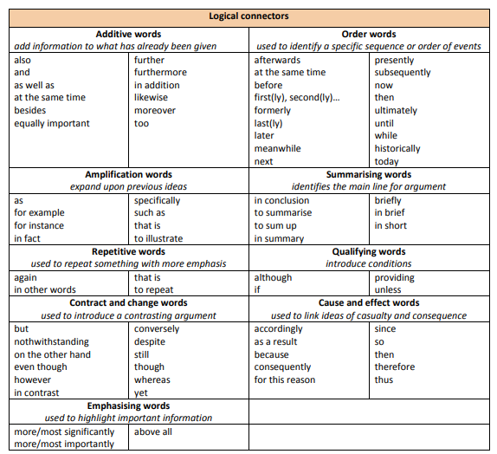

Slide 8
THANK YOU

