Slide 1
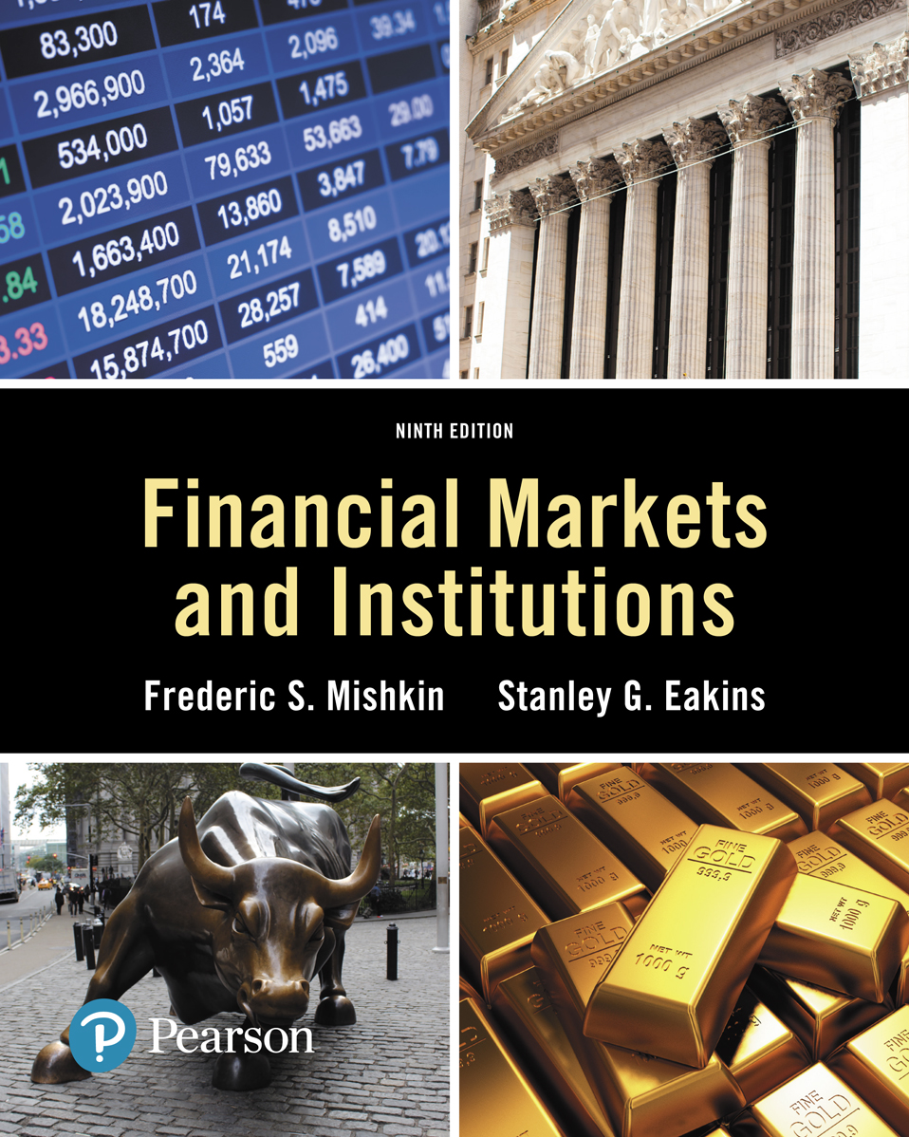
Lecture 6: The bond market
Ninth Edition
Copyright © 2018, 2015, 2012 Pearson Education, Inc. All Rights Reserved
Notes:
If this PowerPoint presentation contains mathematical equations, you may need to check that your computer has the following installed:
1) MathType Plugin
2) Math Player (free versions available)
3) NVDA Reader (free versions available)
Slides in this presentation contain hyperlinks. JAWS users should be able to get a list of links by using INSERT+F7

Slide 2
Overview
Purpose of the Capital Market
Capital Market Participants
Capital Market Trading
Types of Bonds
Treasury Notes and Bonds
Municipal Bonds
Corporate Bonds
Financial Guarantees for Bonds
Oversight of the Bond Markets
Current Yield Calculation
Finding the Value of Coupon Bonds
Investing in Bonds

Slide 3
Purpose of the Capital Market
Original maturity is greater than one year, typically for long-term financing or investments
Best known capital market securities:
Stocks and bonds

Slide 4
Capital Market Participants
Primary issuers of securities:
Federal and local governments: debt issuers
Corporations: equity and debt issuers
Largest purchasers of securities:
You and me

Slide 5
Capital Market Trading
Primary market for initial sale (I P O)
Secondary market
Over-the-counter
Organized exchanges (i.e., N Y S E)

Slide 6
Types of Bonds
Bonds are securities that represent debt owed by the issuer to the investor, and typically have specified payments on specific dates.
Types of bonds we will examine include long-term government bonds (T-bonds), municipal bonds, and corporate bonds.

Slide 7
Figure 1 Hamilton/B P Corporate Bond

Slide 8
Treasury Notes and Bonds
The U.S. Treasury issues notes and bonds to finance its operations.
The following table summarizes the maturity differences among the various Treasury securities.

Slide 9
Table 12.1 Treasury Securities
Type | Maturity
Treasury bill | Less than 1 year
Treasury note | 1 to 10 years
Treasury bond | 10 to 30 years

Slide 10
Treasury Bond Interest Rates
No default risk since the Treasury can print money to payoff the debt
Very low interest rates, often considered the risk-free rate (although inflation risk is still present)

Slide 11
Figure 2 Interest Rate on Treasury Bonds and the Inflation Rate, 1973–2016 (January of Each Year)
Source:
http://www.federalreserve.gov/releases
and
https://www.treasury.gov/resource-
center/data-chart-center/interest-rates/Pages/TextView.aspx?data=reallongtermrate
.
Notes:
The vertical axis is labeled "Rate (Percent)" and ranges from 0 to 14 in increments of 2. The horizontal axis lists dates from 19 74 to 20 16 in 2-year increments. The line for inflation shows rate to be 6.2% for the year 19 74, which falls down to 5.8% by 19 76 but recovers back to a peak value of 14% by 19 80. The rate shows a sudden decline thereafter and falls down to 2% by 1986 but increases to 5.5% by 19 90. With a fluctuating trend over the years, the rate falls down to 1.75% by 2002 and becomes 0% in 20 13 and shows a slight gain in 20 14 to reach to a value of 1%. The line for 10-year bonds shows the rate close to 6.2% for the year 19 74, which increases to a peak value of 12.5% by the year 1981. The rate for this category shows a consistent decline over the years and falls down to a value of 6% by 19 93, 4% in 2006, and 2% in 20 12. It recovers back to 3% in 20 14 but falls down once again to 2% by 20 15. All values are approximate.

Slide 12
Figure 3 Interest Rate on Treasury Bills and Treasury Bonds, 1974–2016 (January of Each Year)
Source:
http://www.federalreserve.gov/releases/h15/data.htm
.
Notes:
The vertical axis is labeled Rate left parenthesis Percent right parenthesis and ranges from 0 to 16 in increments of 2. The horizontal axis lists years from 19 75 to 20 15 in 2-year increments. The line for 20-year treasury bonds shows rate to be 6.5% for the year 19 75, which increases to a peak value of 13% by 19 82. The rate shows consistent decline over the years and falls down to a value of 8% by 19 87, 6% by 2001, 4% by 2009, and 3% by 20 12. The line for 90-day treasury bills shows the rate to be 7.5% for the year 19 75, which declines down to 4.5% by 19 77. With a sudden growth, the value for rate reaches a peak value of 15.75% by the year 19 81. The rate, however, shows a consistently declining trend thereafter and falls down to a value of 6% by 19 85, 4% by 19 93, and to 0.5% by 2004. The rate shows a sudden growth after this point and reaches to a value of 5% by year 2007 but falls down suddenly to 0% by 2009 and remains unchanged thereafter. All values are approximate.

Slide 13
Treasury Bonds: Recent Innovation
Treasury Inflation-Indexed Securities: the principal amount is tied to the current rate of inflation to protect investor purchasing power
Treasury S T R I P S: the coupon and principal payments are “stripped” from a T-Bond and sold as individual zero-coupon bonds.

Slide 14
Treasury Bonds: Agency Debt
Although not technically Treasury securities, agency bonds are issued by government-sponsored entities, such as G N M A, F N M A, and F H L M C.
The debt has an “implicit” guarantee that the U.S. government will not let the debt default. This “guarantee” was clear during the 2008 bailout…

Slide 15
The 2007–2009 Financial Crisis: Bailout of Fannie and Freddie
Both Fannie and Freddie managed their political situation effectively, allowing them to engage in risky activities, despite concerns raised.
By 2008, the two had purchased or guaranteed over $5 trillion in mortgages or mortgage-backed securities.

Slide 16
The 2007–2009 Financial Crisis: Bailout of Fannie and Freddie (cont.)
Part of this growth was driven by their Congressional mission to support affordable housing. They did this by purchasing subprime and Alt-A mortgages.
As these mortgages defaults, large losses mounted for both agencies.
By October of 2016, the two agencies had paid $250 billion in dividends to the treasury.

Slide 17
Municipal Bonds
Issued by local, county, and state governments
Used to finance public interest projects

Slide 18
Municipal Bonds: Example
Suppose the rate on a corporate bond is 5% and the rate on a municipal bond is 3.5%. Which should you choose? Your marginal tax rate is 28%.

Slide 19
Municipal Bonds: Example (cont.)
Suppose the rate on a corporate bond is 5% and the rate on a municipal bond is 3.5%. Which should you choose? Your marginal tax rate is 28%.
Find the equivalent tax-free rate (E T F R):
The E T F R = 3.36%. If the actual muni-rate is above this (it is), choose the muni.

Slide 20
Corporate Bonds (1 of 3)
Typically have a face value of $1,000, although some have a face value of $5,000 or $10,000
Pay interest semi-annually
Cannot be redeemed anytime the issuer wishes, unless a specific clause states this (call option).
Degree of risk varies with each bond, even from the same issuer. Following suite, the required interest rate varies with level of risk.
The degree of risk ranges from low-risk (A A A) to higher risk (B B B). Any bonds rated below BBB are considered sub-investment grade debt.

Slide 21
Figure 5 Corporate Bond Interest Rates, 1973–2015 (End of Year)
Source:
http://www.federalreserve.gov/releases/h15/data.htm
.
Notes:
The vertical axis is labeled Interest rate left parenthesis percent right parenthesis and ranges from 0 to 18 in increments of 2. The horizontal axis lists dates from 19 74 to 20 14 in 2-year increments. The line for A A A shows interest rate for the year 19 74 as 8.5%, which increases to a peak value of 14% by the year 19 81. The interest rate for this category shows a consistent decline over the year and falls down to a value of 8% by the year 19 86, 7% by year 19 93, 6% by 2003, and to 4% by 2012. The line for B B B shows interest rate for the year 19 76 as 10%, which increases to a peak value of 17% by the year 19 81. The interest rate for this category shows a consistent decline over the year and falls down to a value of 10% by the year 19 86, 9% by year 19 93, 7% by 2003, and to 6% by 20 12.

Slide 22
Characteristics of Corporate Bonds
Restrictive Covenants
Mitigates conflicts with shareholder interests
May limit dividends, new debt, ratios, etc.
Usually includes a cross-default clause

Slide 23
Characteristics of Corporate Bonds (cont.)
Call Provisions
Higher required yield
Mechanism to adhere to a sinking fund provision
Interest of the stockholders
Alternative opportunities
Conversion
Some debt may be converted to equity
Similar to a stock option, but usually more limited

Slide 24
Corporate Bonds: Characteristics of Corporate Bonds (cont.)
Secured Bonds
Mortgage bonds
Equipment trust certificates
Unsecured Bonds
Debentures
Subordinated debentures
Variable-rate bonds

Slide 25
Corporate Bonds: Characteristics of Corporate Bonds (cont.)
Junk Bonds
Debt that is rated below B B B
Often, trusts and insurance companies are not permitted to invest in junk debt
Michael Milken developed this market in the mid-1980s, although he was subsequently convicted of insider trading

Slide 26
Table 2 Debt Rating Descriptions
Standard & Poor’s | Moody’s | Definition
A A A | A a a | Best quality and highest rating. Capacity to pay interest and repay principal is extremely strong. Smallest degree of investment risk.
AaA | Aa | High quality. Very strong capacity to pay interest and repay principal and differs from A A A/A a a in a small degree.
A | A | Strong capacity to pay interest and repay principal. Possess many favorable investment attributes and are considered upper-medium-grade obligations. Somewhat more susceptible to the adverse effects of changes in circumstances and economic conditions.

Slide 27
Table 2 Debt Rating Descriptions (cont.)
Standard & Poor’s | Moody’s | Definition
B B B | B a a | Medium-grade obligations. Neither highly protected nor poorly secured. Adequate capacity to pay interest and repay principal. May lack long-term reliability and protective elements to secure interest and principal payments.
B B | Ba | Moderate ability to pay interest and repay principal. Have speculative elements and future cannot be considered well assured. Adverse business, economic, and financial conditions could lead to inability to meet financial obligations.
B | B | Lack characteristics of desirable investment. Assurance of interest and principal payments over long period of time may be small. Adverse conditions likely to impair ability to meet financial obligations.

Slide 28
Table 2 Debt Rating Descriptions (cont.)
Standard & Poor’s | Moody’s | Definition
C C C | C a a | Poor standing. Identifiable vulnerability to default and dependent on favorable business, economic, and financial conditions to meet timely payment of interest and repayment of principal.
C C | Ca | Represent obligations that are speculative to a high degree. Issues often default and have other marked shortcomings.
C | C | Lowest-rated class of bonds. Have extremely poor prospects of attaining any real investment standard. May be used to cover a situation where bankruptcy petition has been filed, but debt service payments are continued.

Slide 29
Table 12.2 Debt Rating Descriptions (cont.)
Standard & Poor’s | Moody’s | Definition
C I | C a a | Reserved for income bonds on which no interest is being paid.
D | Ca | Payment default.
N R |  | No public rating has been requested.
left parenthesis plus right parenthesis or left parenthesis minus right parenthesis | C | Ratings from A A to C C C may be modified by the addition of a plus or minus sign to show relative standing within the major rating categories.

Slide 30
Financial Guarantees for Bonds
Some debt issuers purchase financial guarantees to lower the risk of their debt.
The guarantee provides for timely payment of interest and principal, and are usually backed by large insurance companies.

Slide 31
Oversight of the Bond Markets
Bond trades are not available to the public, making trading less transparent.
T R A C E, under F I N R A, was developed to:
Make some bond transactions reported to the public
Develop a trading platform to make transaction data available to the public

Slide 32
Table 3 Sample Violations in the Bond Market
Violation | Fine
Excessive trading | $5,000 to $110,000
Excessive markups | $5,000 to $146,000
Failure to supervise | $5,000 to $73,000
Fraud/Misrepresentation | $2,500 to $146,000
Late reporting | $5,000 to $146,000
Net capital deficiencies | $1,000 to $73,000
Outside business activities | $2,500 to $73,000
Recordkeeping violations | $1,000 to $146,000
Sale of unregistered securities | $2,500 to $73,000
Unsuitable recommendations | $2,500 to $110,000

Slide 33
Current Yield Calculations
Bond yields are quoted using a variety of conventions, depending on both the type of issue and the market.
We will examine the current yield calculation that is commonly used for long-term debt.

Slide 34
Bond Current Yield Calculation
What is the current yield for a bond with a face value of $1,000, a current price of $921.01, and a coupon rate of 10.95%?
Answer:
Note: C (coupon)

Slide 35
Finding the Value of Coupon Bonds
Bond pricing is, in theory, no different than pricing any set of known cash flows.
Once the cash flows have been identified, they should be discounted to time zero at an appropriate discount rate.

Slide 36
Table 3 Bond Terminology
Term | Definition
Coupon interest rate | The stated annual interest rate on the bond. It is usually fixed for the life of the bond.
Current yield | The coupon interest payment divided by the current market price of the bond.
Face amount | The maturity value of the bond. The holder of the bond will receive the face amount from the issuer when the bond matures. Face amount is synonymous with par value.

Slide 37
Table 3 Bond Terminology (cont.)
Term | Definition
Indenture | The contract that accompanies a bond and specifies the terms of the loan agreement. It includes management restrictions, called covenants.
Market rate | The interest rate currently in effect in the market for securities of similar risk and maturity. The market rate is used to value bonds.

Slide 38
Table 3 Bond Terminology (cont.)
Term | Definition
Maturity | The number of years or periods until the bond matures and the holder is paid the face amount.
Par value | The same as face amount, the maturity value of the bond.
Yield to maturity | The yield an investor will earn if the bond is purchased at the current market price and held until maturity.

Slide 39
Finding the Value of Coupon Bonds
Let’s use a simple example to illustrate the bond pricing idea.
What is the price of two-year, 10% coupon bond (semi-annual coupon payments) with a face value of $1,000 and a required rate of 12%?

Slide 40
Finding the Value of Coupon Bonds (cont.)
Solution:
Identify the cash flows:
$50 is received every six months in interest
$1000 is received in two years as principal repayment
Find the present value of the cash flows (calculator solution):
N = 4, F V = 1000, P M T = 50, I = 6
Computer the P V. P V = 965.35

Slide 41
Investing in Bonds
Bonds are the most popular alternative to stocks for long-term investing.
Even though the bonds of a corporation are less risky than its equity, investors still have risk: price risk and interest rate risk

Slide 42
Figure 6 Bonds and Stocks Issued, 1983–2015
Source:
http://www.federalreserve.gov/econresdata/releases/corpsecure/current.htm
.
Notes:
The vertical axis is labeled Amount Issued left parenthesis dollar billions right parenthesis and ranges from 0 to 2,600 in increments of 200. The horizontal axis lists dates from 19 83 to 20 15. The data from the graph is as follows. All values are approximate. Year Amount Issued left parenthesis dollar billions right parenthesis Bonds Issued Stock Issued 19 83 80 70 19 84 125 25 19 85 175 50 19 86 300 100 19 87 250 75 19 88 300 50 19 89 200 60 19 90 300 40 19 91 400 75 19 92 450 100 19 93 650 110 19 94 450 100 19 95 500 110 19 96 480 110 19 97 625 110 19 98 1000 175 19 99 1100 225 2000 800 260 2001 1400 225 2002 1300 200 2003 1700 210 2004 1900 180 2005 2300 150 2006 2500 150 2007 2200 175 2008 850 200 2009 950 220 20 10 925 130 20 11 940 130 20 12 1350 160 20 13 1400 200 20 14 1550 220 20 15 1650 220

Slide 43
Summary
Purpose of the Capital Market: provide financing for long-term capital assets
Capital Market Participants: governments and corporations issue bond, and we buy them
Capital Market Trading: primary and secondary markets exist for most securities of governments and corporations
Types of Bonds: includes Treasury, municipal, and corporate bonds
Treasury Notes and Bonds: issued and backed by the full faith and credit of the U.S. Federal government
Municipal Bonds: issued by state and local governments, tax-exempt, defaultable.

Slide 44
Chapter Summary (cont.)
Corporate Bonds: issued by corporations and have a wide range of features and risk
Financial Guarantees for Bonds: bond “insurance” should the issuer default
Oversight of the Bond Markets: T R A C E developed to add transparency to bond markets
Bond Current Yield Calculation: how to calculation the current yield for a bond
Finding the Value of Coupon Bonds: determining the cash flows and discounting back to the present at an appropriate discount rate
Investing in Bonds: most popular alternative to investing in the stock market for long-term investments

