Slide 1
Communication Scientifique
Dr F. YOUS

Slide 2
De quoi parlons nous ?
Communication : Échange d’informations et une mise en commun de connaissances. La notion d'aller-retour est ici centrale.
La communication est un processus impliquant six éléments : le message, envoyé par un émetteur et écrit dans un langage, est acheminé vers des récepteurs via des canaux dans lesquels circule également du bruit (Shannon et Weaver).
La « communication scientifique » est définie comme l’échange d’informations et de points de vue sur la science pour favoriser une meilleure compréhension de ses résultats et de ses méthodes. Cela inclut une meilleure compréhension des diverses opinions et préoccupations du public à propos d’une controverse.

Slide 3
De quoi parlons nous ?
Communication = Information = Vulgarisation =Culture
Support affiché inerte
Support affiché Animé Hyperspécialisée
Ciblée Vulgarisée
Orale
Communication
Ecrite

Slide 4
De quoi parlons nous ?
La communication est une fonction innée chez l’humain, toutefois la communication scientifique doit être optimisé et donc répondre à certains impératifs (Quintilien & Lasswell)
Qui : Sujet de l’étude du/des émetteurs
Dit quoi : Analyse du contenu du message
Quel média : Ensemble des techniques utilisées pour la diffusion de l’information
À qui : population cible ou publique récepteur
Quels effets : Influence du message sur l’audience

Slide 5
De quoi parlons nous ?
La communication est une fonction innée chez l’humain, toutefois la communication scientifique doit être optimisé et donc répondre à certains impératifs (Quintilien & Lasswell)
Qui : Sujet de l’étude du/des émetteurs
Dit quoi : Analyse du contenu du message
Quel média : Ensemble des techniques utilisées pour la diffusion de l’information
À qui : population cible ou publique récepteur
Quels effets : Influence du message sur l’audience
Bruit de fond et interférences sonores et visuelles
Obstacles à la transmission du message scientifique
Connaissances pré-existantes et représentations mentales

Slide 6
Communication Scientifique

Slide 7
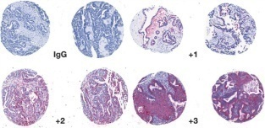
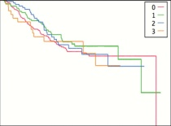
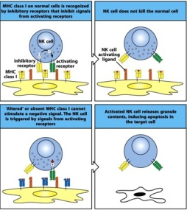
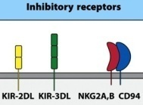
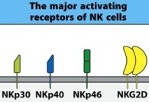
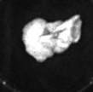
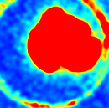
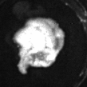
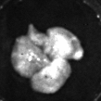
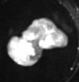
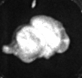
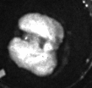
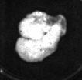
De quoi parlons nous ?
Inter-Pares & Peer- Review
for nectin 4. Staining was uniformly cytoplasmic with no nuclear staining observed. Nectin 4 protein expression was differentially expressed (P = .008) across the histologic sub- groups of ovarian cancer, with the highest expression in endo- metrioid carcinomas (57.6% of tumors positive), followed by serous (50.5%), clear cell (41.7%), and mucinous (29.0%)
❚Figure 3B❚ (Table 1).
Silverberg grade 1 tumors showed a significantly higher percentage of intense nectin 4 staining (ie, 16% of the grade 1 tumors received scores of +3 compared with only 5% of the grade 2 or grade 3 tumors; P = .0026) when positive scores were not binarized ❚Figure 3C❚. However, when binarized as “any staining” vs “no staining,” Silverberg grade 1, 2, and 3 tumors each were approximately 50% positive for nectin 4.
Anatomic Pathology / Original Article
Anatomic Pathology / Nectin 4 in Ovarian Cancer Tissues and Serum
Module d’Immunologie
2eme Année Licence
Tronc Commun des Sciences de la Nature Année universitaire 2014-2015
Dr A.Ghidouche / Dr D.Ait-Ali
Nectin 4 expression was not statistically different for dis- ease stage for any histologic subgroups of ovarian cancer when positive scores were binarized (Table 1). Overall, expression of nectin 4 did not alter relapse-free survival (not shown) or overall survival ❚Figure 3D❚, regardless of subtype, stage, or grade.
Nectin 4 Is Elevated in the Serum of Patients With Ovarian Cancer
Serum samples from 134 women were analyzed by ELISA to quantify cleaved nectin 4. ROC curves were con- structed, and the Youden index was used to place the opti- mal threshold value to distinguish between serous ovarian cancer and benign samples. The threshold value for serum
Nectin 4 Overexpression in Ovarian Cancer Tissues and Serum
Potential Role as a Serum Biomarker
Melissa S. DeRycke, PhD,¹ Stefan E. Pambuccian, MD,¹ C. Blake Gilks, MD,² Steve E. Kalloger,² Abderrezak Ghidouche,³ Marc Lopez, PhD,³ Robin L. Bliss, MS,⁴ Melissa A. Geller, MD,⁵
Peter A. Argenta, MD,⁵ Katherine M. Harrington,¹ and Amy P.N. Skubitz, PhD¹
Annals of Oncology 26 (Supplement 3): iii15–iii24, 2015
doi:10.1093/annonc/mdv117.23
Key Words: Nectin 4; Ovarian cancer; Serum biomarker; Tissue microarray; Diagnosis; Detection
DOI: 10.1309/AJCPGXK0FR4MHIHB
biomarkers in breast cancer ( prognostic, predictive and pharmacodynamic)
Nectin4 effects in the tumor phenotype
growth, migration and invasion, both in vitro and in vivo. We used breast cancer cell lines MCF-7 and BT-474 expressing an endogenous nectin-4, but also MDA-MB213 cell lines transfected with native forms of nectin-4 (MDA-MB213 R4. C1) or with a form of nectin-4 truncate of eight amino acids at juxta-membrane domain
(MDA-MB231 Del8.6). We observed that the MDA-MB231 R4.C1 and MDA-MB231 Del8.6 cells, have high growth capacities ( p > 0.005). But this growth seems more important in drastic middle conditions (0% FCS) only for MDA-MB231 R4.C1 cells. Using monoclonal antibodies targeting the extracellular domain of nectin-4, we observed significant ( p> 0.005) diminution of cell growth for BT-474 cell line and MCF-7 cell line when using a specific siRNA. Nectin-4 is also implicated in the
61P
A. Ghidouche¹, L. Marc², R. Castellano², D. Olive2 increase of the cellular migration. Indeed, cells expressing nectin-4 show a migration
¹Laboratoire de Recherche en Génie Biologique des Cancers, Université de Bejaia, capability higher than about 66 % compared with MDA-MB231 wt cells and it seems
A
B
% Nectin 4 Positive by Staining Score
60
A b s t r a c t
Early detection of ovarian cancer is difficult owing to the lack of specific and sensitive tests available. Previously, we found expression of nectin 4 to be increased in ovarian cancer compared with normal ovaries. Reverse transcriptase–polymerase chain reaction (RT-PCR) and quantitative RT-PCR validated the overexpression of nectin 4 messenger RNA in ovarian cancer compared with normal ovarian cell lines and tissues. Protein levels of nectin 4 were elevated in ovarian cancer cell lines and tissue compared with normal ovarian cell lines as demonstrated by Western immunoblotting, flow
cytometry, and immunohistochemical staining of tissue
microarray slides. Cleaved nectin 4 was detectable in a number of patient serum samples by enzyme- linked immunosorbent assay. In patients with benign gynecologic diseases with high serum CA125 levels, nectin 4 was not detected in the majority of cases, suggesting that nectin 4 may serve as a potential
biomarker that helps discriminate benign gynecologic
diseases from ovarian cancer in a panel with CA125.
Bejaia, Algeria
²Centre de Recherche en Cancérologie de Marseille, Centre de Recherche en
Cancérologie de Marseille, Marseille, France
Nectin-4 is a transmembrane immunoglobulin of the nectin familly. It is weakly expressed in healthy tissues, in contrast with embryonic stage. Interestingly, an expression of nectin-4 is found in breast, ovarian and lung tumors. The intensity of tissue expression of nectin-4 is correlated to the advanced stages of these cancerous pathologies. Furthermore, high levels of the plasmatic form are also found at an important rate in the advanced stages of breast, ovarian and lung carcinomas. To identify roles of nectin -4 expression in tumor progression, we aimed to study cell
that the soluble form does not influence cell migration intensity.The use of a monoclonal antibody anti-nectin-4 led to a reduction in the migration of
MDA-MB231 R4.C1 cells. For the cell clonogenicity power, we observed an effect on
MDA-MB-231 R4.C1 cells compared with MDA-MB231 wt and MDA-MB231 Del8.6 cells. In vivo, on MDA-MB231 wt and MDA-MB231 R4.C1 xenograft NOG mouse, the expression of nectin-4 significantly increased tumoral volume as well as the metastatic power. Anti-nectin-4 antibody does not affect tumor growth, but seems to decrease metastatic potential. In vitro & in vivo results seem to demonstrate that the cell surface expression of nectin-4 but also the soluble form are involved on tumorigenicity.
Disclosure: All authors have declared no conflicts of interest.
50
Ovarian cancer is the seventh leading cause of cancer- related death in women¹; in the United States, more than 20,000 women were diagnosed with ovarian cancer, resulting in more than 14,000 deaths.² Survival is greatly increased when ovarian cancer is diagnosed in early stages; however, approximately 70% of cases are diagnosed at stage III or IV, when the 5-year survival rate decreases dramatically.³ Subtle symptoms and the lack of a specific, sensitive diagnostic test contribute to the delay in diagnosis, highlighting the need for improved screening methods and novel targeting strategies for treatment.⁴⁻⁶ Currently, an elevated serum CA125 level is used to detect recurrent ovarian cancer; however, its use in screening the general population is precluded owing to a lack of specificity and modest sensitivity in the detection of early-stage disease.
Our group previously identified nectin 4 gene up-regu- lation in ovarian cancer tissues as part of an effort to iden- tify novel ovarian cancer biomarkers.⁶ Nectins are a family of immunoglobulin-like cell adhesion molecules important in the formation and maintenance of adherens junctions and tight junctions. All nectins share a similar structure: 3 immunoglobulin-like extracellular loops, a single transmem- brane region, and a short cytoplasmic domain that can bind to afadin.⁷⁻¹⁰ Nectins function by first forming homo cis-dimers on the cell surface and then trans-dimers on adjacent cells in a homophilic and a heterophilic manner. The specificity of binding is different for each nectin.^{9,11,12} For example, nectin 4 can form trans-homodimers and trans-heterodimers with nectin 1 but not with nectin 2 or 3.¹³
Four nectin proteins have been described; nectin 1 and 2 are broadly expressed in adult tissues, while nectin 3 is expressed mainly in the testes and placenta.^{11,13-15} Expression
Downloaded from http://annonc.oxfordjournals.org/ by guest on September 21, 2015
40
3
2
1
30
20
10
Serous Endometrioid Clear Cell Mucinous
abstracts
Chapitre II : Lignée lymphoïde &
immunité adaptative
I) Génération des cellules de la lignée lymphoïde
Cellules NK
Interaction avec les Interaction avec des molécules HLA molécules de CMH
induite dans un état de stresse (famille MIC)
Dr A.Ghidouche / Dr D.Ait-Ali 2014-2015
C
% Nectin 4 Expression by Staining Score
100
80
60
40
D
1.0
0.9
0.8
0.7
0.6
0.5
0.4
0.3
0.2
0.1
0.0
0
1
2
3
3
2
1
0
Surviving
20
1 2 3
Silverberg Grade
0 1,000 2,000 3,000 4,000 5,000 6,000 7,000
Time (d)
❚Figure 3❚ Immunohistochemical staining for nectin 4 of ovarian cancer tissue microarrays. A, Staining and grading examples of tissue microarray (TMA) samples. IgG, control primary stain. +1, <10% of cancer cells staining; +2, 10%-50% of cancer cells
staining; and +3, >50% of cancer cells staining. B, Percentage of TMA cases positive for nectin 4 by ovarian cancer subtype. C, Percentage of TMA cases positive for nectin 4 by Silverberg grade. D, Kaplan-Meier survival curve of TMA patients measured in days. Red, staining score 0; green, staining score +1; blue, staining score +2; orange, staining score +3.
© American Society for Clinical Pathology
Am J Clin Pathol 2010;134:835-845 841
DOI: 10.1309/AJCPGXK0FR4MHIHB 841
© American Society for Clinical Pathology
Am J Clin Pathol 2010;134:835-845 835
DOI: 10.1309/AJCPGXK0FR4MHIHB
© The Author 2015. Published by Oxford University Press on behalf of the European Society for Medical Oncology. All rights reserved. For permissions, please email: journals.permissions@oup.com.
Communication Scientifique
Nectin-4 effect in tumor phenotype
A.Ghidouche¹∙², M.Lopez ³∙⁴, R.Castellano³∙⁴ & D.Olive ³∙⁴
¹ Laboratoire de Génie Biologique des Cancers. Université de Bejaia. Algérie.
² Faculté des Sciences de la Nature et de la Vie. Université de Bejaia. Algérie
³ Inserm, U1068, Centre de Recherche en Cancérologie de Marseille, Marseille, France
⁴ Institut Paoli-Calmettes, Marseille, France
Introduction
Nectins are transmembranary cell adhesion molecules widely expressed in tissues and play an essential role in most biological functions during development and adult life [1][2][3]. Nectin-4 is a transmembrane glycoprotein of 66kDa localized at the adherens junctions [4][5]. TACE/ADAM-17, a metalloprotease responsible of the cleavage of nectin-4 extracellular region and the production of a soluble form of 43kDa [6][7]. Several studies demonstrated the role of nectin-4 in the infection by measles virus [8][9]. Moreover, nectin-4 mutations are involved in Ectodermal Dysplasia Syndactyly Syndrome [10][11]. However, nectin-4 is weakly expressed in healthy tissues, in contrast with embryonic stage. Interestingly, an expression of nectin-4 is found in the breast, ovarian and lung tumors. The intensity of tissular expression of nectin-4 is correlated to the advanced stages of these cancerous pathologies. Furthermore, high levels of plasmatic form is also found at an important rate in the advanced stages of breast, ovarian and lung carcinomas [12][13][14][15].
Table des Matières
Traitement par immunothérapie:
Cas de Her2/neu ............................................................................................................................................ 36
IV.1-Cellules tumorales ............................................................................................................................. 37
IV.2-Cellules autologues ........................................................................................................................... 37
IV.3-ADN ........................................................................................................................................................... 37
IV.4-Cellules dendritiques ........................................................................................................................ 38
IV.5-Peptides .................................................................................................................................................... 39
IV.5.1-Vaccins multipeptidiques ............................................................................................................ 39
IV.5.2-Peptides E75&GP2 ........................................................................................................................ 39
IV.6-Vaccins protéiques ............................................................................................................................ 40
Autres antigènes utilisés en immunothérapie
du cancer du sein ............................................................................................................................................ 41
Nouveau antigène tumoral: Nectine-4
La famille des nectines ......................................................................................................................... 42
I.1-Biologie des nectines et nectines-Like ...................................................................................... 42
I.2-Nectines & pathologies ...................................................................................................................... 44
I.2.1-Implication dans les pathologies cancéreuses ............................................................................. 45
I.2.1.1-Interactions entre les cellules tumorales et cellules immunitaires ................................. 45
I.2.1.1-Effets sur les capacités tumorales des cellules cancéreuses ............................................. 46
Nectine-4 ........................................................................................................................................................ 48
II.1-Biologie ........................................................................................................................................................ 48
II.2-Nectine-4 & pathologies .................................................................................................................... 49
II.2.1-Nectine-4 & Cancers ......................................................................................................................... 50
II.2.1.1-Dans le cancer du sein .................................................................................................................. 50
II.2.1.2-Dans le cancer du poumon .......................................................................................................... 51
II.2.1.3-Dans le cancer ovarien ................................................................................................................. 51
Objectifs de l’étude ................................................................................................................................... 53
Résultats
Identification de peptides se fixant sur
les HLAs de classe I .................................................................................................................................. 54
Article :
Identification of a naturally processed HLA-A*0201 restricted
CTL epitope in the tumor associated antigen Nectin4 .................................................................. 55
I.1-Conclusion Intermédiaire ..................................................................................................................... 56
Résultats supplémentaires ............................................................................................................... 56
II.1-iTopia ............................................................................................................................................................. 56
II.1.1-Fixation ..................................................................................................................................................... 56
II.1.2-Dissociation et calcul du T½ ............................................................................................................ 59
Nectine-4: Nouvelle cible dans l’immunothérapie du cancer du sein.
ECOLE DOCTORALE DES SCIENCES DE LA VIE ET DE LA SANTÉ
UNIVERSITÉ DE LA MÉDITERRANÉE- AIX-MARSEILLE II
FACULTE DE MÉDECINE DE MARSEILLE
Materiel & Methods
Cell lines : MCF-7 and BT-474 cell lignes were provided from ATCC®. MDA-MB231 wt cell ligne was transfected with an empty p3XFL vector. MDA-MB231 Del8.6 & MDA-MB231 R4.C1 cell ligne are a MDA-MB 231 cell lignes transfected with p3XFL vector containing sequence of nectin-4 deleted on eight juxta-membranare amino-acids and p3XFL vector containing native sequence of nectin-4, respectively. Flow Cytometry : 1x10⁶ cells were analyzed by BD FACScan™. IgG1 antibody was used as isotype control. Mouse antihuman nectin N4.61clone was used for the detection of nectin-4 expression. PE goat anti-mouse antibody was used to detect N4.61 antibody. ELISA assay : Performed as described previously by DeRycke et al [15]. Proliferation assay : Cells were incubated at 37°C in medium containing RPMI® without FBS or supplemented with 10% FBS. Cell number was measured by using CellTiter-Glo® assay according to manufacturer instructions. Nectin-4 siRNAs used are previously described by Takano et al [14]. si-RNA control is siRNA against luciferase. N4.40 clone is nectin-4 monoclonal antibody that
target different epitope regarding to N4.61 antibody. N3.81 clone is nectin-3 monoclonal antibody. Cell migration assay : The woundhealing test was performed using ibidi® insert. Each insert contain 5000 cells incubated in medium containing 10%FCS. After removing the insertion image acquisition is performed during 9 hours (5minutes interval between two successive images at the same position) by Time-Laps digital camera. Pics analysis and migration speed were performed using Metamorph® software. Colonogenic power assay : in soft agar colony formation assay, medium were cultured at 37°C in medium containing agar and agarose and RPMI supplemented with 10%FBS. Xenograft tumor : Female immunodeficient nude mice that were 6 to 8 weeks old were injected (subcutaneous) in flank with 2x10E06 cells previously transfects with luciferase lentivirus without Matrigel®. Concentration of 500µg/week/mice of N4.61 was injected from 21 days pots-xenograft.
Results
THÈSE DE DOCTORAT
Pour lʼobtention du grade de Docteur de lʼuniversité de la Méditerranée
Discipline: Oncologie
NECTINE-4: Nouvelle cible dans l’immunothérapie du cancer du sei
NECTINE-4: Nouvelle cible dans l’immunothérapie du cancer du sein
A M^{M}D^{D}A^{A}-M^{-M}B^{B2}2³3¹1^{w}W^{t} T B
A
B
04 !"#$%&,*)
.'- /"01
A ^{125 Figure6 B 55}
54
25
100
24
'5
'4
&5 &4 (5
(4
5
4
Concentration (pM/10E06 Cells)
% of expression
75
Mfi07r81a9ti-+&o)
MMDDAA-M-MBB223311DDele8.6l8.6
RLU
RLU
C
50
25
0
Conditions
!"#$!%&'( *+ !"#$!%&'( 12/3(
!"C##e%lls&'"(
Cells
Cells
75000
D
150000
*
Figure 1 : Phenotype of MDA-MB231 cell lines
MMDDAA-M-MBB223311RR4.4C.1C1
A : Cell surface expression of nectin-4 on MDA-MB231 cell lines Gray
histogramme correspond to isotype control & withe histogramme correspond to nectin-4 expression using a specific monoclonal antibody
B : Concentration of nectin-4 soluble form.
The soluble forme resulting on shedding of extracellular region of nectin-4 by metalloprotease TACE/ADAM10. The concentration was measured
after 48Hours incubation
Nectin-4
60000
RLU
120000
ns
Présenté et soutenue publiquement par
Abderrezak Ghidouche
le 24 Juin 2011
RLU
45000
90000
Days
Figure 2: Effect of nectin-4 on cellular growth
A : Cell medium culture containing 10%FCS B : Cell medium culture containing 0%FCS
: MDA-MB231 wt : MDA-MB231 Del8.6 : MDA-MB231 R4.C1.
The test is performed 4 fold in triplicate
The RLU detected by CellTiter-Glo® is correlated with number of cells.
Days
30000
60000
15000
30000
0
siRNA-Nec4#1 siRNA-Nec4#2 siRNA-Cntr
Conditions
MDA-MB231 WT MDA-MB231 R4.C1
Cells
A
T₀ T₁ T₂
B
500
**
NS
Figure 3: Effect of level of expression of nectin-4 on cellular growth
A : Effect of specific siRNA on level of expression of MCF-7 cell line. The percentage of expression is calculated according to siRNA-control
B : Effect of specific siRNA on level of expression of MDA-MB 231 wt & MDA-MB231 R4.C1 cell lines. The tests are performed 4 fold in triplicate
The RLU detected by CellTiter-Glo® is correlated with number of cells.
* p>0.005
450
A
**
A
MDA-MB MDA-MB2 ^{B}
MDA-MB2
400
**
105
**
2000
nm/min
350
300
250
200
90
1750
1500
1250
1000
750
500
250
%% ºof^{f}C^{c}el^{e}ls^{lls}
75
Tumor volume (mm³)
150
60
Laboratoire dʼimmunologie et cancers Centre de Recherche en Cancérologie de Marseille
INSERM UMR 891
100
45
T = 0h T = 4h T = 8h
50
0
30
MDA-MB231 WT MDA-MB231 Del8.6 MDA-MB231 R4.C1
15
C
D
Cells
MDA-MB231 WT
0
Herceptin N4.40 N4.61 N3.82 Medium
AAnntitibboodideise(s100µg/ml)
**
30000
MDA-MB231 Del8 MDA-MB231 R4.C
B
105
C
105
**
250
% of cells
RLU
200
%% oof fCeclles lls
% of Cells
0
0 7 14 17 21 24 27 31 34 38 41 45 49 52
15000
Days post-xenograft
MDA-MB231 wt MDA-MB231 R4.C1
10000
500
Figure 5: Impact of nectin-4 in vivo
0
1000
Number of Cells
500
Herceptin N4.40 N4.61 N3.82
^{An}A^{ti}n^{bo}ti^{di}b^{e}o^{s (}d¹⁰ie^{0µ}s^{g/ml)}
Herceptin N4.40 N4.61 N3.82
^{Ant}A^{ib}n^{od}ti^{i}b^{es}o⁽d¹⁰i⁰e^{µ}s^{g/ml)}
A : effects of the expression of nectin-4 & anti-nectin-4 antibody on tumor volume on xenograft nude mice.
MDA-MB231 wt + PBS MDA-MB231 wt + N4.61 MDA-MB231 R4.C1 + PBS MDA-MB231 R4.C1 + N4.61
Black arrow corresponds to the start of treatment injection (PBS or N4;61)
B : Effect of anti-nectin-4 antibody on the formation of pulmonary metastasis. Up : photography of luminescence intensity of control. In the middle : pics of luminescence intensity of mices treated with PBS. Bottom : pics of luminescence intensity of mices treated with N4.61 antibody
Cells used in this test were previously transfected with luciferase lentivirus. 2x10⁶ Cells are injected without Matrigel® in the flank of nude mices.
The N4.61 was injected at concentration of 500µg/week/mice.
Membres du Jury:
Figure 5: Tumorogeneicity properties of MDA-MB231 cell lines
A : Cell migration assay pics. Up :MDA-MB231 wt, Bottom : MDA-MB231 R4.C1. B : Cell migration speed. The test is performed 3 fold with 4 inserts for each test. C : Clonogenicity assay pics. D : Colony and cell growth. Number of cells is the cells cultured in each well at Day 0.
The photography and count were performed after four days of cell culture. The RLU detected by CellTiter-Glo® is correlated with number of cells.
** p>0.001
Figure 4: Effect of specific antibodies on cellular growth
A : BT-474 cell line. B : MDA-MB 231 Del8.6 cell line. C : MDA-MB231 R4.C1 cell line.
Herceptin® : monoclonal antibody against Erbb2. N4.40 & N4.61 : monoclonal antibodies against nectin-4. N3.82 : monoclonal antibody against nectin-3 used as negative control
Percentage of cells is measured after four days of culture. Concentration of antibodies is 100µg/ml The tests are performed 4 fold in triplicate
** p>0.001
Président :
Pr Jean-Louis Mege
Discussion
de novo expression of nectin-4, confers high proliferative, migration and invasion capacities for cells. This appears to be due to the activation of many signaling pathways including src signaling [16]. In addition, this study demonstrates that this re- expression of nectin-4 in tumor cells is a mechanism developed by these tumors to increase their invasive potential, which results in an increase in the potential for cellular growth and migration. This aggressive tumorigenic phenotype seems to be increasing by the production of the soluble form (43kDa) of nectin-4. This may explain the observations according to which the tissular expression but also serum form of nectin -4 are more important in the advances stages of breast, lung and ovarian cancers. An antibody developed in the laboratory seems to be attenuate invasive effects of tumors expressing nectin-4, and may represent a promising therapeutic tool for the future.
References
[1] Y.Takai et H. Nakanishi, “Nectin and afadin: novel organizers of intercellular junctions,” Journal of Cell Science, vol. 116, n°. 1, p. 17-27, Jan. 2003. [2] Y. Takai, K. Irie, K. Shimizu, T. Sakisaka, et W. Ikeda, “Nectins and nectin-like molecules: roles in cell adhesion, migration, and polarization,” Cancer Science, vol. 94, n°. 8, p. 655-667, Aoû. 2003. [3] Y. Takai, J. Miyoshi, W. Ikeda, et H. Ogita, “Nectins and nectin-like molecules: roles in contact inhibition of cell movement and proliferation,” Nature Reviews. Molecular Cell Biology, vol. 9, n°. 8, p. 603-615, Août. 2008. [4] N. Reymond, S. Fabre, E. Lecocq, J. Adelaïde, P. Dubreuil, et M. Lopez, “Nectin4/ PRR4, a new afadin-associated member of the nectin family that trans-interacts with nectin1/PRR1 through V domain interaction,” The Journal of Biological Chemistry, vol. 276, n°. 46, p. 43205-43215, Nov. 2001. [5] S. Fabre et al., “Prominent role of the Ig-like V domain in trans-interactions of nectins. Nectin3 and nectin 4 bind to the predicted C-C'-C"-D beta-strands of the nectin1 V domain,” The Journal of Biological Chemistry, vol. 277, n°. 30, p. 27006-27013, Juil. 2002. [6] F. Seals et S. A. Courtneidge, “The ADAMs family of metalloproteases: multidomain proteins with multiple functions,” Genes & Development, vol. 17, n°. 1, p. 7-30, Jan. 2003. [7]
S. Fabre-Lafay, S. Garrido-Urbani, N. Reymond, A. Gonçalves, P. Dubreuil, et M. Lopez, “Nectin-4, a new serological breast cancer marker, is a substrate for tumor necrosis factor-alpha-converting enzyme (TACE)/ADAM-17,” The Journal of Biological Chemistry, vol. 280, n°. 20, p. 19543-19550, Mai. 2005. [8] Mühlebach MD, Mateo M, Sinn PL, Prüfer S, Uhlig KM, Leonard VH, Navaratnarajah CK, Frenzke M, Wong XX, Sawatsky B, Ramachandran S, McCray PB Jr, Cichutek K, von Messling V, Lopez M, Cattaneo R, “Adherens junction protein nectin-4 is the epithelial receptor for measles virus” Nature, 2;480(7378):530-3, Nov 2011. [9] Mateo M, Navaratnarajah CK, Willenbring RC, Maroun JW, Iankov I, Lopez M, Sinn PL, Cattaneo R. “Different roles of the three loops forming the adhesive interface of nectin-4 in measles virus binding and cell entry, nectin-4 homodimerization, and heterodimerization with nectin-1.” J Virol. 88(24):14161-71, Dec 2014. [10] F. Brancati et al., “Mutations in PVRL4, encoding cell adhesion molecule nectin-4, cause ectodermal dysplasia-syndactyly syndrome,” American Journal of Human Genetics, vol. 87, n°. 2, p. 265-273, Aoû. 2010. [11] Fortugno P, Josselin E, Tsiakas K, Agolini E, Cestra G, Teson M, Santer R, Castiglia D, Novelli G, Dallapiccola B, Kurth I, Lopez M, Zambruno G, Brancati F “Nectin-4 mutations causing ectodermal dysplasia with syndactyly perturb the rac1 pathway and the kinetics of adherens junction formation.”J Invest Dermatol. 134(8):2146-53, Aug 2014. [12] S. Fabre-Lafay, S. Garrido-Urbani, N. Reymond, A. Gonçalves, P. Dubreuil, et M. Lopez, “Nectin-4, a new serological breast cancer marker, is a substrate for tumor necrosis factor-alpha-converting enzyme (TACE)/ADAM-17,” The Journal of Biological Chemistry, vol. 280, n°. 20, p. 19543-19550, Mai. 2005. [13] S. Fabre-Lafay et al., “Nectin-4 is a new histological and serological tumor associated marker for breast cancer,” BMC Cancer, vol. 7, p. 73, 2007. [14] A. Takano et al., “Identification of nectin-4 oncoprotein as a diagnostic and therapeutic target for lung cancer,” Cancer Research, vol. 69, n°. 16, p. 6694-6703, Aoû. 2009. [15] Derycke MS, Pambuccian SE, Gilks CB, Kalloger SE, Ghidouche A, Lopez M, Bliss RL, Geller MA, Argenta PA, Harrington KM, Skubitz AP. Nectin 4 overexpression in ovarian cancer tissues and serum: potential role as a serum biomarker. Am J Clin Pathol;134:835-45. [16] Pavlova NN, Pallasch C, Elia AE, Braun CJ, Westbrook TF, Hemann M, Elledge SJ. “A role for PVRL4-driven cell-cell interactions in tumorigenesis.” Elife 2013 Apr 30;2:e00358.
E-mail : cancerbioengineering@gmail.com
Rapporteurs :
Dr Olivier Toutirais
Pr Pierre van der Bruggen
A
Examinateur :
Dr Felix Montero-Julian
Directeurs de thèse :
Dr Marc Lopez / Pr Daniel Olive

Slide 8
Résumé scientifique
Le résumé est une brève synthèse de l’article, offrant aux lecteurs un aperçu de son contenu.
De nombreuses revues exigent que des résumés soient rédigés avant la publication des articles.
Grâce au résumé, l’article scientifique a gagné en visibilité : son contenu peut être identifié plus rapidement, sa diffusion est plus facile et son référencement optimisée.
Ne le confondez pas avec l’introduction : le but du résumé est de passer en revue l’ensemble de l’article, y compris la méthode, les résultats et la conclusion.

Slide 9
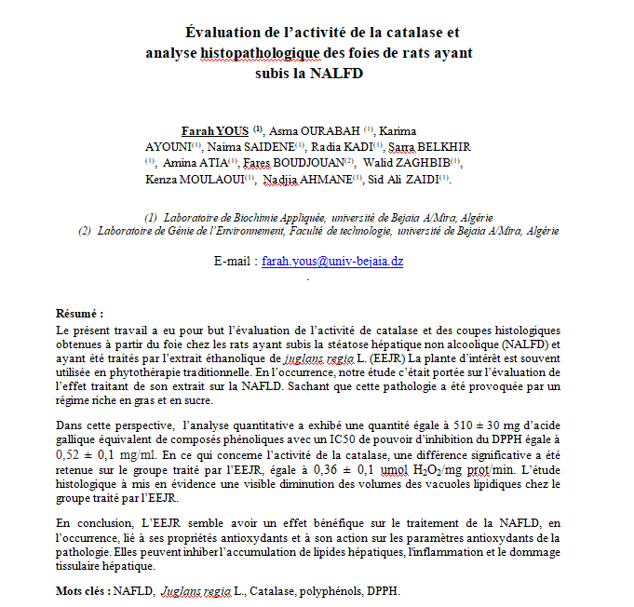
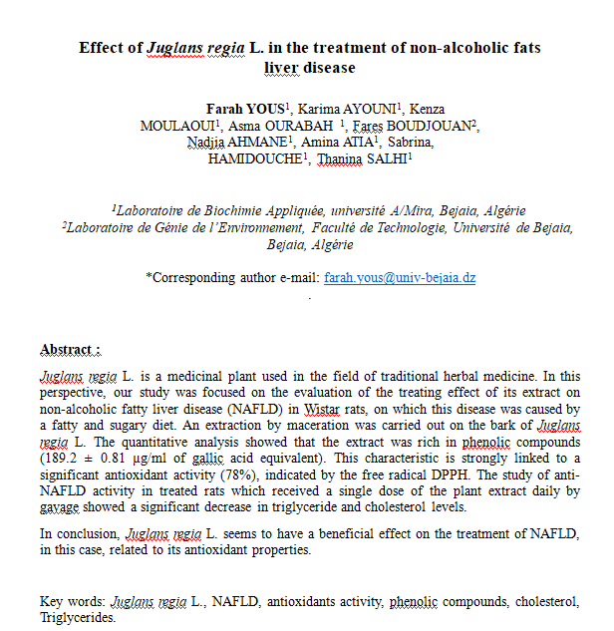
Résumé scientifique

Slide 10
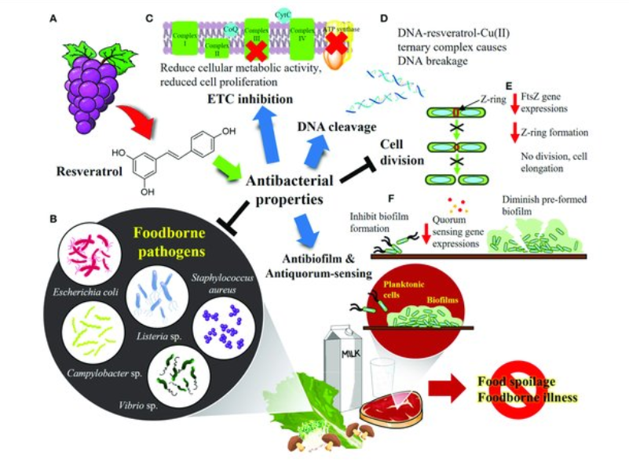
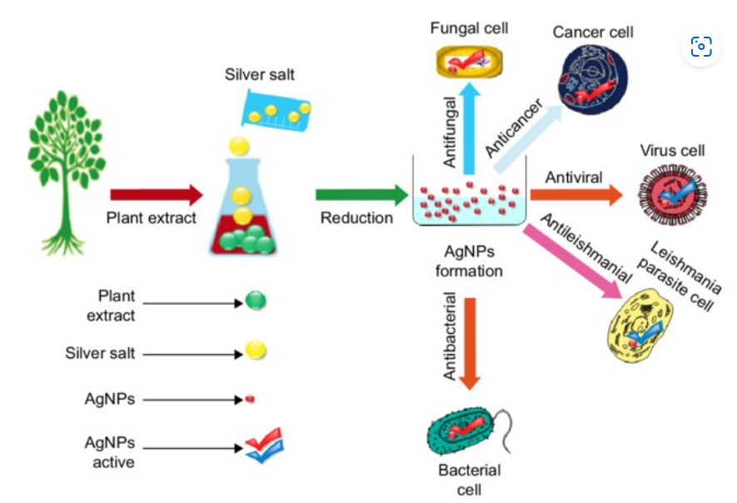
Graph abstract

Slide 11
POSTER

Slide 12
Poster scientifique
la bonne formule
Poster interactif, e-poster, format vidéo… le poster scientifique évolue avec son temps.
Moyen séduisant pour développer sa notoriété et promouvoir son travail, le poster informe sur l’avancée de ses travaux et les résultats obtenus.
Il permet de toucher un public large, pas forcément spécialiste du sujet.
Pour susciter la discussion, que ce soit en présentiel ou en ligne, il doit réunir certaines qualités. Voyons lesquelles !

Slide 13
Le temps de lecture doit être réduit car la concentration des lecteurs est limitée.
Ils veulent découvrir vos recherches, ainsi que celles de vos collègues en un temps restreint.
De plus, un poster doit donner envie de poser des questions, d’entamer un dialogue avec l’auteur de l’étude.
Bref, il s’agit d’un exercice d’écriture avec ses propres codes et ses difficultés.
Alors comment faire pour créer un poster attractif et adapté aux évènements en présentiel ou en ligne ?

Slide 14
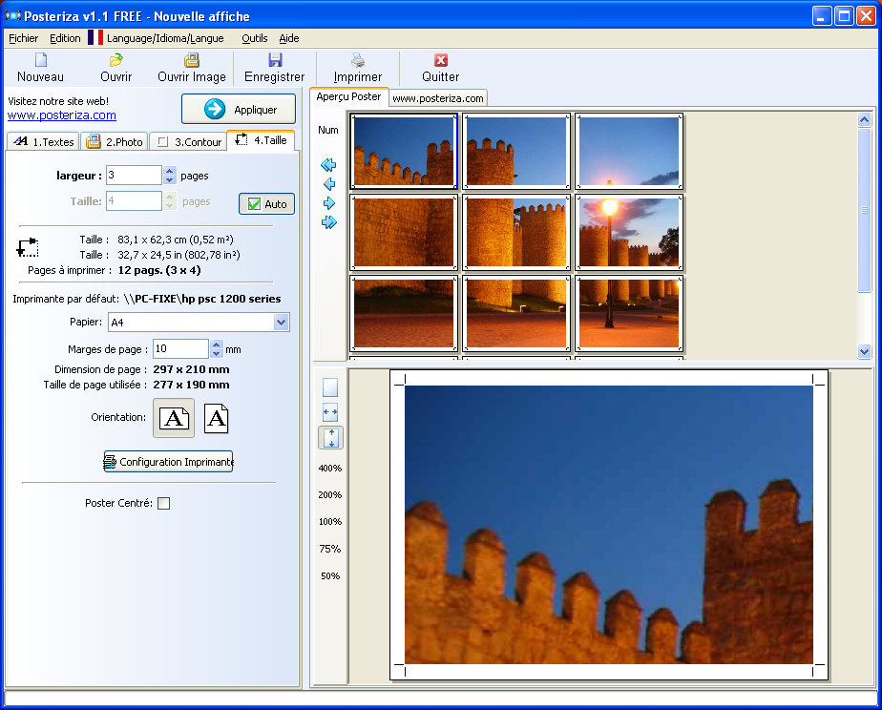
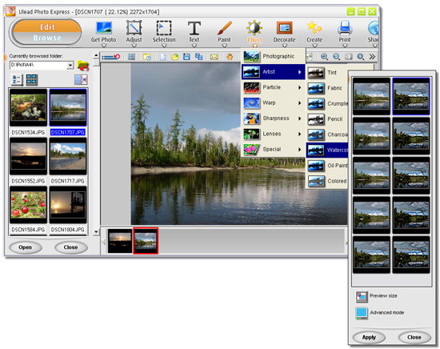
Logiciels en ligne pour production de posters

Slide 15
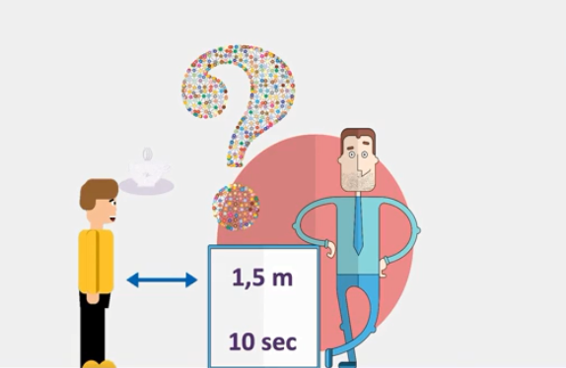
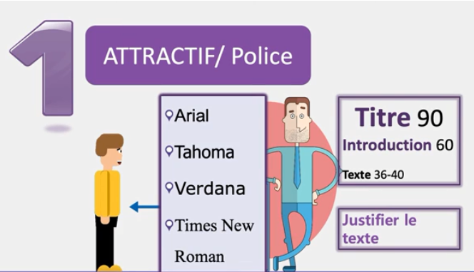

Slide 16
Travailler l’attractivité visuelle
Pour atteindre ses objectifs, un poster scientifique doit avant tout être attractif.
A la différence d’une présentation orale, durant laquelle l’auditoire est relativement captif, la lecture d’un poster ne s’impose pas.
Les lecteurs potentiels sont libres de s’arrêter devant votre création ou de passer leur chemin.
Tous les efforts investis dans sa réalisation sont vains s’il n’attire pas le regard immédiatement.
Durant les sessions de posters scientifiques, la concurrence est rude entre les auteurs.
Pour sortir du lot, un poster doit provoquer la curiosité et capter l’attention.

Slide 17
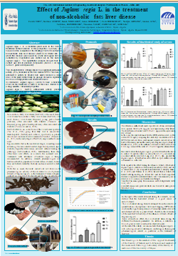
Pensez à soigner la présentation de votre document. Un poster attrayant aura une charte graphique simple, un découpage en rubriques pour faciliter la lecture, des couleurs contrastées.
Il pourra être lu sans effort en se tenant à une distance de 1,5 mètres en présentiel ou à 50 cm en distanciel. Il comportera peu de texte et intégrera 2 ou 3 illustration particulièrement parlantes.

Slide 18
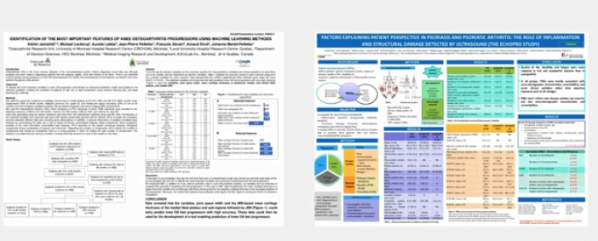

Slide 19
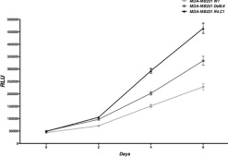
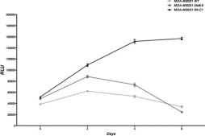
Outils de la communication scientifique ?
Communication affichée
Titre
Succinct , visible et pertinent
Affiliation
Structure académique et de recherche de chaque auteur. Un auteur peut avoir plusieurs affiliations
Nectin-4 effect in tumor phenotype
A.Ghidouche¹∙², M.Lopez ³∙⁴, R.Castellano³∙⁴ & D.Olive ³∙⁴
¹ Laboratoire de Génie Biologique des Cancers. Université de Bejaia. Algérie.
² Faculté des Sciences de la Nature et de la Vie. Université de Bejaia. Algérie
³ Inserm, U1068, Centre de Recherche en Cancérologie de Marseille, Marseille, France
⁴ Institut Paoli-Calmettes, Marseille, France
Auteurs
Ensemble des personnes ayant participé à l’élaboration
du travail . La 1 ere place revient à la personne ayant effectué la majorité du travail. Le chef du projet et le responsable de l’équipe de recherche doivent apparaitre
Introduction
Nectins are transmembranary cell adhesion molecules widely expressed in tissues and play an essential role in most biological functions during development and adult life [1][2][3]. Nectin-4 is a transmembrane glycoprotein of 66kDa localized at the adherens junctions [4][5]. TACE/ADAM-17, a metalloprotease responsible of the cleavage of nectin-4 extracellular region and the production of a soluble form of 43kDa [6][7]. Several studies demonstrated the role of nectin-4 in the infection by measles virus [8][9]. Moreover, nectin-4 mutations are involved in Ectodermal Dysplasia Syndactyly Syndrome [10][11]. However, nectin-4 is weakly expressed in healthy tissues, in contrast with embryonic stage. Interestingly, an expression of nectin-4 is found in the breast, ovarian and lung tumors. The intensity of tissular expression of nectin-4 is correlated to the advanced stages of these cancerous pathologies. Furthermore, high levels of plasmatic form is also found at an important rate in the advanced stages of breast, ovarian and lung carcinomas [12][13][14][15].
Materiel & Methods
Cell lines : MCF-7 and BT-474 cell lignes were provided from ATCC®. MDA-MB231 wt cell ligne was transfected with an empty p3XFL vector. MDA-MB231 Del8.6 & MDA-MB231 R4.C1 cell ligne are a MDA-MB 231 cell lignes transfected with p3XFL vector containing sequence of nectin-4 deleted on eight juxta-membranare amino-acids and p3XFL vector containing native sequence of nectin-4, respectively. Flow Cytometry : 1x10⁶ cells were analyzed by BD FACScan™. IgG1 antibody was used as isotype control. Mouse antihuman nectin N4.61clone was used for the detection of nectin-4 expression. PE goat anti-mouse antibody was used to detect N4.61 antibody. ELISA assay : Performed as described previously by DeRycke et al [15]. Proliferation assay : Cells were incubated at 37°C in medium containing RPMI® without FBS or supplemented with 10% FBS. Cell number was measured by using CellTiter-Glo® assay according to manufacturer instructions. Nectin-4 siRNAs used are previously described by Takano et al [14]. si-RNA control is siRNA against luciferase. N4.40 clone is nectin-4 monoclonal antibody that target different epitope regarding to N4.61 antibody. N3.81 clone is nectin-3 monoclonal antibody. Cell migration assay : The woundhealing test was performed using ibidi® insert. Each insert contain 5000 cells incubated in medium containing 10%FCS. After removing the insertion image acquisition is performed during 9 hours (5minutes interval between two successive images at the same position) by Time-Laps digital camera. Pics analysis and migration speed were performed using Metamorph® software. Colonogenic power assay : in soft agar colony formation assay, medium were cultured at 37°C in medium containing agar and
agarose and RPMI supplemented with 10%FBS. Xenograft tumor : Female immunodeficient nude mice that were 6 to 8 weeks old were injected (subcutaneous) in flank with 2x10E06 cells previously transfects with luciferase lentivirus without Matrigel®. Concentration of 500µg/week/mice of N4.61 was injected from 21 days pots-xenograft.
Results
_{A} 125
04
55
54
25
24
'5
'4
&5 &4 (5
(4
5
4
!"#$%&,*)
^{A} M^{M}D^{D}A^{A}-⁻M^{M}B^{B2}2³3¹1^{w}W^{t} T ^{B}
Figure6
B
-.'/"01
Concentration (pM/10E06 Cells)
A
B
% of expression
100
^{Mfi}07^{r}81ª9^{ti}-+&º)
75
50
MMDDAA--MMBB223311DDele8l.68.6
25
0
siRNA-Nec4#1 siRNA-Nec4#2 siRNA-Cntr Medium
!"#$!%&'( *+ !"#$!%&'( 12/3(
!C"##e%ll&'s^{"(}
Cells
Cells
RLU
RLU
C
75000
Conditions
D
MMDDAA--MMBB223311RR4.4C.1C1
Figure 1 : Phenotype of MDA-MB231 cell lines A : Cell surface expression of nectin-4 on MDA-MB231 cell lines Gray histogramme correspond to isotype control & withe histogramme correspond to nectin-4 expression using a specific monoclonal antibody B : Concentration of nectin-4 soluble form.
The soluble forme resulting on shedding of extracellular region of nectin-4 by metalloprotease TACE/ADAM10. The concentration was measured
after 48Hours incubation
60000
150000
*
120000
ns
45000
RLU
RLU
30000
90000
Nectin-4
Days
Figure 2: Effect of nectin-4 on cellular growth
A : Cell medium culture containing 10%FCS B : Cell medium culture containing 0%FCS
: MDA-MB231 wt : MDA-MB231 Del8.6 : MDA-MB231 R4.C1.
The test is performed 4 fold in triplicate
The RLU detected by CellTiter-Glo® is correlated with number of cells.
Days
15000
60000
30000
0
siRNA-Nec4#1 siRNA-Nec4#2 siRNA-Cntr
0
MDA-MB231 WT MDA-MB231 R4.C1
Conditions Cells
Figure 3: Effect of level of expression of nectin-4 on cellular growth
A : Effect of specific siRNA on level of expression of MCF-7 cell line. The percentage of expression is calculated according to siRNA-control
B : Effect of specific siRNA on level of expression of MDA-MB 231 wt & MDA-MB231 R4.C1 cell lines. The tests are performed 4 fold in triplicate
The RLU detected by CellTiter-Glo® is correlated with number of cells.
* p>0.005
A
500
**
T₀
T₁
T₂
B
450
NS
A
**
A
MDA-MB _{B}
MDA-MB2
400
**
105
90
75
60
45
30
15
**
2000
MDA-MB2
nm/min
350
1750
1500
1250
1000
750
500
250
0
0 7 14 17 21 24 27 31 34 38 41 45 49 52
Days post-xenograft
Figure 5: Impact of nectin-4 in vivo
A : effects of the expression of nectin-4 & anti-nectin-4 antibody on tumor volume on xenograft nude mice.
MDA-MB231 wt + PBS MDA-MB231 wt + N4.61 MDA-MB231 R4.C1 + PBS MDA-MB231 R4.C1 + N4.61
Black arrow corresponds to the start of treatment injection (PBS or N4;61)
B : Effect of anti-nectin-4 antibody on the formation of pulmonary metastasis. Up : photography of luminescence intensity of control. In the middle : pics of luminescence intensity of mices treated with PBS. Bottom : pics of luminescence intensity of mices treated with N4.61 antibody
Cells used in this test were previously transfected with luciferase lentivirus. 2x10⁶ Cells are injected without Matrigel® in the flank of nude mices. The N4.61 was injected at concentration of 500µg/week/mice.
300
250
%% ºof^{f}C^{c}el^{e}ls^{lls}
Tumor volume (mm³)
200
150
T = 0h
T = 4h
T = 8h
100
50
C
0
MDA-MB231 WT
MDA-MB231 Del8.6
MDA-MB231 R4.C1
0
Herceptin N4.40 N4.61 N3.82 Medium
AAnnttiibboodideise(s100µg/ml)
**
**
D
Cells
MDA-MB231 WT
30000
MDA-MB231 Del8
C
B
C
**
25000
MDA-MB231 R4.
105
105
**
20000
90
% of cells
90
RLU
%% oºf ^{f}Ce^{c}ll^{e}s ^{lls}
75
% of Cells
75
Le titre résume l’objectif, les moyens et les résultats du travail présenté, le tout sur une à deux lignes.
Il est important qu’il soit spécifique, afin de différencier votre poster de tous les autres travaux rédigés sur cette thématique.
15000
60
60
MDA-MB231 wt MDA-MB231 R4.C1
10000
45
45
5000
30
30
15
15
0
1000
Number of Cells
500
0
Herceptin N4.40 N4.61
^{An}A^{ti}n^{bo}ti^{di}b^{e}o^{s (}d¹⁰ie^{0µ}s^{g/ml)}
N3.82
0
Herceptin N4.40 N4.61 N3.82
^{Ant}A^{ib}n^{od}ti^{i}b^{es}o⁽d¹⁰i⁰e^{µ}s^{g/ml)}
Figure 5: Tumorogeneicity properties of MDA-MB231 cell lines
A : Cell migration assay pics. Up :MDA-MB231 wt, Bottom : MDA-MB231 R4.C1. B : Cell migration speed. The test is performed 3 fold with 4 inserts for each test. C : Clonogenicity assay pics. D : Colony and cell growth. Number of cells is the cells cultured in each well at Day 0. The photography and count were performed after four days of cell culture.
The RLU detected by CellTiter-Glo® is correlated with number of cells.
** p>0.001
Figure 4: Effect of specific antibodies on cellular growth
A : BT-474 cell line. B : MDA-MB 231 Del8.6 cell line. C : MDA-MB231 R4.C1 cell line.
Herceptin® : monoclonal antibody against Erbb2. N4.40 & N4.61 : monoclonal antibodies against nectin-4. N3.82 : monoclonal antibody against nectin-3 used as negative control
Percentage of cells is measured after four days of culture. Concentration of antibodies is 100µg/ml The tests are performed 4 fold in triplicate
** p>0.001
Discussion
de novo expression of nectin-4, confers high proliferative, migration and invasion capacities for cells. This appears to be due to the activation of many signaling pathways including src signaling [16]. In addition, this study demonstrates that this re- expression of nectin-4 in tumor cells is a mechanism developed by these tumors to increase their invasive potential, which results in an increase in the potential for cellular growth and migration. This aggressive tumorigenic phenotype seems to be increasing by the production of the soluble form (43kDa) of nectin-4. This may explain the observations according to which the tissular expression but also serum form of nectin -4 are more important in the advances stages of breast, lung and ovarian cancers. An antibody developed in the laboratory seems to be attenuate invasive effects of tumors expressing nectin-4, and may represent a promising therapeutic tool for the future.
References
[1] Y.Takai et H. Nakanishi, “Nectin and afadin: novel organizers of intercellular junctions,” Journal of Cell Science, vol. 116, n°. 1, p. 17-27, Jan. 2003. [2] Y. Takai, K. Irie, K. Shimizu, T. Sakisaka, et W. Ikeda, “Nectins and nectin-like molecules: roles in cell adhesion, migration, and polarization,” Cancer Science, vol. 94, n°. 8, p. 655-667, Aoû. 2003. [3] Y. Takai, J. Miyoshi, W. Ikeda, et H. Ogita, “Nectins and nectin-like molecules: roles in contact inhibition of cell movement and proliferation,” Nature Reviews. Molecular Cell Biology, vol. 9, n°. 8, p. 603-615, Août. 2008. [4] N. Reymond, S. Fabre, E. Lecocq, J. Adelaïde, P. Dubreuil, et M. Lopez, “Nectin4/ PRR4, a new afadin-associated member of the nectin family that trans-interacts with nectin1/PRR1 through V domain interaction,” The Journal of Biological Chemistry, vol. 276, n°. 46, p. 43205-43215, Nov. 2001. [5] S. Fabre et al., “Prominent role of the Ig-like V domain in trans-interactions of nectins. Nectin3 and nectin 4 bind to the predicted C-C'-C"-D beta-strands of the nectin1 V domain,” The Journal of Biological Chemistry, vol. 277, n°. 30, p. 27006-27013, Juil. 2002. [6] F. Seals et S. A. Courtneidge, “The ADAMs family of metalloproteases: multidomain proteins with multiple functions,” Genes & Development, vol. 17, n°. 1, p. 7-30, Jan. 2003. [7]
S. Fabre-Lafay, S. Garrido-Urbani, N. Reymond, A. Gonçalves, P. Dubreuil, et M. Lopez, “Nectin-4, a new serological breast cancer marker, is a substrate for tumor necrosis factor-alpha-converting enzyme (TACE)/ADAM-17,” The Journal of Biological Chemistry, vol. 280, n°. 20, p. 19543-19550, Mai. 2005. [8] Mühlebach MD, Mateo M, Sinn PL, Prüfer S, Uhlig KM, Leonard VH, Navaratnarajah CK, Frenzke M, Wong XX, Sawatsky B, Ramachandran S, McCray PB Jr, Cichutek K, von Messling V, Lopez M, Cattaneo R, “Adherens junction protein nectin-4 is the epithelial receptor for measles virus” Nature, 2;480(7378):530-3, Nov 2011. [9] Mateo M, Navaratnarajah CK, Willenbring RC, Maroun JW, Iankov I, Lopez M, Sinn PL, Cattaneo R. “Different roles of the three loops forming the adhesive interface of nectin-4 in measles virus binding and cell entry, nectin-4 homodimerization, and heterodimerization with nectin-1.” J Virol. 88(24):14161-71, Dec 2014. [10] F. Brancati et al., “Mutations in PVRL4, encoding cell adhesion molecule nectin-4, cause ectodermal dysplasia-syndactyly syndrome,” American Journal of Human Genetics, vol. 87, n°. 2, p. 265-273, Aoû. 2010. [11] Fortugno P, Josselin E, Tsiakas K, Agolini E, Cestra G, Teson M, Santer R, Castiglia D, Novelli G, Dallapiccola B, Kurth I, Lopez
M, Zambruno G, Brancati F “Nectin-4 mutations causing ectodermal dysplasia with syndactyly perturb the rac1 pathway and the kinetics of adherens junction formation.”J Invest Dermatol. 134(8):2146-53, Aug 2014. [12] S. Fabre-Lafay, S. Garrido-Urbani, N. Reymond, A. Gonçalves, P. Dubreuil, et M. Lopez, “Nectin-4, a new serological breast cancer marker, is a substrate for tumor necrosis factor-alpha-converting enzyme (TACE)/ADAM-17,” The Journal of Biological Chemistry, vol. 280, n°. 20, p. 19543-19550, Mai. 2005. [13] S. Fabre-Lafay et al., “Nectin-4 is a new histological and serological tumor associated marker for breast cancer,” BMC Cancer, vol. 7, p. 73, 2007. [14] A. Takano et al., “Identification of nectin-4 oncoprotein as a diagnostic and therapeutic target for lung cancer,” Cancer Research, vol. 69, n°. 16, p. 6694-6703, Aoû. 2009. [15] Derycke MS, Pambuccian SE, Gilks CB, Kalloger SE, Ghidouche A, Lopez M, Bliss RL, Geller MA, Argenta PA, Harrington KM, Skubitz AP. Nectin 4 overexpression in ovarian cancer tissues and serum: potential role as a serum biomarker. Am J Clin Pathol;134:835-45. [16] Pavlova NN, Pallasch C, Elia AE, Braun CJ, Westbrook TF, Hemann M, Elledge SJ. “A role for PVRL4-driven cell-cell interactions in tumorigenesis.” Elife 2013 Apr 30;2:e00358.
E-mail : cancerbioengineering@gmail.com

Slide 20
Outils de la communication scientifique ?
Communication affichée
Titre
Succinct , visible et pertinent
Affiliation
Structure académique et de recherche de chaque auteur. Un auteur peut avoir plusieurs affiliations
Nectin-4 effect in tumor phenotype
A.Ghidouche¹∙², M.Lopez ³∙⁴, R.Castellano³∙⁴ & D.Olive ³∙⁴
¹ Laboratoire de Génie Biologique des Cancers. Université de Bejaia. Algérie.
² Faculté des Sciences de la Nature et de la Vie. Université de Bejaia. Algérie
³ Inserm, U1068, Centre de Recherche en Cancérologie de Marseille, Marseille, France
⁴ Institut Paoli-Calmettes, Marseille, France
Auteurs
Ensemble des personnes ayant participé à l’élaboration
du travail . La 1 ere place revient à la personne ayant effectué la majorité du travail. Le chef du projet et le responsable de l’équipe de recherche doivent apparaitre
Introduction
Nectins are transmembranary cell adhesion molecules widely expressed in tissues and play an essential role in most biological functions during development and adult life [1][2][3]. Nectin-4 is a transmembrane glycoprotein of 66kDa localized at the adherens junctions [4][5]. TACE/ADAM-17, a metalloprotease responsible of the cleavage of nectin-4 extracellular region and the production of a soluble form of 43kDa [6][7]. Several studies demonstrated the role of nectin-4 in the infection by measles virus [8][9]. Moreover, nectin-4 mutations are involved in Ectodermal Dysplasia Syndactyly Syndrome [10][11]. However, nectin-4 is weakly expressed in healthy tissues, in contrast with embryonic stage. Interestingly, an expression of nectin-4 is found in the breast, ovarian and lung tumors. The intensity of tissular expression of nectin-4 is correlated to the advanced stages of these cancerous pathologies. Furthermore, high levels of plasmatic form is also found at an important rate in the advanced stages of breast, ovarian and lung carcinomas [12][13][14][15].
Materiel & Methods
Cell lines : MCF-7 and BT-474 cell lignes were provided from ATCC®. MDA-MB231 wt cell ligne was transfected with an empty p3XFL vector. MDA-MB231 Del8.6 & MDA-MB231 R4.C1 cell ligne are a MDA-MB 231 cell lignes transfected with p3XFL vector containing sequence of nectin-4 deleted on eight juxta-membranare amino-acids and p3XFL vector containing native sequence of nectin-4, respectively. Flow Cytometry : 1x10⁶ cells were analyzed by BD FACScan™. IgG1 antibody was used as isotype control. Mouse antihuman nectin N4.61clone was used for the detection of nectin-4 expression. PE goat anti-mouse antibody was used to detect N4.61 antibody. ELISA assay : Performed as described previously by DeRycke et al [15]. Proliferation assay : Cells were incubated at 37°C in medium containing RPMI® without FBS or supplemented with 10% FBS. Cell number was measured by using CellTiter-Glo® assay according to manufacturer instructions. Nectin-4 siRNAs used are previously described by Takano et al [14]. si-RNA control is siRNA against luciferase. N4.40 clone is nectin-4 monoclonal antibody that target different epitope regarding to N4.61 antibody. N3.81 clone is nectin-3 monoclonal antibody. Cell migration assay : The woundhealing test was performed using ibidi® insert. Each insert contain 5000 cells incubated in medium containing 10%FCS. After removing the insertion image acquisition is performed during 9 hours (5minutes interval between two successive images at the same position) by Time-Laps digital camera. Pics analysis and migration speed were performed using Metamorph® software. Colonogenic power assay : in soft agar colony formation assay, medium were cultured at 37°C in medium containing agar and
agarose and RPMI supplemented with 10%FBS. Xenograft tumor : Female immunodeficient nude mice that were 6 to 8 weeks old were injected (subcutaneous) in flank with 2x10E06 cells previously transfects with luciferase lentivirus without Matrigel®. Concentration of 500µg/week/mice of N4.61 was injected from 21 days pots-xenograft.
Results
_{A} 125
04
55
54
25
24
'5
'4
&5 &4 (5
(4
5
4
!"#$%&,*)
^{A} M^{M}D^{D}A^{A}-⁻M^{M}B^{B2}2³3¹1^{w}W^{t} T ^{B}
Figure6
B
-.'/"01
Concentration (pM/10E06 Cells)
A
B
% of expression
100
^{Mfi}07^{r}81ª9^{ti}-+&º)
75
50
MMDDAA--MMBB223311DDele8l.68.6
25
0
siRNA-Nec4#1 siRNA-Nec4#2 siRNA-Cntr Medium
!"#$!%&'( *+ !"#$!%&'( 12/3(
!C"##e%ll&'s^{"(}
Cells
Cells
RLU
RLU
C
75000
Conditions
D
MMDDAA--MMBB223311RR4.4C.1C1
Figure 1 : Phenotype of MDA-MB231 cell lines A : Cell surface expression of nectin-4 on MDA-MB231 cell lines Gray histogramme correspond to isotype control & withe histogramme correspond to nectin-4 expression using a specific monoclonal antibody B : Concentration of nectin-4 soluble form.
The soluble forme resulting on shedding of extracellular region of nectin-4 by metalloprotease TACE/ADAM10. The concentration was measured
after 48Hours incubation
60000
150000
*
120000
ns
45000
RLU
RLU
30000
90000
Nectin-4
Days
Figure 2: Effect of nectin-4 on cellular growth
A : Cell medium culture containing 10%FCS B : Cell medium culture containing 0%FCS
: MDA-MB231 wt : MDA-MB231 Del8.6 : MDA-MB231 R4.C1.
The test is performed 4 fold in triplicate
The RLU detected by CellTiter-Glo® is correlated with number of cells.
Days
15000
60000
30000
0
siRNA-Nec4#1 siRNA-Nec4#2 siRNA-Cntr
0
MDA-MB231 WT MDA-MB231 R4.C1
Conditions Cells
Figure 3: Effect of level of expression of nectin-4 on cellular growth
A : Effect of specific siRNA on level of expression of MCF-7 cell line. The percentage of expression is calculated according to siRNA-control
B : Effect of specific siRNA on level of expression of MDA-MB 231 wt & MDA-MB231 R4.C1 cell lines. The tests are performed 4 fold in triplicate
The RLU detected by CellTiter-Glo® is correlated with number of cells.
* p>0.005
A
500
**
T₀
T₁
T₂
B
450
NS
A
**
A
MDA-MB _{B}
MDA-MB2
400
**
105
90
75
60
45
30
15
**
2000
MDA-MB2
nm/min
350
1750
1500
1250
1000
750
500
250
0
0 7 14 17 21 24 27 31 34 38 41 45 49 52
Days post-xenograft
Figure 5: Impact of nectin-4 in vivo
A : effects of the expression of nectin-4 & anti-nectin-4 antibody on tumor volume on xenograft nude mice.
MDA-MB231 wt + PBS MDA-MB231 wt + N4.61 MDA-MB231 R4.C1 + PBS MDA-MB231 R4.C1 + N4.61
Black arrow corresponds to the start of treatment injection (PBS or N4;61)
B : Effect of anti-nectin-4 antibody on the formation of pulmonary metastasis. Up : photography of luminescence intensity of control. In the middle : pics of luminescence intensity of mices treated with PBS. Bottom : pics of luminescence intensity of mices treated with N4.61 antibody
Cells used in this test were previously transfected with luciferase lentivirus. 2x10⁶ Cells are injected without Matrigel® in the flank of nude mices. The N4.61 was injected at concentration of 500µg/week/mice.
300
250
%% ºof^{f}C^{c}el^{e}ls^{lls}
Tumor volume (mm³)
200
150
T = 0h
T = 4h
T = 8h
100
50
C
0
MDA-MB231 WT
MDA-MB231 Del8.6
MDA-MB231 R4.C1
0
Herceptin N4.40 N4.61 N3.82 Medium
AAnnttiibboodideise(s100µg/ml)
**
**
D
Cells
MDA-MB231 WT
30000
MDA-MB231 Del8
C
B
C
**
25000
MDA-MB231 R4.
105
105
**
20000
90
% of cells
90
RLU
%% oºf ^{f}Ce^{c}ll^{e}s ^{lls}
75
% of Cells
75
15000
60
60
MDA-MB231 wt MDA-MB231 R4.C1
10000
45
45
5000
30
30
15
15
0
1000
Number of Cells
500
0
Herceptin N4.40 N4.61
^{An}A^{ti}n^{bo}ti^{di}b^{e}o^{s (}d¹⁰ie^{0µ}s^{g/ml)}
N3.82
0
Herceptin N4.40 N4.61 N3.82
^{Ant}A^{ib}n^{od}ti^{i}b^{es}o⁽d¹⁰i⁰e^{µ}s^{g/ml)}
Figure 5: Tumorogeneicity properties of MDA-MB231 cell lines
A : Cell migration assay pics. Up :MDA-MB231 wt, Bottom : MDA-MB231 R4.C1. B : Cell migration speed. The test is performed 3 fold with 4 inserts for each test. C : Clonogenicity assay pics. D : Colony and cell growth. Number of cells is the cells cultured in each well at Day 0. The photography and count were performed after four days of cell culture.
The RLU detected by CellTiter-Glo® is correlated with number of cells.
** p>0.001
Figure 4: Effect of specific antibodies on cellular growth
A : BT-474 cell line. B : MDA-MB 231 Del8.6 cell line. C : MDA-MB231 R4.C1 cell line.
Herceptin® : monoclonal antibody against Erbb2. N4.40 & N4.61 : monoclonal antibodies against nectin-4. N3.82 : monoclonal antibody against nectin-3 used as negative control
Percentage of cells is measured after four days of culture. Concentration of antibodies is 100µg/ml The tests are performed 4 fold in triplicate
** p>0.001
Discussion
de novo expression of nectin-4, confers high proliferative, migration and invasion capacities for cells. This appears to be due to the activation of many signaling pathways including src signaling [16]. In addition, this study demonstrates that this re- expression of nectin-4 in tumor cells is a mechanism developed by these tumors to increase their invasive potential, which results in an increase in the potential for cellular growth and migration. This aggressive tumorigenic phenotype seems to be increasing by the production of the soluble form (43kDa) of nectin-4. This may explain the observations according to which the tissular expression but also serum form of nectin -4 are more important in the advances stages of breast, lung and ovarian cancers. An antibody developed in the laboratory seems to be attenuate invasive effects of tumors expressing nectin-4, and may represent a promising therapeutic tool for the future.
References
[1] Y.Takai et H. Nakanishi, “Nectin and afadin: novel organizers of intercellular junctions,” Journal of Cell Science, vol. 116, n°. 1, p. 17-27, Jan. 2003. [2] Y. Takai, K. Irie, K. Shimizu, T. Sakisaka, et W. Ikeda, “Nectins and nectin-like molecules: roles in cell adhesion, migration, and polarization,” Cancer Science, vol. 94, n°. 8, p. 655-667, Aoû. 2003. [3] Y. Takai, J. Miyoshi, W. Ikeda, et H. Ogita, “Nectins and nectin-like molecules: roles in contact inhibition of cell movement and proliferation,” Nature Reviews. Molecular Cell Biology, vol. 9, n°. 8, p. 603-615, Août. 2008. [4] N. Reymond, S. Fabre, E. Lecocq, J. Adelaïde, P. Dubreuil, et M. Lopez, “Nectin4/ PRR4, a new afadin-associated member of the nectin family that trans-interacts with nectin1/PRR1 through V domain interaction,” The Journal of Biological Chemistry, vol. 276, n°. 46, p. 43205-43215, Nov. 2001. [5] S. Fabre et al., “Prominent role of the Ig-like V domain in trans-interactions of nectins. Nectin3 and nectin 4 bind to the predicted C-C'-C"-D beta-strands of the nectin1 V domain,” The Journal of Biological Chemistry, vol. 277, n°. 30, p. 27006-27013, Juil. 2002. [6] F. Seals et S. A. Courtneidge, “The ADAMs family of metalloproteases: multidomain proteins with multiple functions,” Genes & Development, vol. 17, n°. 1, p. 7-30, Jan. 2003. [7]
S. Fabre-Lafay, S. Garrido-Urbani, N. Reymond, A. Gonçalves, P. Dubreuil, et M. Lopez, “Nectin-4, a new serological breast cancer marker, is a substrate for tumor necrosis factor-alpha-converting enzyme (TACE)/ADAM-17,” The Journal of Biological Chemistry, vol. 280, n°. 20, p. 19543-19550, Mai. 2005. [8] Mühlebach MD, Mateo M, Sinn PL, Prüfer S, Uhlig KM, Leonard VH, Navaratnarajah CK, Frenzke M, Wong XX, Sawatsky B, Ramachandran S, McCray PB Jr, Cichutek K, von Messling V, Lopez M, Cattaneo R, “Adherens junction protein nectin-4 is the epithelial receptor for measles virus” Nature, 2;480(7378):530-3, Nov 2011. [9] Mateo M, Navaratnarajah CK, Willenbring RC, Maroun JW, Iankov I, Lopez M, Sinn PL, Cattaneo R. “Different roles of the three loops forming the adhesive interface of nectin-4 in measles virus binding and cell entry, nectin-4 homodimerization, and heterodimerization with nectin-1.” J Virol. 88(24):14161-71, Dec 2014. [10] F. Brancati et al., “Mutations in PVRL4, encoding cell adhesion molecule nectin-4, cause ectodermal dysplasia-syndactyly syndrome,” American Journal of Human Genetics, vol. 87, n°. 2, p. 265-273, Aoû. 2010. [11] Fortugno P, Josselin E, Tsiakas K, Agolini E, Cestra G, Teson M, Santer R, Castiglia D, Novelli G, Dallapiccola B, Kurth I, Lopez
M, Zambruno G, Brancati F “Nectin-4 mutations causing ectodermal dysplasia with syndactyly perturb the rac1 pathway and the kinetics of adherens junction formation.”J Invest Dermatol. 134(8):2146-53, Aug 2014. [12] S. Fabre-Lafay, S. Garrido-Urbani, N. Reymond, A. Gonçalves, P. Dubreuil, et M. Lopez, “Nectin-4, a new serological breast cancer marker, is a substrate for tumor necrosis factor-alpha-converting enzyme (TACE)/ADAM-17,” The Journal of Biological Chemistry, vol. 280, n°. 20, p. 19543-19550, Mai. 2005. [13] S. Fabre-Lafay et al., “Nectin-4 is a new histological and serological tumor associated marker for breast cancer,” BMC Cancer, vol. 7, p. 73, 2007. [14] A. Takano et al., “Identification of nectin-4 oncoprotein as a diagnostic and therapeutic target for lung cancer,” Cancer Research, vol. 69, n°. 16, p. 6694-6703, Aoû. 2009. [15] Derycke MS, Pambuccian SE, Gilks CB, Kalloger SE, Ghidouche A, Lopez M, Bliss RL, Geller MA, Argenta PA, Harrington KM, Skubitz AP. Nectin 4 overexpression in ovarian cancer tissues and serum: potential role as a serum biomarker. Am J Clin Pathol;134:835-45. [16] Pavlova NN, Pallasch C, Elia AE, Braun CJ, Westbrook TF, Hemann M, Elledge SJ. “A role for PVRL4-driven cell-cell interactions in tumorigenesis.” Elife 2013 Apr 30;2:e00358.
E-mail : cancerbioengineering@gmail.com

Slide 21
Outils de la communication scientifique ?
Communication affichée
Nectin-4 effect in tumor phenotype
A.Ghidouche¹∙², M.Lopez ³∙⁴, R.Castellano³∙⁴ & D.Olive ³∙⁴
¹ Laboratoire de Génie Biologique des Cancers. Université de Bejaia. Algérie.
² Faculté des Sciences de la Nature et de la Vie. Université de Bejaia. Algérie
³ Inserm, U1068, Centre de Recherche en Cancérologie de Marseille, Marseille, France
⁴ Institut Paoli-Calmettes, Marseille, France
Introduction
Nectins are transmembranary cell adhesion molecules widely expressed in tissues and play an essential role in most biological functions during development and adult life [1][2][3]. Nectin-4 is a transmembrane glycoprotein of 66kDa localized at the adherens junctions [4][5]. TACE/ADAM-17, a metalloprotease responsible of the cleavage of nectin-4 extracellular region and the production of a soluble form of 43kDa [6][7]. Several studies demonstrated the role of nectin-4 in the infection by measles virus [8][9]. Moreover, nectin-4 mutations are involved in Ectodermal Dysplasia Syndactyly Syndrome [10][11]. However, nectin-4 is weakly expressed in healthy tissues, in contrast with embryonic stage. Interestingly, an expression of nectin-4 is found in the breast, ovarian and lung tumors. The intensity of tissular expression of nectin-4 is correlated to the advanced stages of these cancerous pathologies. Furthermore, high levels of plasmatic form is also found at an important rate in the advanced stages of breast, ovarian and lung carcinomas [12][13][14][15].
Materiel & Methods
Cell lines : MCF-7 and BT-474 cell lignes were provided from ATCC®. MDA-MB231 wt cell ligne was transfected with an empty p3XFL vector. MDA-MB231 Del8.6 & MDA-MB231 R4.C1 cell ligne are a MDA-MB 231 cell lignes transfected with p3XFL vector containing sequence of nectin-4 deleted on eight juxta-membranare amino-acids and p3XFL vector containing native sequence of nectin-4, respectively. Flow Cytometry : 1x10⁶ cells were analyzed by BD FACScan™. IgG1 antibody was used as isotype control. Mouse antihuman nectin N4.61clone was used for the detection of nectin-4 expression. PE goat anti-mouse antibody was used to detect N4.61 antibody. ELISA assay : Performed as described previously by DeRycke et al [15]. Proliferation assay : Cells were incubated at 37°C in medium containing RPMI® without FBS or supplemented with 10% FBS. Cell number was measured by using CellTiter-Glo® assay according to manufacturer instructions. Nectin-4 siRNAs used are previously described by Takano et al [14]. si-RNA control is siRNA against luciferase. N4.40 clone is nectin-4 monoclonal antibody that target different epitope regarding to N4.61 antibody. N3.81 clone is nectin-3 monoclonal antibody. Cell migration assay : The woundhealing test was performed using ibidi® insert. Each insert contain 5000 cells incubated in medium containing 10%FCS. After removing the insertion image acquisition is performed during 9 hours (5minutes interval between two successive images at the same position) by Time-Laps digital camera. Pics analysis and migration speed were performed using Metamorph® software. Colonogenic power assay : in soft agar colony formation assay, medium were cultured at 37°C in medium containing agar and
agarose and RPMI supplemented with 10%FBS. Xenograft tumor : Female immunodeficient nude mice that were 6 to 8 weeks old were injected (subcutaneous) in flank with 2x10E06 cells previously transfects with luciferase lentivirus without Matrigel®. Concentration of 500µg/week/mice of N4.61 was injected from 21 days pots-xenograft.
Introduction
Revue bibliographique ciblée? Les phrases doivent être courte et permettre de comprendre aisément.
Matériel & méthodes
Ensemble des procédés expérimentaux utilisés dans l’étude présentée. énumérer l’essentiel des procédés sans s’étaler sur les détails
Results
_{A} 125
04
55
54
25
24
'5
'4
&5 &4 (5
(4
5
4
!"#$%&,*)
^{A} M^{M}D^{D}A^{A}-⁻M^{M}B^{B2}2³3¹1^{w}W^{t} T ^{B}
Figure6
B
-.'/"01
Concentration (pM/10E06 Cells)
A
B
% of expression
100
^{Mfi}07^{r}81ª9^{ti}-+&º)
75
50
MMDDAA--MMBB223311DDele8l.68.6
25
0
siRNA-Nec4#1 siRNA-Nec4#2 siRNA-Cntr Medium
!"#$!%&'( *+ !"#$!%&'( 12/3(
!C"##e%ll&'s^{"(}
Cells
Cells
RLU
RLU
C
75000
Conditions
D
MMDDAA--MMBB223311RR4.4C.1C1
Figure 1 : Phenotype of MDA-MB231 cell lines A : Cell surface expression of nectin-4 on MDA-MB231 cell lines Gray histogramme correspond to isotype control & withe histogramme correspond to nectin-4 expression using a specific monoclonal antibody B : Concentration of nectin-4 soluble form.
The soluble forme resulting on shedding of extracellular region of nectin-4 by metalloprotease TACE/ADAM10. The concentration was measured
after 48Hours incubation
60000
150000
*
120000
ns
45000
RLU
RLU
30000
90000
Nectin-4
Days
Figure 2: Effect of nectin-4 on cellular growth
A : Cell medium culture containing 10%FCS B : Cell medium culture containing 0%FCS
: MDA-MB231 wt : MDA-MB231 Del8.6 : MDA-MB231 R4.C1.
The test is performed 4 fold in triplicate
The RLU detected by CellTiter-Glo® is correlated with number of cells.
Days
15000
60000
30000
0
siRNA-Nec4#1 siRNA-Nec4#2 siRNA-Cntr
0
MDA-MB231 WT MDA-MB231 R4.C1
Conditions Cells
Figure 3: Effect of level of expression of nectin-4 on cellular growth
A : Effect of specific siRNA on level of expression of MCF-7 cell line. The percentage of expression is calculated according to siRNA-control
B : Effect of specific siRNA on level of expression of MDA-MB 231 wt & MDA-MB231 R4.C1 cell lines. The tests are performed 4 fold in triplicate
The RLU detected by CellTiter-Glo® is correlated with number of cells.
* p>0.005
A
500
**
T₀
T₁
T₂
B
450
NS
A
**
A
MDA-MB _{B}
MDA-MB2
400
**
105
90
75
60
45
30
15
**
2000
MDA-MB2
nm/min
350
1750
1500
1250
1000
750
500
250
0
0 7 14 17 21 24 27 31 34 38 41 45 49 52
Days post-xenograft
Figure 5: Impact of nectin-4 in vivo
A : effects of the expression of nectin-4 & anti-nectin-4 antibody on tumor volume on xenograft nude mice.
MDA-MB231 wt + PBS MDA-MB231 wt + N4.61 MDA-MB231 R4.C1 + PBS MDA-MB231 R4.C1 + N4.61
Black arrow corresponds to the start of treatment injection (PBS or N4;61)
B : Effect of anti-nectin-4 antibody on the formation of pulmonary metastasis. Up : photography of luminescence intensity of control. In the middle : pics of luminescence intensity of mices treated with PBS. Bottom : pics of luminescence intensity of mices treated with N4.61 antibody
Cells used in this test were previously transfected with luciferase lentivirus. 2x10⁶ Cells are injected without Matrigel® in the flank of nude mices. The N4.61 was injected at concentration of 500µg/week/mice.
300
250
%% ºof^{f}C^{c}el^{e}ls^{lls}
Tumor volume (mm³)
200
150
T = 0h
T = 4h
T = 8h
100
50
C
0
MDA-MB231 WT
MDA-MB231 Del8.6
MDA-MB231 R4.C1
0
Herceptin N4.40 N4.61 N3.82 Medium
AAnnttiibboodideise(s100µg/ml)
**
**
D
Cells
MDA-MB231 WT
30000
MDA-MB231 Del8
C
B
C
**
25000
MDA-MB231 R4.
105
105
**
20000
90
% of cells
90
RLU
%% oºf ^{f}Ce^{c}ll^{e}s ^{lls}
75
% of Cells
75
15000
60
60
MDA-MB231 wt MDA-MB231 R4.C1
10000
45
45
5000
30
30
15
15
0
1000
Number of Cells
500
0
Herceptin N4.40 N4.61
^{An}A^{ti}n^{bo}ti^{di}b^{e}o^{s (}d¹⁰ie^{0µ}s^{g/ml)}
N3.82
0
Herceptin N4.40 N4.61 N3.82
^{Ant}A^{ib}n^{od}ti^{i}b^{es}o⁽d¹⁰i⁰e^{µ}s^{g/ml)}
Figure 5: Tumorogeneicity properties of MDA-MB231 cell lines
A : Cell migration assay pics. Up :MDA-MB231 wt, Bottom : MDA-MB231 R4.C1. B : Cell migration speed. The test is performed 3 fold with 4 inserts for each test. C : Clonogenicity assay pics. D : Colony and cell growth. Number of cells is the cells cultured in each well at Day 0. The photography and count were performed after four days of cell culture.
The RLU detected by CellTiter-Glo® is correlated with number of cells.
** p>0.001
Figure 4: Effect of specific antibodies on cellular growth
A : BT-474 cell line. B : MDA-MB 231 Del8.6 cell line. C : MDA-MB231 R4.C1 cell line.
Herceptin® : monoclonal antibody against Erbb2. N4.40 & N4.61 : monoclonal antibodies against nectin-4. N3.82 : monoclonal antibody against nectin-3 used as negative control
Percentage of cells is measured after four days of culture. Concentration of antibodies is 100µg/ml The tests are performed 4 fold in triplicate
** p>0.001
Discussion
de novo expression of nectin-4, confers high proliferative, migration and invasion capacities for cells. This appears to be due to the activation of many signaling pathways including src signaling [16]. In addition, this study demonstrates that this re- expression of nectin-4 in tumor cells is a mechanism developed by these tumors to increase their invasive potential, which results in an increase in the potential for cellular growth and migration. This aggressive tumorigenic phenotype seems to be increasing by the production of the soluble form (43kDa) of nectin-4. This may explain the observations according to which the tissular expression but also serum form of nectin -4 are more important in the advances stages of breast, lung and ovarian cancers. An antibody developed in the laboratory seems to be attenuate invasive effects of tumors expressing nectin-4, and may represent a promising therapeutic tool for the future.
References
[1] Y.Takai et H. Nakanishi, “Nectin and afadin: novel organizers of intercellular junctions,” Journal of Cell Science, vol. 116, n°. 1, p. 17-27, Jan. 2003. [2] Y. Takai, K. Irie, K. Shimizu, T. Sakisaka, et W. Ikeda, “Nectins and nectin-like molecules: roles in cell adhesion, migration, and polarization,” Cancer Science, vol. 94, n°. 8, p. 655-667, Aoû. 2003. [3] Y. Takai, J. Miyoshi, W. Ikeda, et H. Ogita, “Nectins and nectin-like molecules: roles in contact inhibition of cell movement and proliferation,” Nature Reviews. Molecular Cell Biology, vol. 9, n°. 8, p. 603-615, Août. 2008. [4] N. Reymond, S. Fabre, E. Lecocq, J. Adelaïde, P. Dubreuil, et M. Lopez, “Nectin4/ PRR4, a new afadin-associated member of the nectin family that trans-interacts with nectin1/PRR1 through V domain interaction,” The Journal of Biological Chemistry, vol. 276, n°. 46, p. 43205-43215, Nov. 2001. [5] S. Fabre et al., “Prominent role of the Ig-like V domain in trans-interactions of nectins. Nectin3 and nectin 4 bind to the predicted C-C'-C"-D beta-strands of the nectin1 V domain,” The Journal of Biological Chemistry, vol. 277, n°. 30, p. 27006-27013, Juil. 2002. [6] F. Seals et S. A. Courtneidge, “The ADAMs family of metalloproteases: multidomain proteins with multiple functions,” Genes & Development, vol. 17, n°. 1, p. 7-30, Jan. 2003. [7]
S. Fabre-Lafay, S. Garrido-Urbani, N. Reymond, A. Gonçalves, P. Dubreuil, et M. Lopez, “Nectin-4, a new serological breast cancer marker, is a substrate for tumor necrosis factor-alpha-converting enzyme (TACE)/ADAM-17,” The Journal of Biological Chemistry, vol. 280, n°. 20, p. 19543-19550, Mai. 2005. [8] Mühlebach MD, Mateo M, Sinn PL, Prüfer S, Uhlig KM, Leonard VH, Navaratnarajah CK, Frenzke M, Wong XX, Sawatsky B, Ramachandran S, McCray PB Jr, Cichutek K, von Messling V, Lopez M, Cattaneo R, “Adherens junction protein nectin-4 is the epithelial receptor for measles virus” Nature, 2;480(7378):530-3, Nov 2011. [9] Mateo M, Navaratnarajah CK, Willenbring RC, Maroun JW, Iankov I, Lopez M, Sinn PL, Cattaneo R. “Different roles of the three loops forming the adhesive interface of nectin-4 in measles virus binding and cell entry, nectin-4 homodimerization, and heterodimerization with nectin-1.” J Virol. 88(24):14161-71, Dec 2014. [10] F. Brancati et al., “Mutations in PVRL4, encoding cell adhesion molecule nectin-4, cause ectodermal dysplasia-syndactyly syndrome,” American Journal of Human Genetics, vol. 87, n°. 2, p. 265-273, Aoû. 2010. [11] Fortugno P, Josselin E, Tsiakas K, Agolini E, Cestra G, Teson M, Santer R, Castiglia D, Novelli G, Dallapiccola B, Kurth I, Lopez
M, Zambruno G, Brancati F “Nectin-4 mutations causing ectodermal dysplasia with syndactyly perturb the rac1 pathway and the kinetics of adherens junction formation.”J Invest Dermatol. 134(8):2146-53, Aug 2014. [12] S. Fabre-Lafay, S. Garrido-Urbani, N. Reymond, A. Gonçalves, P. Dubreuil, et M. Lopez, “Nectin-4, a new serological breast cancer marker, is a substrate for tumor necrosis factor-alpha-converting enzyme (TACE)/ADAM-17,” The Journal of Biological Chemistry, vol. 280, n°. 20, p. 19543-19550, Mai. 2005. [13] S. Fabre-Lafay et al., “Nectin-4 is a new histological and serological tumor associated marker for breast cancer,” BMC Cancer, vol. 7, p. 73, 2007. [14] A. Takano et al., “Identification of nectin-4 oncoprotein as a diagnostic and therapeutic target for lung cancer,” Cancer Research, vol. 69, n°. 16, p. 6694-6703, Aoû. 2009. [15] Derycke MS, Pambuccian SE, Gilks CB, Kalloger SE, Ghidouche A, Lopez M, Bliss RL, Geller MA, Argenta PA, Harrington KM, Skubitz AP. Nectin 4 overexpression in ovarian cancer tissues and serum: potential role as a serum biomarker. Am J Clin Pathol;134:835-45. [16] Pavlova NN, Pallasch C, Elia AE, Braun CJ, Westbrook TF, Hemann M, Elledge SJ. “A role for PVRL4-driven cell-cell interactions in tumorigenesis.” Elife 2013 Apr 30;2:e00358.
E-mail : cancerbioengineering@gmail.com

Slide 22
Outils de la communication scientifique ?
Communication affichée
Nectin-4 effect in tumor phenotype
A.Ghidouche¹∙², M.Lopez ³∙⁴, R.Castellano³∙⁴ & D.Olive ³∙⁴
¹ Laboratoire de Génie Biologique des Cancers. Université de Bejaia. Algérie.
² Faculté des Sciences de la Nature et de la Vie. Université de Bejaia. Algérie
³ Inserm, U1068, Centre de Recherche en Cancérologie de Marseille, Marseille, France
⁴ Institut Paoli-Calmettes, Marseille, France
Introduction
Nectins are transmembranary cell adhesion molecules widely expressed in tissues and play an essential role in most biological functions during development and adult life [1][2][3]. Nectin-4 is a transmembrane glycoprotein of 66kDa localized at the adherens junctions [4][5]. TACE/ADAM-17, a metalloprotease responsible of the cleavage of nectin-4 extracellular region and the production of a soluble form of 43kDa [6][7]. Several studies demonstrated the role of nectin-4 in the infection by measles virus [8][9]. Moreover, nectin-4 mutations are involved in Ectodermal Dysplasia Syndactyly Syndrome [10][11]. However, nectin-4 is weakly expressed in healthy tissues, in contrast with embryonic stage. Interestingly, an expression of nectin-4 is found in the breast, ovarian and lung tumors. The intensity of tissular expression of nectin-4 is correlated to the advanced stages of these cancerous pathologies. Furthermore, high levels of plasmatic form is also found at an important rate in the advanced stages of breast, ovarian and lung carcinomas [12][13][14][15].
Materiel & Methods
Cell lines : MCF-7 and BT-474 cell lignes were provided from ATCC®. MDA-MB231 wt cell ligne was transfected with an empty p3XFL vector. MDA-MB231 Del8.6 & MDA-MB231 R4.C1 cell ligne are a MDA-MB 231 cell lignes transfected with p3XFL vector containing sequence of nectin-4 deleted on eight juxta-membranare amino-acids and p3XFL vector containing native sequence of nectin-4, respectively. Flow Cytometry : 1x10⁶ cells were analyzed by BD FACScan™. IgG1 antibody was used as isotype control. Mouse antihuman nectin N4.61clone was used for the detection of nectin-4 expression. PE goat anti-mouse antibody was used to detect N4.61 antibody. ELISA assay : Performed as described previously by DeRycke et al [15]. Proliferation assay : Cells were incubated at 37°C in medium containing RPMI® without FBS or supplemented with 10% FBS. Cell number was measured by using CellTiter-Glo® assay according to manufacturer instructions. Nectin-4 siRNAs used are previously described by Takano et al [14]. si-RNA control is siRNA against luciferase. N4.40 clone is nectin-4 monoclonal antibody that target different epitope regarding to N4.61 antibody. N3.81 clone is nectin-3 monoclonal antibody. Cell migration assay : The woundhealing test was performed using ibidi® insert. Each insert contain 5000 cells incubated in medium containing 10%FCS. After removing the insertion image acquisition is performed during 9 hours (5minutes interval between two successive images at the same position) by Time-Laps digital camera. Pics analysis and migration speed were performed using Metamorph® software. Colonogenic power assay : in soft agar colony formation assay, medium were cultured at 37°C in medium containing agar and
agarose and RPMI supplemented with 10%FBS. Xenograft tumor : Female immunodeficient nude mice that were 6 to 8 weeks old were injected (subcutaneous) in flank with 2x10E06 cells previously transfects with luciferase lentivirus without Matrigel®. Concentration of 500µg/week/mice of N4.61 was injected from 21 days pots-xenograft.
Résultats
Figures réalisée grace aux procédés expérimentaux. Aucune explication des résultats ne doit être inscrite
Results
_{A} 125
04
55
54
25
24
'5
'4
&5 &4 (5
(4
5
4
!"#$%&,*)
^{A} M^{M}D^{D}A^{A}-⁻M^{M}B^{B2}2³3¹1^{w}W^{t} T ^{B}
Figure6
B
-.'/"01
Concentration (pM/10E06 Cells)
A
B
% of expression
100
^{Mfi}07^{r}81ª9^{ti}-+&º)
75
50
MMDDAA--MMBB223311DDele8l.68.6
25
0
siRNA-Nec4#1 siRNA-Nec4#2 siRNA-Cntr Medium
!"#$!%&'( *+ !"#$!%&'( 12/3(
!C"##e%ll&'s^{"(}
Cells
Cells
RLU
RLU
C
75000
Conditions
D
MMDDAA--MMBB223311RR4.4C.1C1
Figure 1 : Phenotype of MDA-MB231 cell lines A : Cell surface expression of nectin-4 on MDA-MB231 cell lines Gray histogramme correspond to isotype control & withe histogramme correspond to nectin-4 expression using a specific monoclonal antibody B : Concentration of nectin-4 soluble form.
The soluble forme resulting on shedding of extracellular region of nectin-4 by metalloprotease TACE/ADAM10. The concentration was measured
after 48Hours incubation
60000
150000
*
120000
ns
45000
RLU
RLU
30000
90000
Nectin-4
Days
Figure 2: Effect of nectin-4 on cellular growth
A : Cell medium culture containing 10%FCS B : Cell medium culture containing 0%FCS
: MDA-MB231 wt : MDA-MB231 Del8.6 : MDA-MB231 R4.C1.
The test is performed 4 fold in triplicate
The RLU detected by CellTiter-Glo® is correlated with number of cells.
Days
15000
60000
30000
0
siRNA-Nec4#1 siRNA-Nec4#2 siRNA-Cntr
0
MDA-MB231 WT
MDA-MB231 R4.C1
Conditions Cells
Figure 3: Effect of level of expression of nectin-4 on cellular growth
A : Effect of specific siRNA on level of expression of MCF-7 cell line. The percentage of expression is calculated according to siRNA-control
B : Effect of specific siRNA on level of expression of MDA-MB 231 wt & MDA-MB231 R4.C1 cell lines. The tests are performed 4 fold in triplicate
The RLU detected by CellTiter-Glo® is correlated with number of cells.
* p>0.005
A
500
**
T₀
T₁
T₂
B
450
NS
A
**
A
MDA-MB _{B}
MDA-MB2
400
**
105
90
75
60
45
30
15
**
2000
MDA-MB2
nm/min
350
1750
1500
1250
1000
750
500
250
0
0 7 14 17 21 24 27 31 34 38 41 45 49 52
Days post-xenograft
Figure 5: Impact of nectin-4 in vivo
A : effects of the expression of nectin-4 & anti-nectin-4 antibody on tumor volume on xenograft nude mice.
MDA-MB231 wt + PBS MDA-MB231 wt + N4.61 MDA-MB231 R4.C1 + PBS MDA-MB231 R4.C1 + N4.61
Black arrow corresponds to the start of treatment injection (PBS or N4;61)
B : Effect of anti-nectin-4 antibody on the formation of pulmonary metastasis. Up : photography of luminescence intensity of control. In the middle : pics of luminescence intensity of mices treated with PBS. Bottom : pics of luminescence intensity of mices treated with N4.61 antibody
Cells used in this test were previously transfected with luciferase lentivirus. 2x10⁶ Cells are injected without Matrigel® in the flank of nude mices. The N4.61 was injected at concentration of 500µg/week/mice.
300
250
%% ºof^{f}C^{c}el^{e}ls^{lls}
Tumor volume (mm³)
200
150
T = 0h
T = 4h
T = 8h
100
50
C
0
MDA-MB231 WT
MDA-MB231 Del8.6
MDA-MB231 R4.C1
0
Herceptin N4.40 N4.61 N3.82 Medium
AAnnttiibboodideise(s100µg/ml)
**
**
D
Cells
MDA-MB231 WT
30000
MDA-MB231 Del8
C
B
C
**
25000
MDA-MB231 R4.
105
105
**
20000
90
% of cells
90
RLU
%% oºf ^{f}Ce^{c}ll^{e}s ^{lls}
75
% of Cells
75
15000
60
60
MDA-MB231 wt MDA-MB231 R4.C1
10000
45
45
5000
30
30
15
15
0
1000
Number of Cells
500
0
Herceptin N4.40 N4.61
^{An}A^{ti}n^{bo}ti^{di}b^{e}o^{s (}d¹⁰ie^{0µ}s^{g/ml)}
N3.82
0
Herceptin N4.40 N4.61 N3.82
^{Ant}A^{ib}n^{od}ti^{i}b^{es}o⁽d¹⁰i⁰e^{µ}s^{g/ml)}
Figure 5: Tumorogeneicity properties of MDA-MB231 cell lines
A : Cell migration assay pics. Up :MDA-MB231 wt, Bottom : MDA-MB231 R4.C1. B : Cell migration speed. The test is performed 3 fold with 4 inserts for each test. C : Clonogenicity assay pics. D : Colony and cell growth. Number of cells is the cells cultured in each well at Day 0. The photography and count were performed after four days of cell culture.
The RLU detected by CellTiter-Glo® is correlated with number of cells.
** p>0.001
Figure 4: Effect of specific antibodies on cellular growth
A : BT-474 cell line. B : MDA-MB 231 Del8.6 cell line. C : MDA-MB231 R4.C1 cell line.
Herceptin® : monoclonal antibody against Erbb2. N4.40 & N4.61 : monoclonal antibodies against nectin-4. N3.82 : monoclonal antibody against nectin-3 used as negative control
Percentage of cells is measured after four days of culture. Concentration of antibodies is 100µg/ml The tests are performed 4 fold in triplicate
** p>0.001
Discussion
de novo expression of nectin-4, confers high proliferative, migration and invasion capacities for cells. This appears to be due to the activation of many signaling pathways including src signaling [16]. In addition, this study demonstrates that this re- expression of nectin-4 in tumor cells is a mechanism developed by these tumors to increase their invasive potential, which results in an increase in the potential for cellular growth and migration. This aggressive tumorigenic phenotype seems to be increasing by the production of the soluble form (43kDa) of nectin-4. This may explain the observations according to which the tissular expression but also serum form of nectin -4 are more important in the advances stages of breast, lung and ovarian cancers. An antibody developed in the laboratory seems to be attenuate invasive effects of tumors expressing nectin-4, and may represent a promising therapeutic tool for the future.
References
[1] Y.Takai et H. Nakanishi, “Nectin and afadin: novel organizers of intercellular junctions,” Journal of Cell Science, vol. 116, n°. 1, p. 17-27, Jan. 2003. [2] Y. Takai, K. Irie, K. Shimizu, T. Sakisaka, et W. Ikeda, “Nectins and nectin-like molecules: roles in cell adhesion, migration, and polarization,” Cancer Science, vol. 94, n°. 8, p. 655-667, Aoû. 2003. [3] Y. Takai, J. Miyoshi, W. Ikeda, et H. Ogita, “Nectins and nectin-like molecules: roles in contact inhibition of cell movement and proliferation,” Nature Reviews. Molecular Cell Biology, vol. 9, n°. 8, p. 603-615, Août. 2008. [4] N. Reymond, S. Fabre, E. Lecocq, J. Adelaïde, P. Dubreuil, et M. Lopez, “Nectin4/ PRR4, a new afadin-associated member of the nectin family that trans-interacts with nectin1/PRR1 through V domain interaction,” The Journal of Biological Chemistry, vol. 276, n°. 46, p. 43205-43215, Nov. 2001. [5] S. Fabre et al., “Prominent role of the Ig-like V domain in trans-interactions of nectins. Nectin3 and nectin 4 bind to the predicted C-C'-C"-D beta-strands of the nectin1 V domain,” The Journal of Biological Chemistry, vol. 277, n°. 30, p. 27006-27013, Juil. 2002. [6] F. Seals et S. A. Courtneidge, “The ADAMs family of metalloproteases: multidomain proteins with multiple functions,” Genes & Development, vol. 17, n°. 1, p. 7-30, Jan. 2003. [7]
S. Fabre-Lafay, S. Garrido-Urbani, N. Reymond, A. Gonçalves, P. Dubreuil, et M. Lopez, “Nectin-4, a new serological breast cancer marker, is a substrate for tumor necrosis factor-alpha-converting enzyme (TACE)/ADAM-17,” The Journal of Biological Chemistry, vol. 280, n°. 20, p. 19543-19550, Mai. 2005. [8] Mühlebach MD, Mateo M, Sinn PL, Prüfer S, Uhlig KM, Leonard VH, Navaratnarajah CK, Frenzke M, Wong XX, Sawatsky B, Ramachandran S, McCray PB Jr, Cichutek K, von Messling V, Lopez M, Cattaneo R, “Adherens junction protein nectin-4 is the epithelial receptor for measles virus” Nature, 2;480(7378):530-3, Nov 2011. [9] Mateo M, Navaratnarajah CK, Willenbring RC, Maroun JW, Iankov I, Lopez M, Sinn PL, Cattaneo R. “Different roles of the three loops forming the adhesive interface of nectin-4 in measles virus binding and cell entry, nectin-4 homodimerization, and heterodimerization with nectin-1.” J Virol. 88(24):14161-71, Dec 2014. [10] F. Brancati et al., “Mutations in PVRL4, encoding cell adhesion molecule nectin-4, cause ectodermal dysplasia-syndactyly syndrome,” American Journal of Human Genetics, vol. 87, n°. 2, p. 265-273, Aoû. 2010. [11] Fortugno P, Josselin E, Tsiakas K, Agolini E, Cestra G, Teson M, Santer R, Castiglia D, Novelli G, Dallapiccola B, Kurth I, Lopez
M, Zambruno G, Brancati F “Nectin-4 mutations causing ectodermal dysplasia with syndactyly perturb the rac1 pathway and the kinetics of adherens junction formation.”J Invest Dermatol. 134(8):2146-53, Aug 2014. [12] S. Fabre-Lafay, S. Garrido-Urbani, N. Reymond, A. Gonçalves, P. Dubreuil, et M. Lopez, “Nectin-4, a new serological breast cancer marker, is a substrate for tumor necrosis factor-alpha-converting enzyme (TACE)/ADAM-17,” The Journal of Biological Chemistry, vol. 280, n°. 20, p. 19543-19550, Mai. 2005. [13] S. Fabre-Lafay et al., “Nectin-4 is a new histological and serological tumor associated marker for breast cancer,” BMC Cancer, vol. 7, p. 73, 2007. [14] A. Takano et al., “Identification of nectin-4 oncoprotein as a diagnostic and therapeutic target for lung cancer,” Cancer Research, vol. 69, n°. 16, p. 6694-6703, Aoû. 2009. [15] Derycke MS, Pambuccian SE, Gilks CB, Kalloger SE, Ghidouche A, Lopez M, Bliss RL, Geller MA, Argenta PA, Harrington KM, Skubitz AP. Nectin 4 overexpression in ovarian cancer tissues and serum: potential role as a serum biomarker. Am J Clin Pathol;134:835-45. [16] Pavlova NN, Pallasch C, Elia AE, Braun CJ, Westbrook TF, Hemann M, Elledge SJ. “A role for PVRL4-driven cell-cell interactions in tumorigenesis.” Elife 2013 Apr 30;2:e00358.
E-mail : cancerbioengineering@gmail.com

Slide 23
Outils de la communication scientifique ?
Communication affichée
Les références bibliographiques ne sont pas indispensables dans un poster scientifique. Cependant, un auteur ayant lui-même rédigé des articles sur le sujet présenté pourra avoir intérêt à les mentionner. Ils valideront la qualité scientifique de son travail.
Introduction
Materiel & Methods
Results
_{A} 125
04
55
54
25
24
'5
'4
&5 &4 (5
(4
5
4
!"#$%&,*)
% of expression
100
Figure6
B
^{Mfi}07^{r}81ª9^{ti}-+&º)
-.'/"01
75
50
25
0
siRNA-N 1
ec4# siRNA-Nec4#2 siRNA-Cntr
Medium
!"#$!%&'( *+ !"#$!%&'( 12/3(
!C"##e%ll&'s^{"(}
C
75000
Conditions
D
60000
150000
*
120000
ns
45000
RLU
RLU
30000
90000
Days
15000
60000
30000
0
siRNA-Nec4#1 siRNA-Nec4#2 siRNA-Cntr
0
MDA-MB231 WT
MDA-MB231 R4.C1
Conditions Cells
Figure 3: Effect of level of expression of nectin-4 on cellular growth
A : Effect of specific siRNA on level of expression of MCF-7 cell line. The percentage of expression is calculated according to siRNA-control
B : Effect of specific siRNA on level of expression of MDA-MB 231 wt & MDA-MB231 R4.C1 cell lines. The tests are performed 4 fold in triplicate
The RLU detected by CellTiter-Glo® is correlated with number of cells.
* p>0.005
A
MDA-MB _{B}
MDA-MB2
2000
MDA-MB2
Tumor volume (mm³)
1750
1500
1250
1000
750
500
250
Références bibliographiques
Ensemble de la bibliographies utilisée pour la réalisation de ce travaill
**
**
0
0 7 14 17 21 24 27 31 34 38 41 45 49 52
Days post-xenograft
Figure 5: Impact of nectin-4 in vivo
A : effects of the expression of nectin-4 & anti-nectin-4 antibody on tumor volume on xenograft nude mice.
MDA-MB231 wt + PBS MDA-MB231 wt + N4.61 MDA-MB231 R4.C1 + PBS MDA-MB231 R4.C1 + N4.61
Black arrow corresponds to the start of treatment injection (PBS or N4;61)
B : Effect of anti-nectin-4 antibody on the formation of pulmonary metastasis. Up : photography of luminescence intensity of control. In the middle : pics of luminescence intensity of mices treated with PBS. Bottom : pics of luminescence intensity of mices treated with N4.61 antibody
Cells used in this test were previously transfected with luciferase lentivirus. 2x10⁶ Cells are injected without Matrigel® in the flank of nude mices. The N4.61 was injected at concentration of 500µg/week/mice.
Herceptin N4.40 N4.61 N3.82
^{Ant}A^{ib}n^{od}ti^{i}b^{es}o⁽d¹⁰i⁰e^{µ}s^{g/ml)}
Figure 4: Effect of specific antibodies on cellular growth
A : BT-474 cell line. B : MDA-MB 231 Del8.6 cell line. C : MDA-MB231 R4.C1 cell line.
Herceptin® : monoclonal antibody against Erbb2. N4.40 & N4.61 : monoclonal antibodies against nectin-4. N3.82 : monoclonal antibody against nectin-3 used as negative control
Percentage of cells is measured after four days of culture. Concentration of antibodies is 100µg/ml The tests are performed 4 fold in triplicate
** p>0.001
Discussion
Rappel des résultats par des phrases simples et
ciblées. Énumérer les perspectives
Discussion

Slide 24
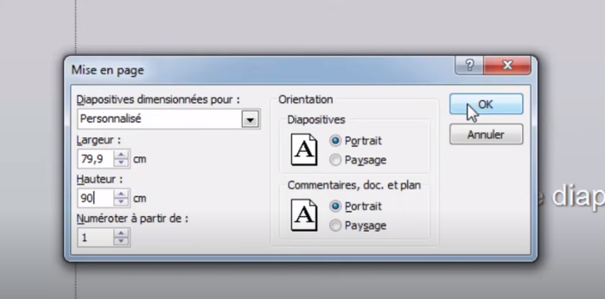
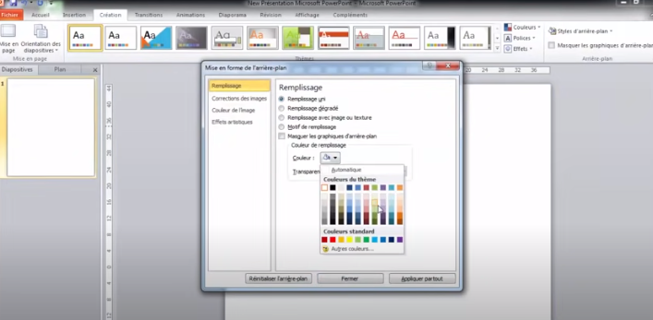
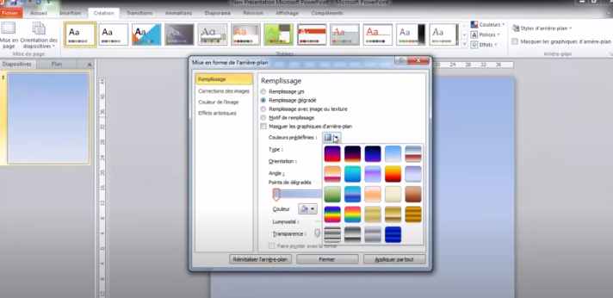
Afin de ne pas être surchargé, ni être trop superficiel, un poster comprend entre 250 et 450 mots.

Slide 25
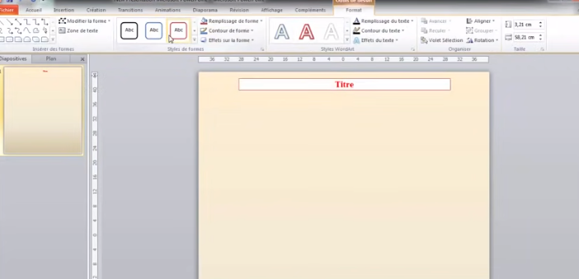
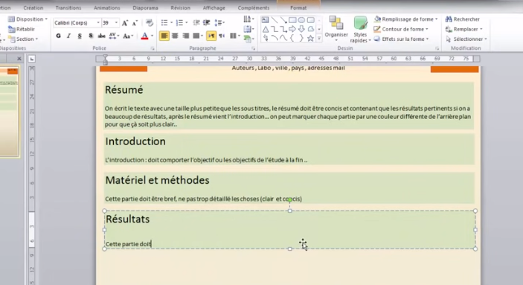
Aller à l’essentiel
Sous le titre, le texte doit faire apparaître les objectifs de la recherche, la méthodologie utilisée et les résultats obtenus, puis la conclusion.
Les sections « Méthodes » et « Résultats » étant les plus importantes, elles doivent représenter les 2/3 du poster.

Slide 26
Alléger votre style
Les phrases simples « sujet – verbe – complément » sont à privilégier car elles facilitent la compréhension des textes.
Chaque phrase doit être la plus courte possible. Idéalement, elle ne doit pas dépasser 15 mots.
Elle sera rédigée dans un style direct en utilisant des mots précis, faciles à comprendre et sans prétention.
Les éléments les plus importants doivent apparaître en début de phrase.
L’écriture scientifique et technique est centrée sur l’efficacité. On est loin des standards de l’écriture littéraire… Car l’objectif du poster est atteint si le public visé comprend le sujet et le message principal de la recherche.

Slide 28
Présenter votre poster en ligne
Les congrès et conférences se tiennent de plus en plus souvent en ligne, via des outils de visioconférence.
Dans ce cas, une galerie numérique regroupe les différents posters scientifiques afin de les rendre accessibles au public.
Le contenu d’un poster scientifique pour ce type d’évènement reste inchangé. Seul change le format du poster numérique qui est fourni en PDF.
Souvent, les intervenants ont la possibilité de réaliser une vidéo explicative de leur poster pour accompagner leur fichier PDF.
Si tel est le cas, saisissez cette opportunité ! D’une durée de 2 à 4 minutes, cette présentation est généralement pré-enregistrée, à la manière d’un webinar. Très proche du format d’un pitch, elle aide votre public à comprendre votre travail.

Slide 29
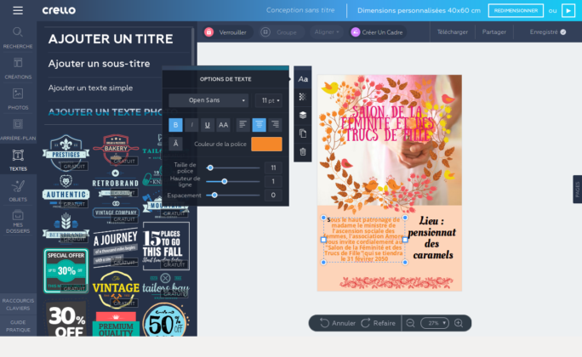
Logiciels en ligne pour production de posters en ligne

Slide 30
ARTICLE SCIENTIFIQUE

Slide 31
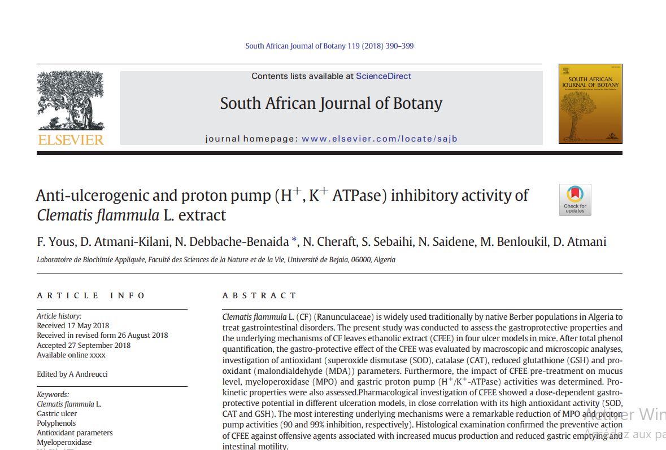
Outils de la communication scientifique ?
Article scientifique

Slide 32
Outils de la communication scientifique ?
Article scientifique
Journal de la publication

Slide 33
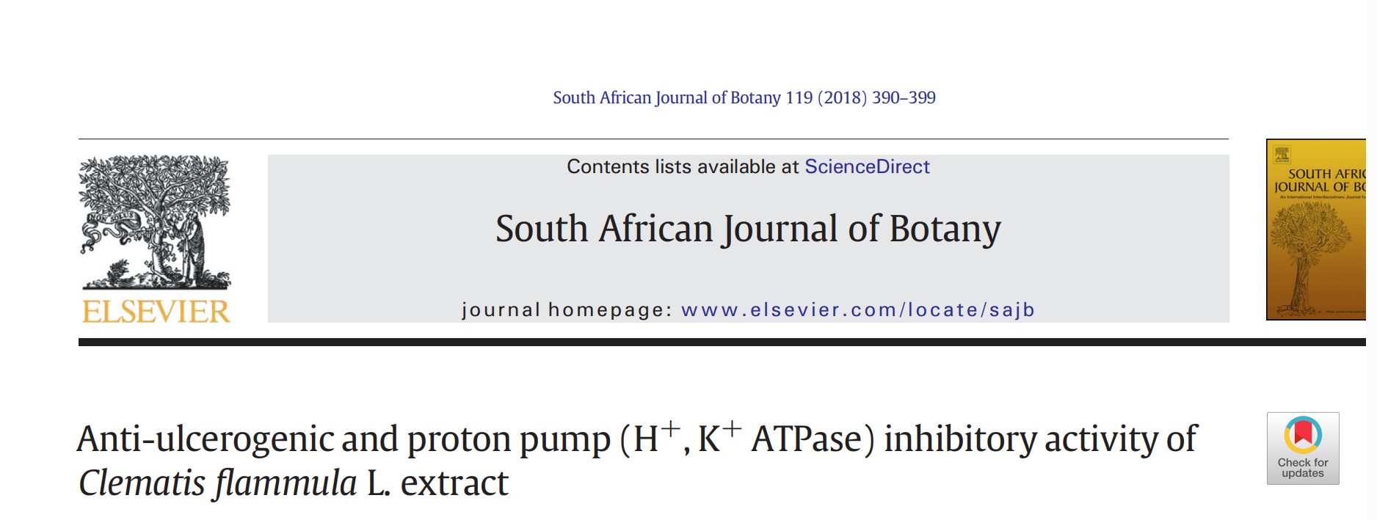
Outils de la communication scientifique ?
Article scientifique
Journal de la publication
Titre
Succinct , visible et pertinent

Slide 34
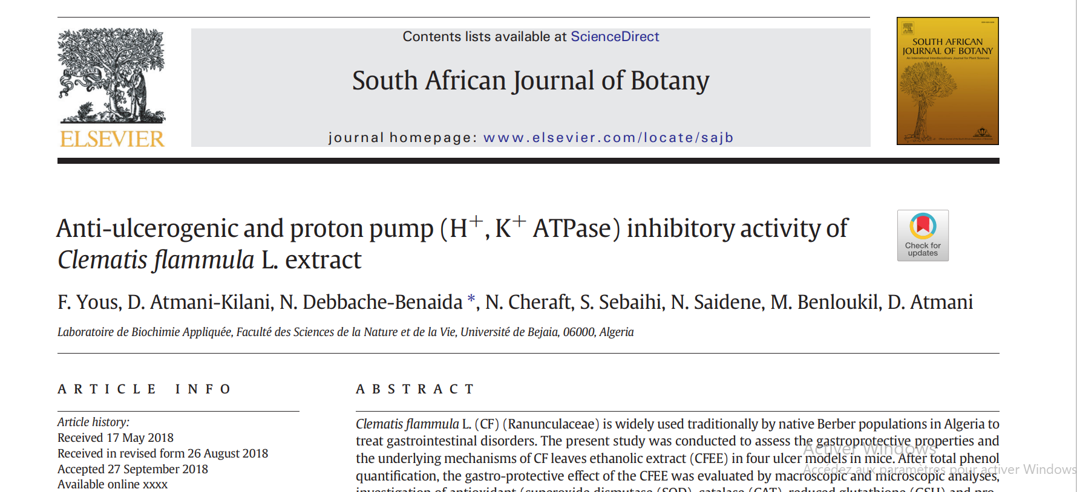
Outils de la communication scientifique ?
Article scientifique
Journal de la publication
Affiliation
Présente ou non sur la 1ere page
de l’article. Selon les spécifications de journal

Slide 35
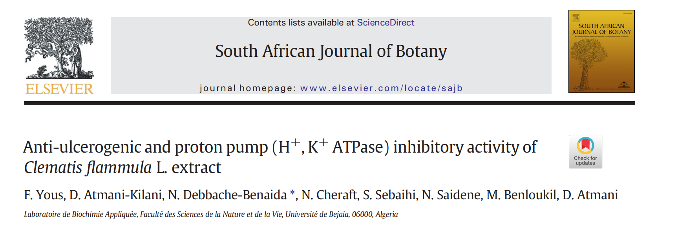
Outils de la communication scientifique ?
Article scientifique
Auteurs
Ensemble des personnes ayant participé à l’élaboration du travail . La 1 ere place revient à la personne ayant effectué la majorité du travail. Le chef du projet et le responsable de l’équipe de recherche doivent apparaitre.
Nombre limite selon les journaux

Slide 36
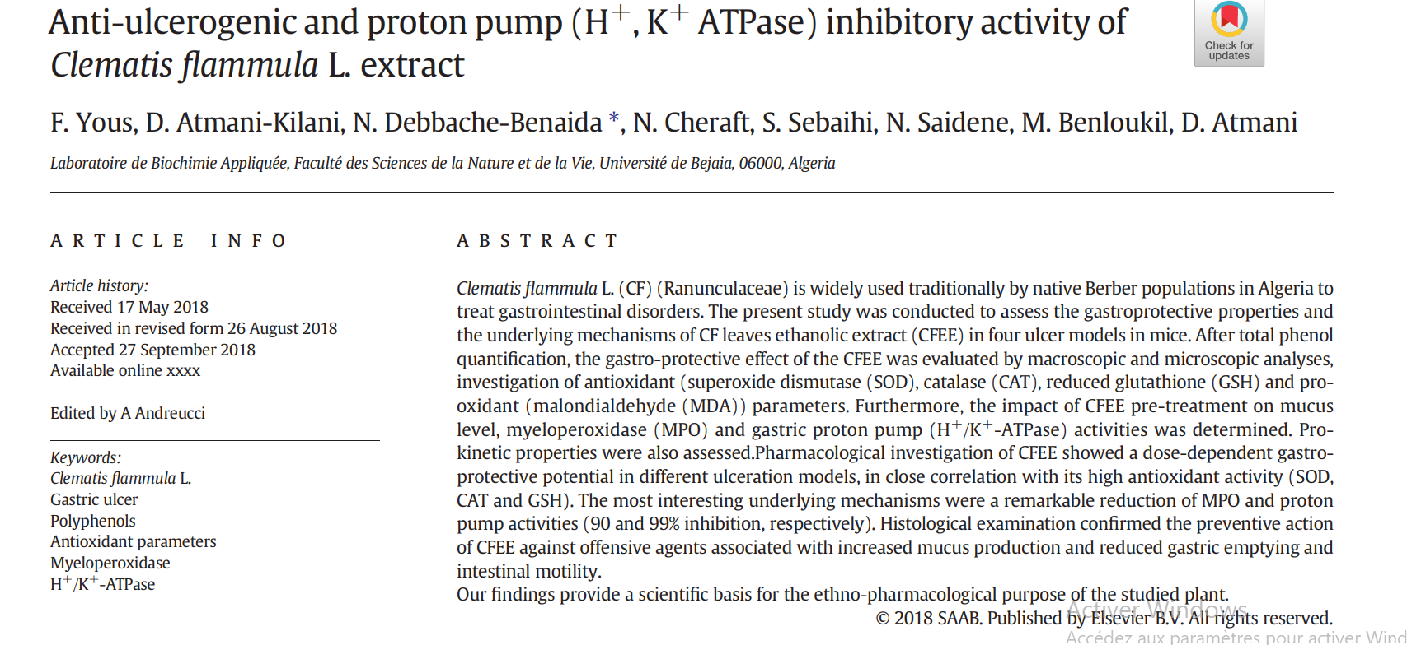
Outils de la communication scientifique ?
Article scientifique
Mots clés
Mots permettant de retrouver plus aisément l’article lors d’une recherche dans les banques de données

Slide 37
Outils de la communication scientifique ?
Article scientifique
Résumé
Nombre de mots limités. Doit reprendre les principaux éléments de l’etude.

Slide 38
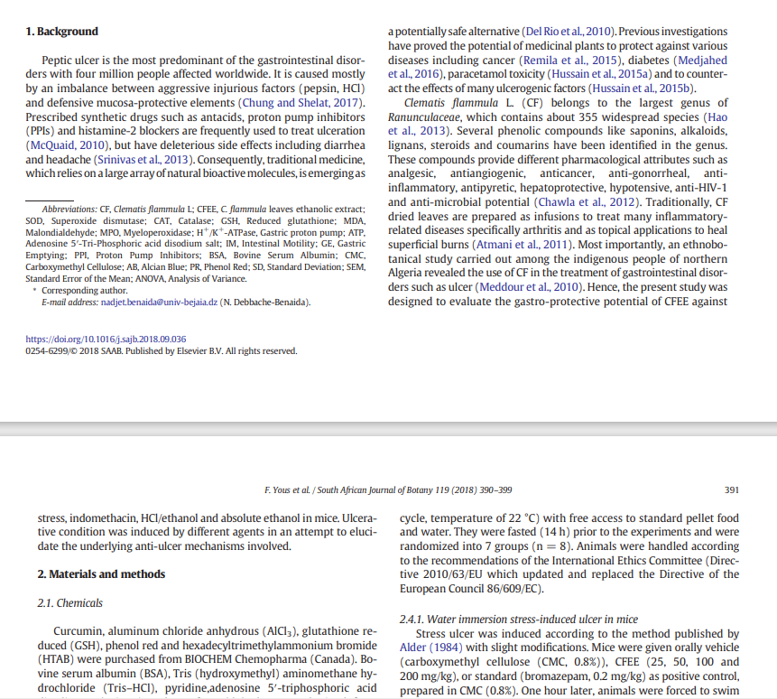
Outils de la communication scientifique ?
Article scientifique
Journal de la publication
Introduction
Revue bibliographique ciblée? Les phrases doivent être courte et permettre de comprendre aisément. Ne dépassant pas 1 page et comportant de nombreuses références bibliographiques

Slide 39
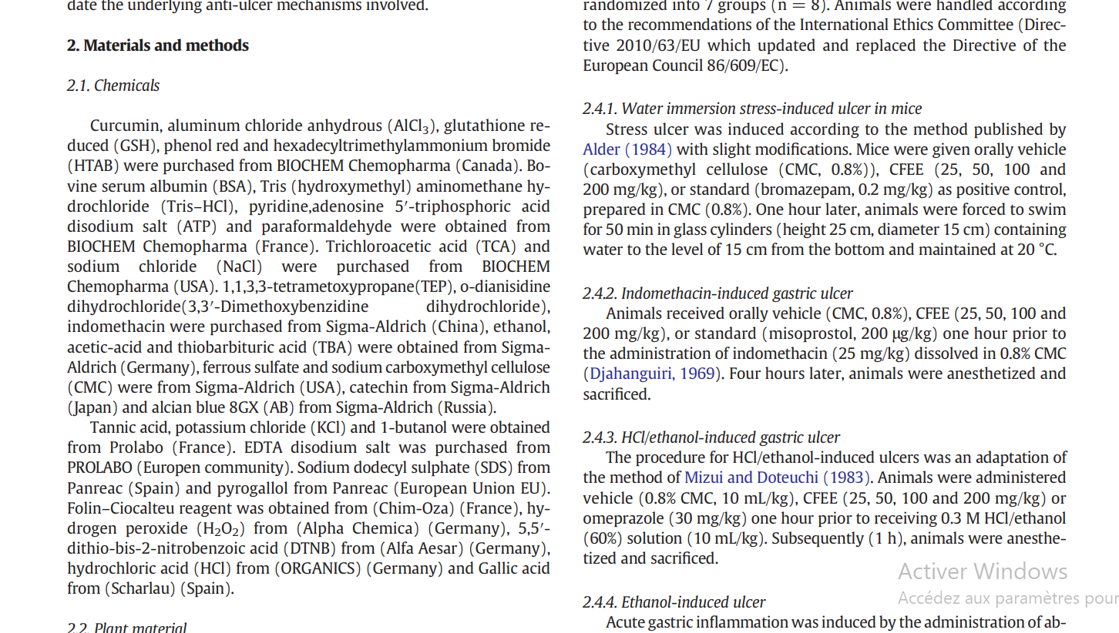
Outils de la communication scientifique ?
Article scientifique
Matériel & méthodes
Énumération de l’ensemble des procédés expérimentaux avec des détails sur la techniques

Slide 40
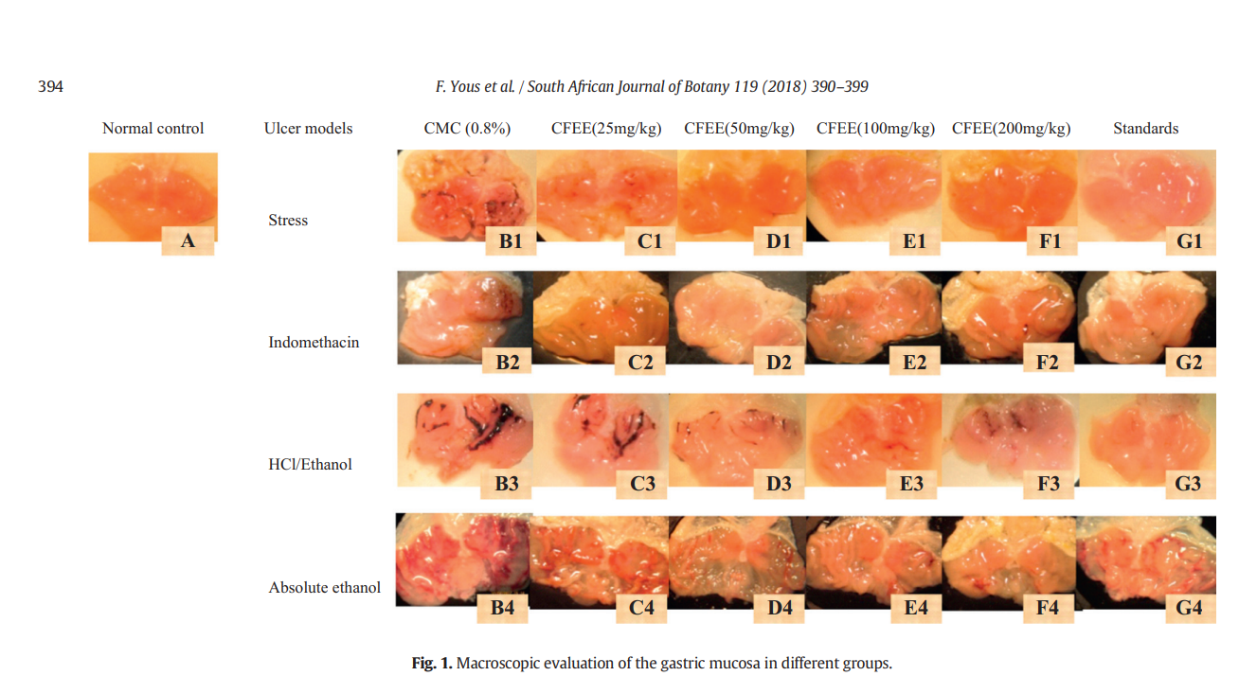
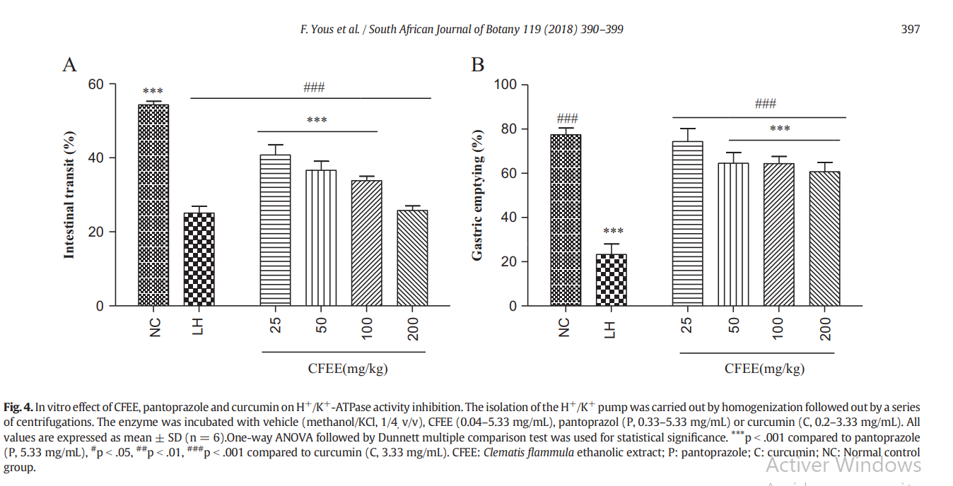
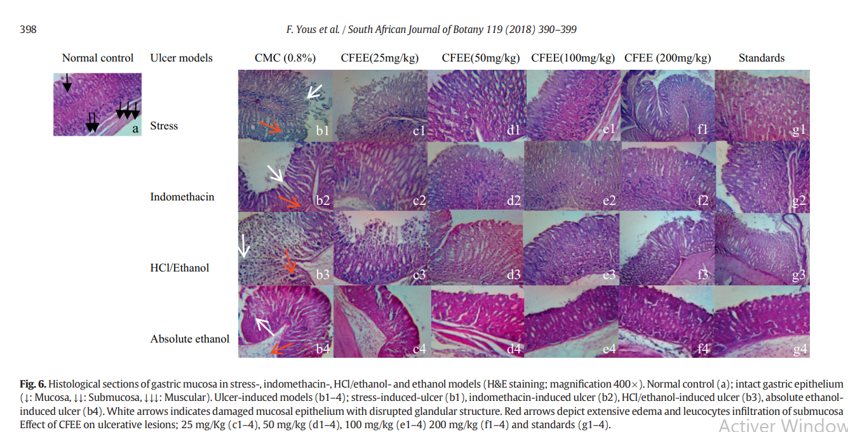
Outils de la communication scientifique ?
Résultats
Figures réalisée grace aux procédés expérimentaux. Et explications détaillées sous format manuscrit
Article scientifique
Année universitaire 2023-2024

Slide 41
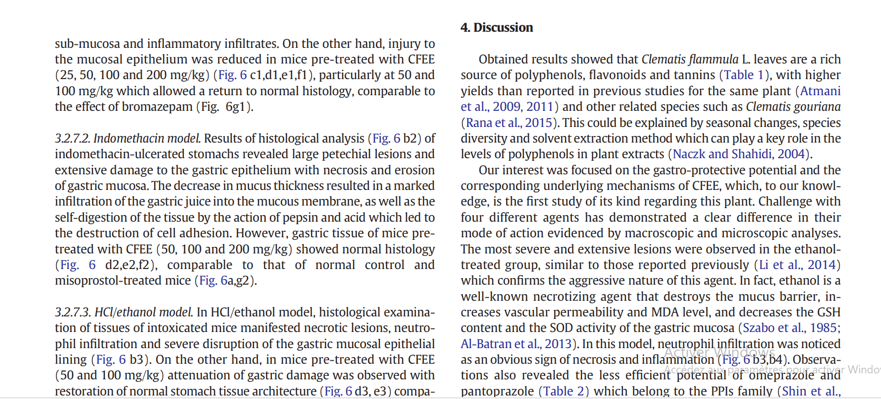
Outils de la communication scientifique ?
Article scientifique
Discussion
PLus longue et fournie que l’introduction. elle reprend des éléments de la revue bibliographique, une explication des résultats, les conclusions tirés d ‘après les résultats obtenus et enfin des perspectives

Slide 42
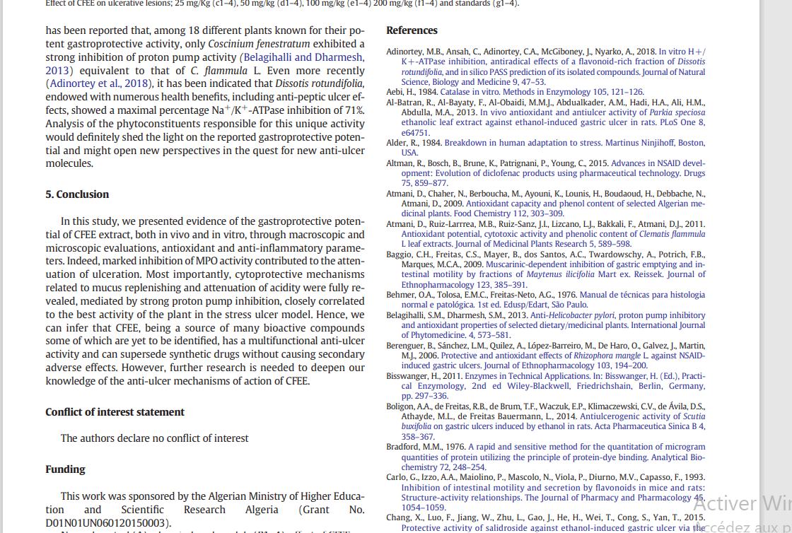
Outils de la communication scientifique ?
Article scientifique
Conclusion
Références Bibliographiques
L ‘ensemble de la bibliographie utilisée et classifiée selon l’ordre d’apparition dans l’article

Slide 43
Outils de la communication scientifique ?
Manuscrit ou rapport

Slide 44
Outils de la communication scientifique ?
Manuscrit ou rapport
Institution
Institution administrative éditrice du rapport
ECOLE DOCTORALE DES SCIENCES DE LA VIE ET DE LA SANTÉ
UNIVERSITÉ DE LA MÉDITERRANÉE- AIX-MARSEILLE II FACULTE DE MÉDECINE DE MARSEILLE
THÈSE DE DOCTORAT
Pour lʼobtention du grade de Docteur de lʼuniversité de la Méditerranée
Discipline: Oncologie
Nature
Type du rapoort
Titre
NECTINE-4: Nouvelle cible dans l’immunothérapie du cancer du sei
NECTINE-4: Nouvelle cible dans l’immunothérapie du cancer du sein
Présenté et soutenue publiquement par
Auteur
Abderrezak Ghidouche
le 24 Juin 2011
Laboratoire dʼimmunologie et cancers Centre de Recherche en Cancérologie de Marseille
INSERM UMR 891
Date d’édition
Membres du Jury:
Président :
Pr Jean-Louis Mege
Jury
Personnels scientifique habilité à juger le rapport. cela
s’applique à des rapports de stage et mémoires
Rapporteurs :
Dr Olivier Toutirais
Pr Pierre van der Bruggen
Examinateur :
Dr Felix Montero-Julian
Directeurs de thèse :
Dr Marc Lopez / Pr Daniel Olive

Slide 45
Outils de la communication scientifique ?
Manuscrit ou rapport
Table des matières
Ensemble du sommaires détaillant les chapitres et sous chapitres et la pagination. Les listes des figues et des tableaux et leurs pagination
Table des Matières
Traitement par immunothérapie:
Cas de Her2/neu ............................................................................................................................................ 36
IV.1-Cellules tumorales ............................................................................................................................. 37
IV.2-Cellules autologues ........................................................................................................................... 37
IV.3-ADN ........................................................................................................................................................... 37
IV.4-Cellules dendritiques ........................................................................................................................ 38
IV.5-Peptides .................................................................................................................................................... 39
IV.5.1-Vaccins multipeptidiques ............................................................................................................ 39
IV.5.2-Peptides E75&GP2 ........................................................................................................................ 39
IV.6-Vaccins protéiques ............................................................................................................................ 40
Autres antigènes utilisés en immunothérapie
du cancer du sein ............................................................................................................................................ 41
Nouveau antigène tumoral: Nectine-4
La famille des nectines ......................................................................................................................... 42
I.1-Biologie des nectines et nectines-Like ...................................................................................... 42
I.2-Nectines & pathologies ...................................................................................................................... 44
I.2.1-Implication dans les pathologies cancéreuses ............................................................................. 45
I.2.1.1-Interactions entre les cellules tumorales et cellules immunitaires ................................. 45
I.2.1.1-Effets sur les capacités tumorales des cellules cancéreuses ............................................. 46
Nectine-4 ........................................................................................................................................................ 48
II.1-Biologie ........................................................................................................................................................ 48
II.2-Nectine-4 & pathologies .................................................................................................................... 49
II.2.1-Nectine-4 & Cancers ......................................................................................................................... 50
II.2.1.1-Dans le cancer du sein .................................................................................................................. 50
II.2.1.2-Dans le cancer du poumon .......................................................................................................... 51
II.2.1.3-Dans le cancer ovarien ................................................................................................................. 51

Objectifs de l’étude ................................................................................................................................... 53
Résultats
Identification de peptides se fixant sur
les HLAs de classe I .................................................................................................................................. 54
Article :
Identification of a naturally processed HLA-A*0201 restricted
CTL epitope in the tumor associated antigen Nectin4 .................................................................. 55
I.1-Conclusion Intermédiaire ..................................................................................................................... 56
Résultats supplémentaires ............................................................................................................... 56
II.1-iTopia ............................................................................................................................................................. 56
II.1.1-Fixation ..................................................................................................................................................... 56
II.1.2-Dissociation et calcul du T½ ............................................................................................................ 59
        
Nectine-4: Nouvelle cible dans l’immunothérapie du cancer du sein.

Slide 46
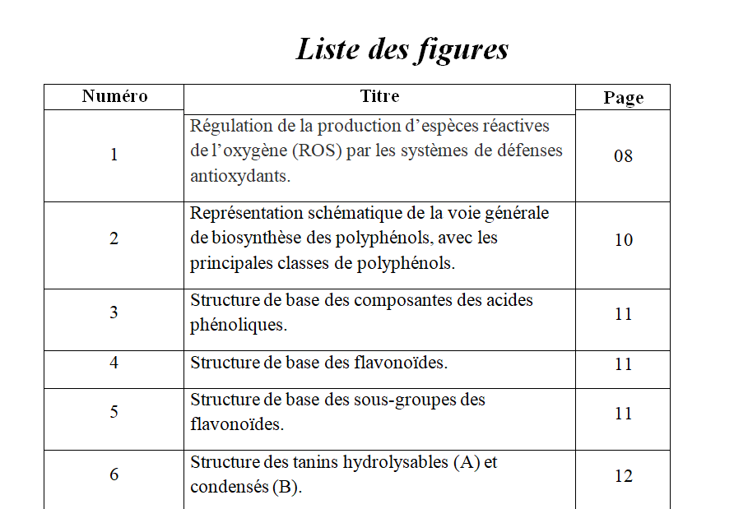
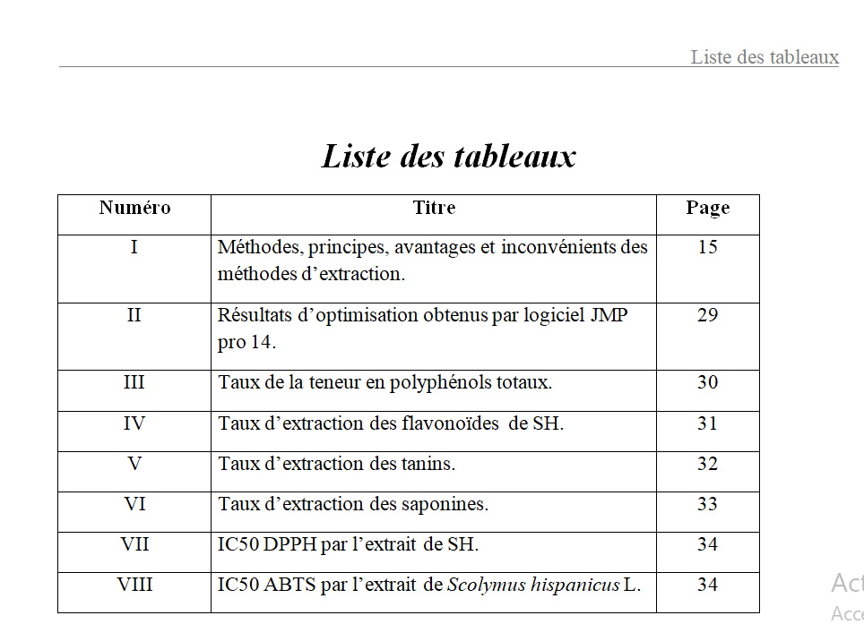
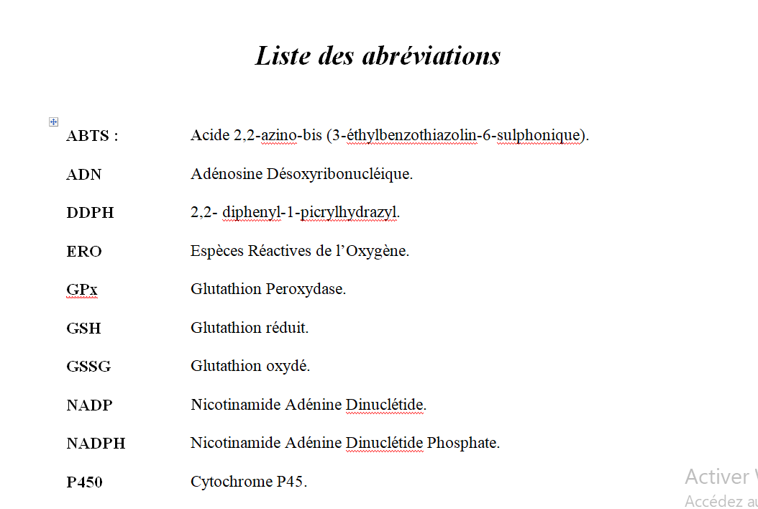
Abbreviations
Ensemble des acronymes utilisés dans le manuscrit
excepté les plus simples et couramment utilisés

Slide 47
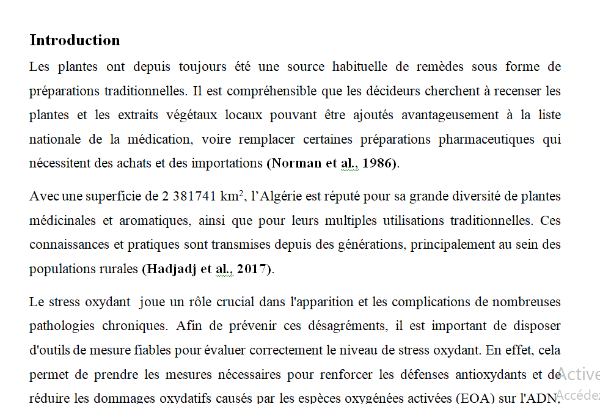

Slide 48
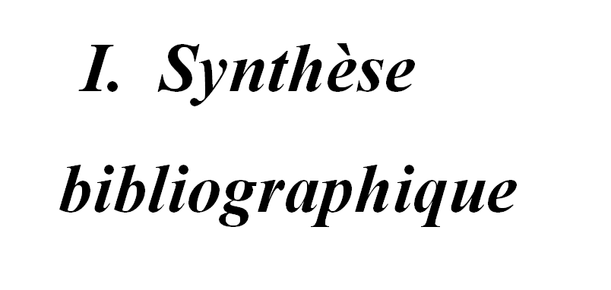

Slide 49
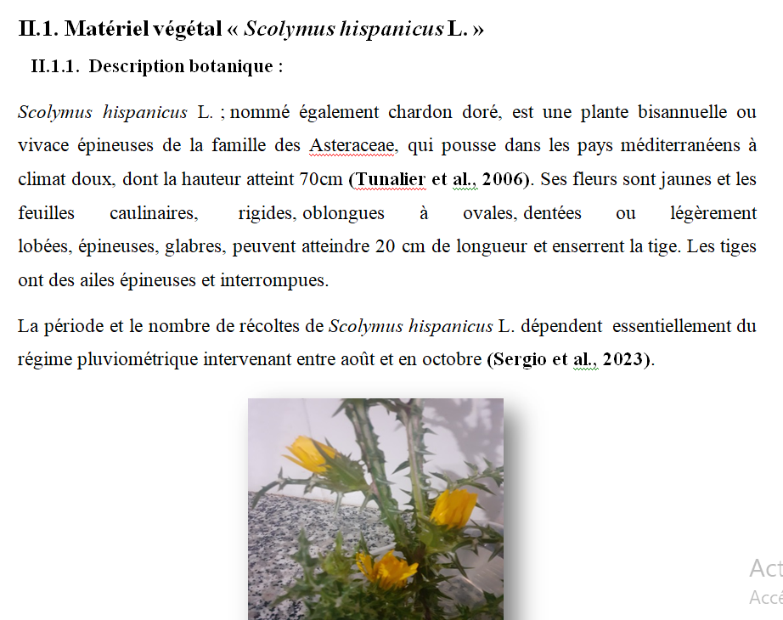
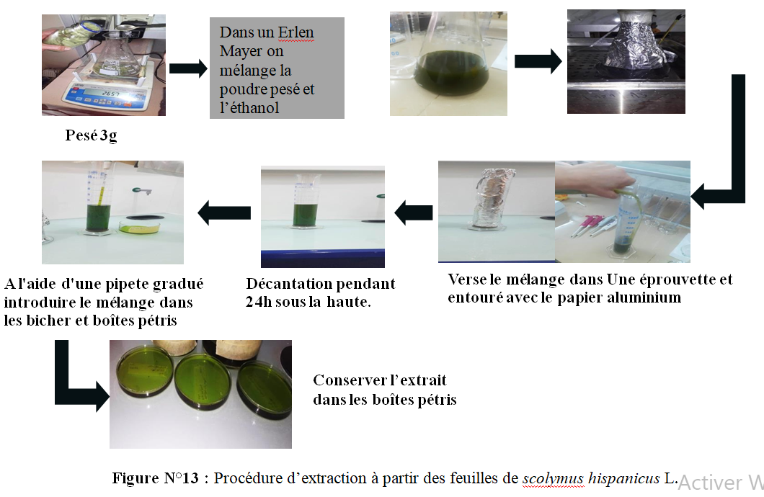

Slide 51
Que doivent contenir les figures ?
A
B
500
**
NS
T₀
T₁
T₂
450
400
**
nm/min
350
300
250
200
150
100
T = 0h
T = 4h
T = 8h
50
C
0
MDA-MB231 WT
MDA-MB231 Del8.6
MDA-MB231 R4.C1
D
Cells
MDA-MB231 WT
MDA-MB231 Del8 MDA-MB231 R4.
30000
C
25000
20000
15000
10000
RLU
MDA-MB231 wt
MDA-MB231 R4.C1
5000
0
1000
500
Number of Cells
Figure 5: Tumorogeneicity properties of MDA-MB231 cell lines
A : Cell migration assay pics. Up :MDA-MB231 wt, Bottom : MDA-MB231 R4.C1. B : Cell migration speed. The test is performed 3 fold with 4 inserts for each test. C : Clonogenicity assay pics. D : Colony and cell growth. Number of cells is the cells cultured in each well at Day 0. The photography and count were performed after four days of cell culture.
The RLU detected by CellTiter-Glo® is correlated with number of cells.
** p>0.001
Titre & numéro
Le numéro est attribué selon l’ordre d’apparition.
Le titre doit être court et ciblé
Légende
Ensemble des explications concernant le procédé expérimental et indication du résultat du test statistique

Slide 52
Outils de la communication scientifique ?
Que doivent contenir les figures ?
A
B
500
**
NS
T₀
T₁
T₂
450
A
❚Figure 2❚ Nectin 4 protein expression in ovarian cancer.
A, Western immunoblotting of ovarian cancer cell lines and immortalized normal ovarian surface epithelial (NOSE) cell lines.
_{Normal NOSE} Nectin 4 appears as an approximately 66-kDa band. �-Actin
was used as a loading control. B, Flow cytometric analysis of ovarian cancer and immortalized NOSE cell lines for nectin 4 (top row), nectin 1 (middle row), and ADAM17 (bottom row). Nectin 1 expression indicates that trans-heterodimers may form between nectin 4– and nectin 1–expressing cells.
Nectin 4 Expression of ADAM17 indicates that nectin 4 may be cleaved
β-actin from the surface of the cells and may be detectable in patient serum samples. Dashed line, IgG control stain; solid line, nectin
4, nectin 1, or ADAM17.
400
**
nm/min
350
300
Ovarian Cancer Cell Lines
250
OVCAR3 A2780s A2780cp OVCA433 OVCA429 OVCAR5 CAOV3 MA148DsRED HEY
ES2 SKOV3 C13 OV2008 HIO117 1816-686
1816-575
IMCC5 IMCC3
MCF7 (+ control)
200
150
T = 0h
T = 4h
T = 8h
100
50
C
0
MDA-MB231 WT
MDA-MB231 Del8.6
MDA-MB231 R4.C1
D
Cells
MDA-MB231 WT
MDA-MB231 Del8 MDA-MB231 R4.
30000
C
25000
B
Ovarian Cancer
Normal NOSE
RLU
20000
200
OVCAR5
200
C13
200
OV2008
200
HIO117
200
1816-575
15000
160 160 160 160 160
120 120 120 120 120
80 80 80 80 80
40 40 40 40 40
0 0 0 0 0
10⁰ 10¹ 10² 10³ 10⁴ 10⁰ 10¹ 10² 10³ 10⁴ 10⁰ 10¹ 10² 10³ 10⁴ 10⁰ 10¹ 10² 10³ 10⁴ 10⁰ 10¹ 10² 10³ 10⁴
Nectin 4
200 200 200 200 200
160 160 160 160 160
120 120 120 120 120
80 80 80 80 80
40 40 40 40 40
0 0 0 0 0
10⁰ 10¹ 10² 10³ 10⁴ 10⁰ 10¹ 10² 10³ 10⁴ 10⁰ 10¹ 10² 10³ 10⁴ 10⁰ 10¹ 10² 10³ 10⁴ 10⁰ 10¹ 10² 10³ 10⁴
Nectin 1
200 200 200 200 200
160 160 160 160 160
120 120 120 120 120
80 80 80 80 80
40 40 40 40 40
0 0 0 0 0
10⁰ 10¹ 10² 10³ 10⁴ 10⁰ 10¹ 10² 10³ 10⁴ 10⁰ 10¹ 10² 10³ 10⁴ 10⁰ 10¹ 10² 10³ 10⁴ 10⁰ 10¹ 10² 10³ 10⁴
ADAM17
MDA-MB231 wt
MDA-MB231 R4.C1
10000
5000
0
1000
Number of Cells
500
Figure 5: Tumorogeneicity properties of MDA-MB231 cell lines
A : Cell migration assay pics. Up :MDA-MB231 wt, Bottom : MDA-MB231 R4.C1. B : Cell migration speed. The test is performed 3 fold with 4 inserts for each test. C : Clonogenicity assay pics. D : Colony and cell growth. Number of cells is the cells cultured in each well at Day 0. The photography and count were performed after four days of cell culture.
The RLU detected by CellTiter-Glo® is correlated with number of cells.
** p>0.001
Titre & numéro
Le numéro est attribué selon l’ordre d’apparition.
Le titre doit être court et ciblé
Légende
Ensemble des explications concernant le procédé expérimental et indication du résultat du test statistique

Slide 56
Le résumé se met sur le dos de la dernière page du manuscrit
Le résumé est une brève synthèse du mémoire, offrant aux lecteurs un aperçu de son contenu.
Grâce au résumé, le manuscrit a gagné en visibilité : son contenu peut être identifié plus rapidement, sa diffusion est plus facile et son référencement optimisée.
Ne le confondez pas avec l’introduction : le but du résumé est de passer en revue l’ensemble du manuscrit, y compris la méthode, les résultats et la conclusion.

Slide 57
FIN DU CHAPITRE

