Slide 1
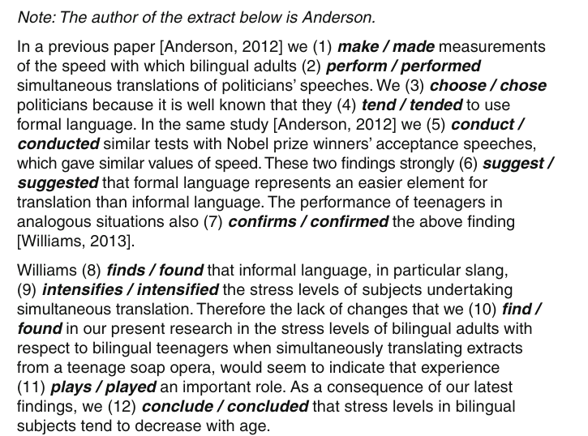
Exercise 1: present simple, present perfect, past simple. Put the verbs in the correct tense.

Slide 2
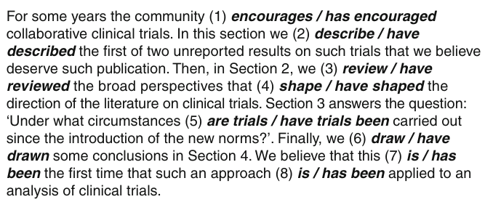
Exercise 2: present simple, present perfect. Put the verbs in the correct tense.

Slide 3
Exercise 3: highlight phrases that emphasize the importance of the study, the scientific approach and current or previous thinking
Abstract
The earliest hominin archaeological sites preserve a record of stone tools used for cutting and pounding. Traditionally, sharp-edged flakes were seen as the primary means by which our earliest ancestors interacted with the world. The importance of pounding tools is increasingly apparent. In some cases, they have been compared with stone hammers and anvils used by chimpanzees for nut-cracking. However, there has been little focus on providing a robust descriptive and quantitative characterization of chimpanzee stone tools, allowing for meaningful comparisons between chimpanzee groups and with archaeological artefacts. Here we apply a primate archaeological approach to characterize the range of chimpanzee nut-cracking stone tools from Djouroutou in the Taï National Park. By combining a techno-typological analysis, and two- and three-dimensional measures of damage, we identify clear differences in the location and extent of damage between nut-cracking hammerstones and anvils used at Djouroutou and when compared with other wild chimpanzee populations. Furthermore, we discuss these results in relation to interpretations of Plio-Pleistocene percussive technology. We highlight potential difficulties in identifying the underlying function of percussive artefacts based on morphological or techno-typological attributes alone. The material record from Djouroutou represents an important new datum of chimpanzee regional and material culture.
Introduction
Our earliest ancestors used a variety of stone tools to interact with, and modify the world around them [1–4]. Tools used for cutting and pounding tasks provided a competitive advantage in accessing different food sources, thus influencing the cultural and biological evolution of our species [5,6]. The role of percussive artefacts for understanding Plio-Pleistocene hominin subsistence has received far less attention compared with stone flake technology [7–10]. Both hammerstones and anvils used for percussive behaviours have been identified at several Plio-Pleistocene archaeological sites and indeed form a component of archaeological assemblages into the Later Stone Age [1,7,9–14].

Slide 4
Exercise 4: countable and uncountable nouns. The following sentences contain mistakes regarding uncountable nouns that have mistakenly been used as if they were countable. Identify the mistakes and correct them.
1. As far as we know, there has only been one research in this fi eld.
2. These money are collected once a month.
3. This may be an evidence for astrologists.
4. About 60% of the feedbacks were negative.
5. Several informations are now available.
6. The earthquake caused few damages and no fatalities.
7. Garbages represent a big problem in the process of urbanization. In fact they cause…
8. They did a training during the course.
9. She was the only child of a blind father (he was struck by a lightning) and a mother who died of a cancer when she was a teenager.
10. The sheeps appeared to be in a good health and gained weight like the normal control sheeps.

