Slide 1
Université A. MIRA Bejaia
Faculté des sciences de la nature et de la vie
Département sciences alimentaires
Rappel sur l’enzymologie
Dr MEKHOUKHE AIDA

Slide 2
Université A. MIRA Bejaia
Faculté des sciences de la nature et de la vie
Département sciences alimentaires Dr MEKHOUKHE AIDA
Structure and property
kinetic
Concept and mode of action
Factors affecting enzyme activity

Slide 3
Université A. MIRA Bejaia
Faculté des sciences de la nature et de la vie
Département sciences alimentaires Dr MEKHOUKHE AIDA
I. structure et propriété
Biological catalysts of living organisms,
They present a three-dimensional structure and they have specificity
They incorporate a small area known as the active site (Figure 1),

Slide 4
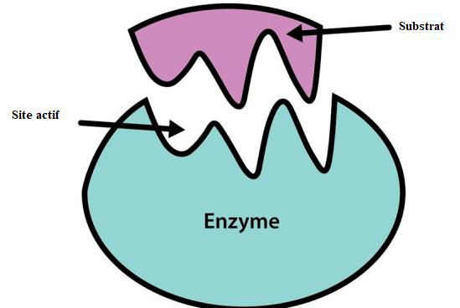
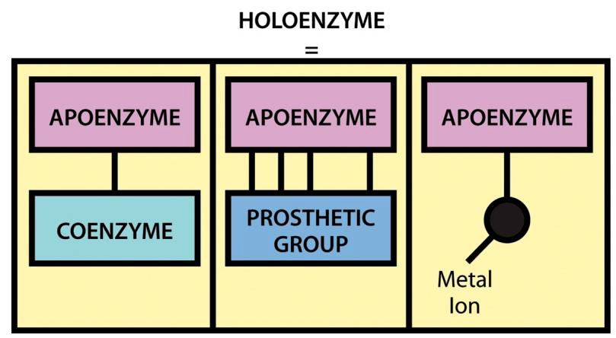
Université A. MIRA Bejaia
Faculté des sciences de la nature et de la vie
Département sciences alimentaires Dr MEKHOUKHE AIDA
Figure 1. Representation of substrate binding to the active site of an enzyme molecule
Figure 2. Component of a holoenzyme

Slide 5
Université A. MIRA Bejaia
Faculté des sciences de la nature et de la vie
Département sciences alimentaires Dr MEKHOUKHE AIDA
II. Cinétique Enzymatique
Enzymes facilitate chemical reactions taking place in living organisms. It is the main family of molecules capable of chemical catalysis in living beings. The overall reaction is composed of two elementary reactions: the substrate first forms a complex with the enzyme, then this complex decomposes into product and enzyme, where E, S, ES, and P symbolize the enzyme, substrate, the complex enzyme-substrate and product, respectively
Figure 3. Reaction
III. Factors affecting enzyme activity

Slide 6
