Slide 1
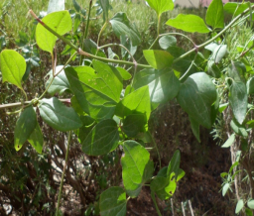
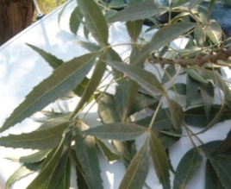
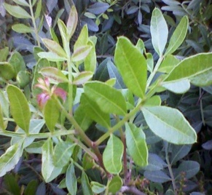
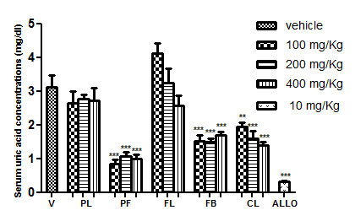
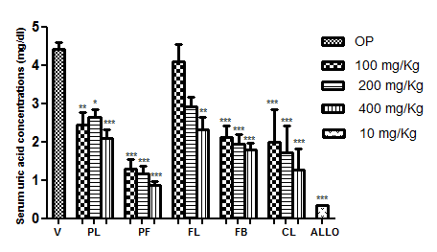
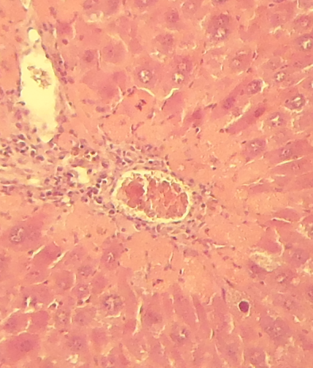
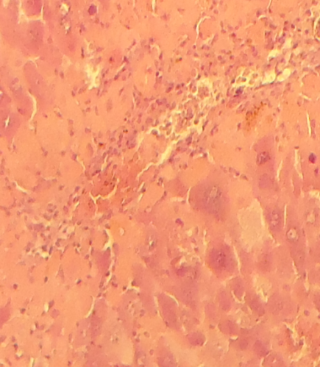
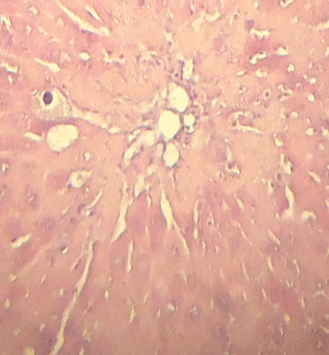
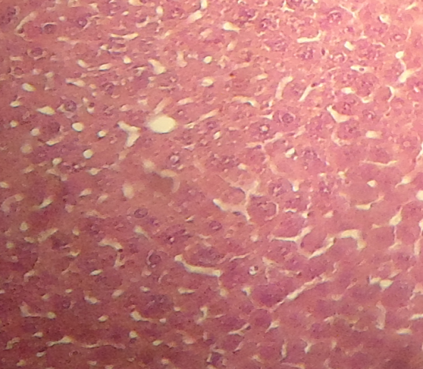
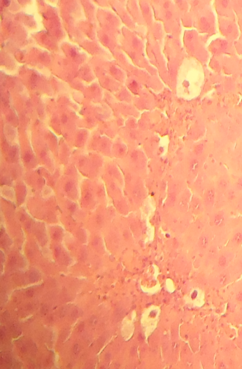
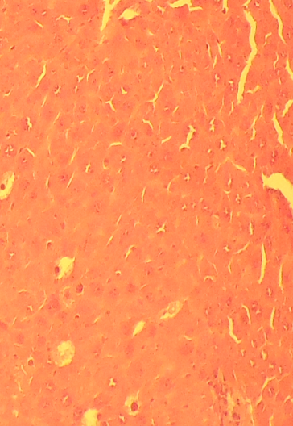
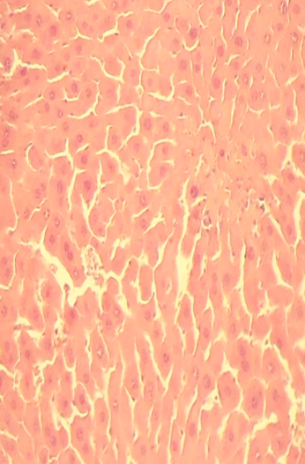
Biological activities of extracts from local medicinal plants: Clematis flammula, Fraxinus angustifolia et Pistacia lentiscus
Djebbar Atmani, Karima Ayouni, Meriem Berboucha, Dina Atmani, Mohand Zine Ait Meziane et Naima Saidene
Abstract
Laboratory of Applied Biochemistry, Faculty of Life and Nature Sciences, University of Bejaia, 06000 Algeria
National Institute of Agronomic Research (INRA), Oued Ghir, Bejaia, 06000 Algeria
Email: djatmani@yahoo.com
Introduction
Oxidative stress is responsible for many inflammatory-related pathologies. The objective of this study was to examine the hepato-protective, anti-inflammatory, diuretic and hypo-uricemic activities of three medicinal plants: P. lentiscus, Fraxinus angustifolia and Clematis flammula used in traditional Algerian medicine.
Materials and methods
The hepato-protective effect of the plant extracts was estimated by the analysis of histological sections of mice livers, while the anti-inflammatory activity was evaluated by the carrageenan-induced paw edema model. The diuretic test was based on the quantification of cumulative urinary volume and the concentration of Na⁺ and K⁺ in extract-treated rats. The hypo-uricemic potential was evaluated by the quantification of serum uric acid and the inhibition of hepatic xanthine oxidoreductase activity.
Results and discussion
Histological analysis indicated that the hepato-protective effect was significant after treatment with F. angustifolia and P. lentiscus leaves extracts (50mg/kg). Ethanolic leaf extracts of F. angustifolia (200mg/Kg) and aqueous of chloroform of C. flammula (200mg/Kg) exhibited an interesting anti-inflammatory effect, comparable to that of diclofenac (50mg/Kg). The fruit extracts of P. lentiscus (200mg/Kg) induced a significant increase in urinary volume, similar to that of furosemide. Moreover, the extracts of P. lentiscus and C. flammula have demonstrated a considerable hypo-uricemic effect, with an appreciable inhibition of xanthine oxydoreductase activity.
Conclusion
Obtained results contribute to validate the therapeutic effects of tested medicinal plants. Identification of active molecules responsible for these effects is under way.
Key words: Anti-inflammatory, hypouricemic, diuretic, xanthine oxidoreductase.
1
Introduction
Clematis flammula (Ranunculaceae), Pistacia lentiscus (Anacardiaceae) and Fraxinus angustifolia (Oleaceae), are used in local traditional medicine against rheumatoid arthritis and artificial burns, for the treatment of throat infections, diarrhea and jaundice and used for rheumatism, inflammation and as a laxative, respectively. In addition, the plants are known for their diuretic properties (Beloued, 1998; Lahsissen et al., 2009).
It has been proven that extracts derived from both plants are potent free radical scavengers, prevent lipid peroxidation in vitro (Atmani et al., 2009) and strong inhibitors of xanthine oxidase (Berboucha et al., 2010). This study was therefore undertaken to investigate the hepatoprotective, diuretic, anti-inflammatory and hypouricemic potentials of C.flammula, P. lentiscus and F. angustifolia ethanolic and aqueous extracts.
Table I: Effect of Fraxinus angustifolia and Pistacia lentiscus extracts and diclofenac on carrageenan-induced paw edema in mice.
Groups | Paw thickness at different time intervals (in mm) % edema inhibition (max)
 | 0H | 1H | 2H | 3H | 4H | 5H | 24H
Control | 2.31±0.20 | 3.11±0.22 | 3.28±0.31 | 3.48±0.19 | 3.70±0.26 | 3.58± 0,16 | 3.56±0.09
C.Flammula (200mg/kg) | 2.41±0.045 | 3,26±0.017 | 3,28±0.03 | 3,23±0.025 | 3,82±0.032 | 3,93±0.03 | 3,97±0.025
F. angustifolia (200mg/Kg) | 2.37±0.19 | 2.99±0.32 | 3.00±0.39 | 3.02±0.41 | 3,06±0.38 47.81%ª | 3.19±0.29 | 3.21±0.36
P. lentiscus (200mg/Kg) | 2.33±0.07 | 3.11±0.16 | 3.02±0.16 40.47%^{a,b} | 3.07±0.14 | 3.27±0.06 | 3.31±0.15 | 3.28±0.16
Diclofenac (50mg/Kg) | 2.41±0.03 | 2.88±0.30 | 2.74±0.11 65.31%ª | 2.64±0.30 | 2.91±0.36 | 2.92±0.26 | 2.91±0.30
2
Experimental
Anti-inflammatory activity (Winter et al., 1962): Ethanolic extracts (200mg/Kg) or diclofenac (50mg/Kg) were administered orally one hour before carrageenan (1%) injection in the left hind paw. Measurements of the edema produced were effected one hour later and during 5 hours.
Table II: Effect of oral administration of Furosemide (10mg/kg) and ethanolic extracts of Pistacia lentiscus leaves (PL) and fruits (PF), Fraxinus angustifloia leaves (FL) and barks (FB) at 200mg/kg on pH, conductivity and cumulative urinary excretion of sodium and potassium in rats.
Clematis flammula
Hepatoprotective activity (Naskar et al., 2010): Ethanolic extracts (50mg/Kg) or vitE (50mg/Kg) were administered orally for seven days and two hours before receiving CCl₄ that was given every 72hours. 24hrs after the last dose of CCl₄ mice were sacrified and their liver excised . Histologic sections were analysed to detect the presence or absence of liver damage.
 | pH | Conductivity | Na⁺ | K⁺
Vehicle | 7,13±0,33 | 12,18±0,98 | 100,5±2,95 | 66,12±0,63
Furosemide | 6,18±0,07 | 15,30±0,95 | 160,16±2,30*** | 150,498±0,42***
PL | 7,90±0,44 | 13,9±2,25 | 126,06±3** | 208,5±1,79***
PF | 7,59±0,68 | 14,05±2,45 | 89,46±2,3 | 150,426±1,89***
FL | 7,79±0,8 | 14,20±0,9 | 96,84±2,18 | 182,85±1,4***
FB | 7,05±0,35 | 15,33±0,35 | 145,14±2,4*** | 155,77±1,86***
Fraxinus angustifolia
Diuretic activity on rats (Kau et al., 1984): Plant extracts (200mg/Kg) or the reference drug furosemide (20mg/kg) were administrated orally or injected by intraperitoneal way, respectively to rats and urine output was measured at several intervals of time after administration of a single dose. Na⁺ and K⁺ levels were determined by atomic absorption spectrophotometer.
Figure 02: Effect of oral administration of Furosemide (10mg/kg) and ethanolic extracts of Pistacia lentiscus leaves (PL) and fruits (PF), Fraxinus angustifloia leaves (FL) and barks (FB) at 200mg/kg on cumulative urine volume per 100 g of body weight per rat. Mean±S.E.M., n =6. *p < 0.05 vs. control, **p < 0.01 vs. control, ***p < 0.001 vs. control.
3
Pistacia lentiscus
Hypouricemic activity on mice (Zhu et al., 2004):mice were injected intraperitoneally with potassium oxonate (250 mg/kg) 1 h before the final drug administration to increase the serum urate level, for three consecutive days. Serum uric acid levels and liver XOR activities were evaluated.
Results
Dilated qnd congested central vein
Infiltration of inflammatory cells
Increase of lipid vacuoles (steatosis)
Figure 03: Effect of allopurinol (10mg/kg) and ethanolic extracts of Pistacia lentiscus leaves (PL) and fruits (PF), Fraxinus angustifloia leaves (FL) and barks (FB), and Clematis flammula leaves (CL) at 200mg/kg on serum urate level in normal mice. Mean±S.E.M., n =6. *p < 0.05 vs. control, **p < 0.01 vs. control, ***p < 0.001 vs. control.
Figure 04: Effect of allopurinol (10mg/kg) and ethanolic extracts of Pistacia lentiscus leaves (PL) and fruits (PF), Fraxinus angustifloia leaves (FL) and barks (FB) and Clematis flammula leaves (CL) at 200mg/kg on serum urate level in hyperuricemic mice. Mean±S.E.M., n =6. *p < 0.05 vs. control, **p < 0.01 vs. control, ***p < 0.001 vs. control.
CCl₄-treated groups: signs of liver damage
Effect of ethanolic extracts of Pistacia lentiscus leaves (PL) and fruits (PF), Fraxinus angustifloia leaves (FL) and barks (FB) and Clematis flammula leaves (CL) on liver xanthine oxidoreductase activities in normal and oxonate pretreated mice, after oral three time administration. Mean±S.E.M., n =6. *p < 0.05 vs. control, **p < 0.01 vs. control, ***p < 0.001 vs. control.
(Normal hepatic architecture)
Absence of lipid peroxidation
Liver protection, against CCl₄ induced hepatic damage, but presence of sinusoidal dilatation
Treatments | Dose (mg/kg) | XO (nmole/min/ mg of [proteins) | XDH (nmole/min/mg of proteins) | % Inhibition
 |  |  |  | XO | XDH
Vehicle | _ | 2.56±0.07 | 2.48±0.06 | --- | ---
PL EtOH | 100 | 2.36±0.10 | 2.37±0.03 | 8.13 | 4.75
PL EtOH | 200 | 2.36±0.17 | 2.18±0.05 | 8.09 | ---
PL EtOH | 400 | 1.84±0.08 | 2.09±0.05 | 28.28 | 21.04
PF EtOH | 100 | 2.54±0.13 | 2.85±0.12 | --- | ---
PF EtOH | 200 | 2.70±0.17 | 3.19±0.26 | --- | ---
PF EtOH | 400 | 2.67±0.30 | 3.33±0.14 | --- | ---
FL EtOH | 100 | 1.84±0.26 | 1.87±0.22 | 25.80 | 21.75
FL EtOH | 200 | 1.70±0.16 | 1.96±0.22 | 31.45 | 17.99
FL EtOH | 400 | 1.51±0.16 | 1.30±0.09 | 39.11 | 45.60
FB EtOH | 100 | 2.84±0.25 | 2.44±0.20 | --- | ---
FB EtOH | 200 | 2.48±0.08 | 2.52±0.41 | --- | ---
FB EtOH | 400 | 2.39±0.25 | 2.63±0.11 | --- | ---
CL AqEA | 100 | 0.87±0.16 | 0.55±0.05 | 68.84 | 76.74
CL AqEA | 200 | 0.92±0.16 | 0.87±0.11 | 66.95 | 63.09
CL AqEA | 400 | 1.10±0.12 | 1.12±0.12 | 60.69 | 52.72
Allopurinol | 10 | 0.66±0.10 | 0.66±0.10 | 73.38 | 72.38
Treatments | Dose (mg/kg) | XO (nmole/min/ mg of proteins) | XDH (nmole/min/mg of proteins) | % Inhibition
 |  |  |  | XO | XDH
PO | 250 | 2.59±0.16 | 2.83±0.17 | --- | ---
PO+PL EtOH | 100 | 2.41±0.08 | 2.54±0.12 | 7.21 | 10.09
PO+PL EtOH | 200 | 2.18±0.05 | 2.40±0.07 | 15.95 | 15.29
PO+PL EtOH | 400 | 2.09±0.10 | 2.30±0.08 | 19.46 | 18.79
PO+PF EtOH | 100 | 2.56±0.04 | 3.15±0.13 | --- | ---
PO+PF EtOH | 200 | 2.97±0.17 | 3.28±0.23 | --- | ---
PO+PF EtOH | 400 | 2.88±0.21 | 2.82±0.16 | --- | ---
PO+FL EtOH | 100 | 1.44±0.16 | 1.53±0.09 | 33.94 | 40.92
PO+FL EtOH | 200 | 1.37±0.07 | 1.31±0.10 | 37.15 | 49.42
PO+FL EtOH | 400 | 1.56±0.25 | 1.44±0.31 | 28.44 | 44.40
PO+FB EtOH | 100 | 2.33±0.03 | 3.55±0.61 | --- | ---
PO+FB EtOH | 200 | 2.39±0.02 | 3.75±0.25 | --- | ---
PO+FB EtOH | 400 | 2.40±0.21 | 2.72±0.14 | --- | ---
PO+CL AqEA | 100 | 1.03±0.14 | 1.59±0.26 | 61.15 | 47.46
PO+CL AqEA | 200 | 0.78±0.07 | 0.84±0.09 | 70.31 | 71.95
PO+CL AqEA | 400 | 1.00±0.04 | 1.15±0.06 | 62.07 | 61.71
PO+Allopurinol | 10 | 0.62±0.11 | 0.60±0.10 | 71.55 | 76.83
Moderate steatosis
Control group F.angustifolia P.lentiscus Vit E
treated group treated group treated group
Figure 01 : Photomicrographs of liver sections from mice stained with eosin hematoxylin
4
Conclusion
Obtained results indicate that Clematis flammula, Fraxinus angustifolia and Pistacia lentiscus extracts exhibited promissing hypouricemic and anti-inflammatory potential and protected mice from liver damage, thereby validating their traditional use as antioxidants, anti-inflammatory and anti-hyperuricemic in North Africa.
5
References
6
Acknowledgements
-A. Beloued, 1998. plantes médicinales d’Algérie Office de publication universitaire. 277p.
-C.A. Winter, E.A. Risley & G.W. Nuss, (1962). Carrageenan-induced edema in hind paw of the rat as an assay for anti-inflammatory drugs ProcSocExp Bio Med 111: 545-547.
-D. Atmani, N. Chaher, M. Berboucha, K. Ayouni, H. Lounis, H. Boudaoud, N. Debbache, Dj. Atmani: Antioxidant capacity and phenol content of selected Algerian medicinal plants. Food Chemistry 112, 303–309, 2009.
-H. Lahsissene, A. Kahouadji. 2010. Usages thérapeutiques traditionnels des plantes médicinales dans le Maroc occidental : cas de la région de Zaër,Phytothérapie 8 : 210-217.
-M. Berboucha, K. Ayouni, D. Atmani, Dj. Atmani, M. Benboubetra: Kinetic study on the inhibition of xanthine oxidase by extracts from two selected Algerian plants traditionally used for the treatment of inflammatory diseases. Journal of medicinal food, 13 (4), 1-9, 2010.
S. Naskar, A. Islam, U.K. Mazumder, N. Saha, P.K. Halder, M. Gupta, (2010). In vivo and in vitro Antioxydant Potentiel of Hydromethanolic Extract of Phoenix dactylifera Fruits. J of Sci Res, 2(10): 144-157.
S.T. kau, J.R. Keddi, D. Andrew, 1984.A method for screening diuretic agents in the rats.journal of pharmacological methods 11: 76-75.
Zhu, J. X., Wang, Y., Kong, L. D., Yang, C., and Zhang, X., (2004). Effects of Biota orientalis extract and its ﬂavonoid constituents, quercetin and rutin on serum uric acid levels in oxonate-induced mice and xanthine dehydrogenase and xanthine oxidase activities in mouse liver. Journal of Ethnopharmacology, 93: 133-140.
We are grateful for the Ministry of Education and Scientific Research as well as the National Agency for Research in Health Sciences for sponsorship.

