Slide 1
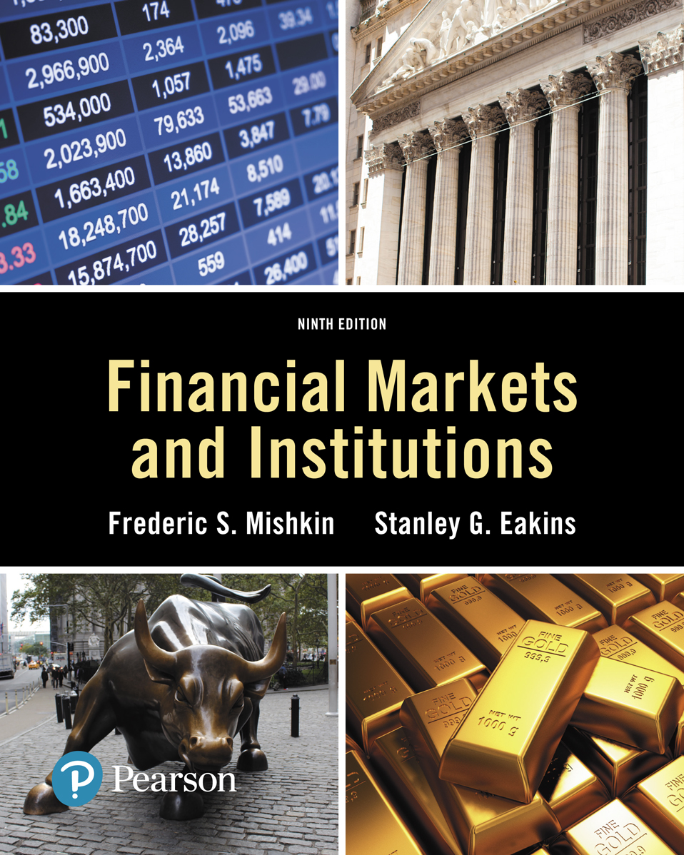
Lecture 7: Stock markets
Copyright © 2018, 2015, 2012 Pearson Education, Inc. All Rights Reserved
Notes:
If this PowerPoint presentation contains mathematical equations, you may need to check that your computer has the following installed:
1) MathType Plugin
2) Math Player (free versions available)
3) NVDA Reader (free versions available)
Slides in this presentation contain hyperlinks. JAWS users should be able to get a list of links by using INSERT+F7

Slide 2
Investing in stock
A share represents ownership in the firm.
Investors can earn return from stock in two ways: Dividend and capital gain.
Rights of shareholders:
Residual claimants
Voting rights
Common stock vs. preferred stock
Similar in terms of legal and tax perspectives
Different in terms of dividend, voting rights and priority over claims.

Slide 3
How stocks are sold?
Organised securities exchanges
Over-the-counter markets
Organised vs. over-the-counter
Organised is auction trading on a trading floor – specialist traders.
OTC have market makers (set the bid and ask prices)
Alternative trading systems (ATSs) and Multilateral trading facilities (MTFs)
bypass traditional exchanges and allow for buyers and sellers of securities to deal directly with each othe

Slide 4
How stocks are traded?
Exchange traded funds (ETFs)
ETFs are formed when a basket of securities is purchased and a stock is created based on this basket that is traded on an exchange
The common characteristics of ETFs:
1. They are listed and traded as individual stocks on a stock exchange.
2. They are indexed rather than actively managed.
3. Their value is based on the underlying net asset value of the stocks held in the index basket. The exact content of the basket is public so that intraday arbitrage keeps the ETF price close to the implied value.

Slide 5
Computing the price of common stock
The one period valuation model:
This assumes that you buy the stock, hold it for one period to get a dividend, then sell the stock.
P0 = D1/(1 + ke) + P1/(1 + ke)
where P0 = the current price of the stock. The zero subscript refers to time period zero, or the present. D1 = the dividend paid at the end of year 1. ke = the required return on investments in equity. P1 = the price at the end of the first year. This is the assumed sales price of the stock.

Slide 6
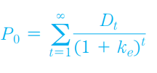
Computing the price of common stock (cont.)
The generalised dividend valuation model
The only cash flows that an investor will receive are dividends and a final sales price when the stock is ultimately sold.
P0 = D1/(1 + ke)¹ + D2/(1 + ke)² + ….+ Dn/(1 + ke)^{n} + Pn/(1 + ke)^{n}
The generalized dividend model is rewritten in Equation 3 without the final sales price.
Notes:
The generalized dividend model says that the price of stock is determined only by the present value of the dividends and that nothing else matters. Many stocks do not pay dividends, so how is it that these stocks have value? Buyers of the stock expect that the firm will pay dividends someday. Most of the time a firm institutes dividends as soon as it has completed the rapid growth phase of its life cycle. The stock price increases as the time approaches for the dividend stream to begin.

Slide 7
Computing the price of common stock (cont.)
The Gordon growth model:
With some simplifications, we obtain
This model is useful for finding the value of stock, given a few assumptions:
1. Dividends are assumed to continue growing at a constant rate forever.
2. The growth rate is assumed to be less than the required return on equity, ke .

Slide 8
Computing the price of common stock
Example:
Find the current market price of Coca-Cola stock, assuming dividends grow at a constant rate of 10.95%, D0 = $1.00, and the required return is 13%.

Slide 9
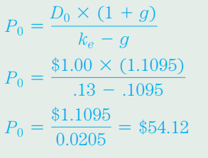
Computing the price of common stock (cont.)
Example (cont.)
Coca-Cola stock should sell for $54.12 if the assumptions regarding the constant growth rate and required return are correct.

Slide 10
Computing the price of common stock (cont.)
Price earnings valuation method
The price earnings ratio (PE) is a widely watched measure of how much the market is willing to pay for $1 of earnings from a firm.
1. A higher-than-average PE may mean that the market expects earnings to rise in the future. This would return the PE to a more normal level.
2. A high PE may alternatively indicate that the market feels the firm’s earnings are very low risk and is therefore willing to pay a premium for them.
Notes:
Firms in the same industry are expected to have similar PE ratios in the long run. The value of a firm’s stock can be found by multiplying the average industry PE times the expected earnings per share.

Slide 11
Computing the price of common stock (cont.)
Example:
The average industry PE ratio for restaurants similar to Applebee’s, a pub restaurant chain, is 23. What is the current price of Applebee’s if earnings per share are projected to be $1.13?

Slide 12
Computing the price of common stock (cont.)
Example (cont.):
P0 = P/E * E P0 = 23 * $1.13 = $26
The PE ratio approach is especially useful for valuing privately held firms and firms that do not pay dividends. The weakness of the PE approach to valuation is that by using an industry average PE ratio, firm-specific factors that might contribute to a long-term PE ratio above or below the average are ignored in the analysis. A skilled analyst will adjust the PE ratio up or down to reflect unique characteristics of a firm when estimating its stock price.

