Slide 1
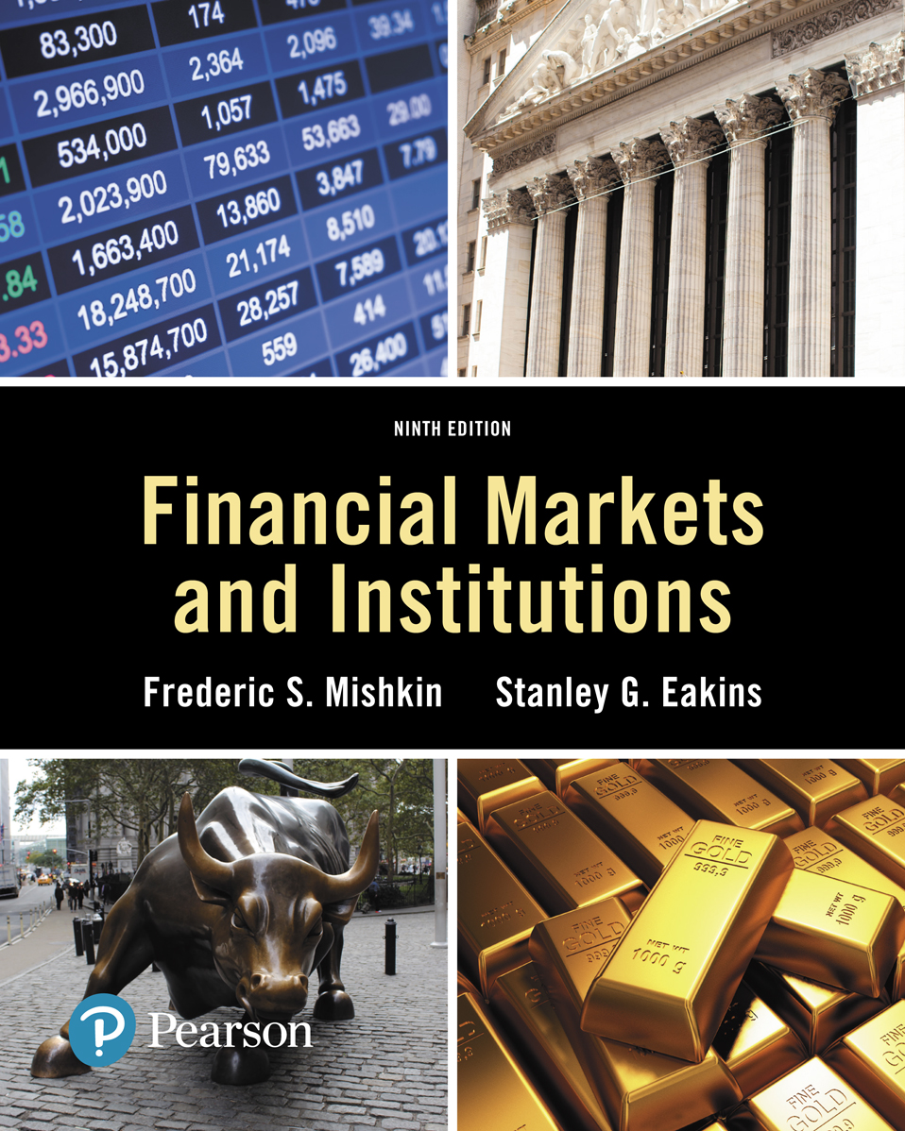
Lecture 3: Interest rates: Their meaning and their role in valuation
Copyright © 2018, 2015, 2012 Pearson Education, Inc. All Rights Reserved
Notes:
If this PowerPoint presentation contains mathematical equations, you may need to check that your computer has the following installed:
1) MathType Plugin
2) Math Player (free versions available)
3) NVDA Reader (free versions available)
Slides in this presentation contain hyperlinks. JAWS users should be able to get a list of links by using INSERT+F7

Slide 2
Lecture Preview
Interest rates are among the most closely watched variables in the economy. It is imperative that what exactly is meant by the phrase interest rates is understood.
In this lecture, we will see that a concept known as yield to maturity (Y T M) is the most accurate measure of interest rates.

Slide 3
Lecture Preview (cont.)
Any description of interest rates entails an understanding certain vernacular and definitions, most of which will not only pertain directly to interest rates but will also be vital to understanding many other foundational concepts presented later in the course.

Slide 4
Lecture Preview (cont.)
In this lecture, we will develop a better understanding of interest rates. We examine the terminology and calculation of various rates, and we show the importance of these rates in our lives and the general economy. Topics include:
Measuring Interest Rates
The Distinction Between Real and Nominal Interest Rates
The Distinction Between Interest Rates and Returns

Slide 5
Present Value Introduction
Different debt instruments have very different streams of cash payments to the holder (known as cash flows), with very different timing.
All else being equal, debt instruments are evaluated against one another based on the amount of each cash flow and the timing of each cash flow.
This evaluation, where the analysis of the amount and timing of a debt instrument’s cash flows lead to its yield to maturity or interest rate, is called present value analysis.

Slide 6
Present Value
The concept of present value (or present discounted value) is based on the commonsense notion that a dollar of cash flow paid to you one year from now is less valuable to you than a dollar paid to you today. This notion is true because you could invest the dollar in a savings account that earns interest and have more than a dollar in one year.
The term present value (P V) can be extended to mean the P V of a single cash flow or the sum of a sequence or group of cash flows.

Slide 7
Present Value Applications
There are four basic types of credit instruments which incorporate present value concepts:
Simple Loan
Fixed Payment Loan
Coupon Bond
Discount Bond

Slide 8
Present Value Concept: Simple Loan Terms
Loan Principal: the amount of funds the lender provides to the borrower.
Maturity Date: the date the loan must be repaid; the Loan Term is from initiation to maturity date.
Interest Payment: the cash amount that the borrower must pay the lender for the use of the loan principal.
Simple Interest Rate: the interest payment divided by the loan principal; the percentage of principal that must be paid as interest to the lender. Convention is to express on an annual basis, irrespective of the loan term.

Slide 9
Present Value Concept: Simple Loan
Simple loan of $100
Year: | 0 | 1 | 2 | 3 | n
Blank | $100 | $110 | $121 | 133 | 100 times left parenthesis 1 + i right parenthesis to the nth power

Slide 10
Present Value Concept: Simple Loan (cont.)
The previous example reinforces the concept that $100 today is preferable to $100 a year from now since today’s $100 could be lent (or deposited) at 10% interest to be worth $110 one year from now, or $121 in two years or $133 in three years.

Slide 11
Yield to Maturity: Loans
Yield to maturity = interest rate that equates today’s value with present value of all future payments
Simple Loan Interest Rate (i = 10%)

Slide 12
Example: Simple Present Value
What is the present value of $250 to be paid in two years if the interest rate is 15%?

Slide 13
Present Value Concept: Fixed-Payment Loan Terms
Simple Loans require payment of one amount which equals the loan principal plus the interest.
Fixed-Payment Loans are loans where the loan principal and interest are repaid in several payments, often monthly, in equal dollar amounts over the loan term.
Installment Loans, such as auto loans and home mortgages are frequently of the fixed-payment type.

Slide 14
Yield to Maturity: Loans
Fixed Payment Loan (i = 12%)

Slide 15
Yield to Maturity: Bonds
Coupon Bond (Coupon rate =
Consol: Fixed coupon payments of $C forever
Notes:
P = start fraction $ 100 over left parenthesis 1 + i right parenthesis end fraction + $ 100 over left parenthesis 1 + i right parenthesis squared end fraction + $ 100 over left parenthesis 1 + i right parenthesis cubed end fraction + ellipsis + $ 100 over left parenthesis 1 + i right parenthesis to the power 10 end fraction + $ 100 over left parenthesis 1 + i right parenthesis to the power 10 end fraction.
P = start fraction C over left parenthesis 1 + i right parenthesis end fraction + start fraction C over left parenthesis 1 + i right parenthesis squared end fraction + start fraction C over left parenthesis 1 + i right parenthesis cubed end fraction + ellipsis + start fraction C over left parenthesis 1 + i right parenthesis to the power n end fraction + start fraction F over left parenthesis 1 + i right parenthesis to the power n end fraction.

Slide 16
Yield to Maturity: Bonds (cont.)
One-Year Discount Bond (P = $900, F = $1000)

Slide 17
Yields to Maturity on a 10% Coupon Rate Bond Maturing in 10 Years (Face Value = $1,000)
Price of Bond($) | Yield to Maturity (%)
1,200 | 7.13
1,100 | 8.48
1,000 | 10.00
900 | 11.75
800 | 13.81
Three interesting facts in the Table above
When bond is at par, yield equals coupon rate
Price and yield are negatively related
Yield greater than coupon rate when bond price is below par value

Slide 18
Relationship Between Price and Yield to Maturity
It’s also straight-forward to show that the value of a bond (price) and yield to maturity (Y T M) are negatively related. If the interest rate i increases (Y T M increases), the P V of any given cash flow is lower; hence, the price of the bond must be lower.

Slide 19
Current Yield
Current yield (C Y) is just an approximation for Y T M - easier to calculate. However, we should be aware of its properties:
If a bond’s price is near par and has a long maturity, then C Y is a good approximation.
A change in the current yield always signals change in same direction as yield to maturity
Formula:

Slide 20
Yield on a Discount Basis
One-Year Bill (P = $900, F = $1000, days = 365)
Two Characteristics
Understates yield to maturity; longer the maturity, greater is understatement
Change in discount yield always signals change in same direction as yield to maturity

Slide 21
Global: Negative T-Bill Rates? It Can Happen
In November 1998, rates on Japanese 6-month government bonds were negative! Investors were willing to pay more than they would receive in the future.
Same thing happened in the U.S. in September of 2008, then Sweden (July 2009), Denmark (July 2012), the Eurozone (June 2014), Switzerland (December 2014), and Japan again in early 2016.
Best explanation is that investors found the convenience of the Treasury bills (in the U.S. case) worth something—more convenient than cash. But that can only go so far—the rate was only slightly negative.

Slide 22
Distinction Between Real and Nominal Interest Rates
Real interest rate
Interest rate that is adjusted for expected changes in the price level
Real interest rate more accurately reflects true cost of borrowing
When the real rate is low, there are greater incentives to borrow and less to lend

Slide 23
Distinction Between Real and Nominal Interest Rates (cont.)
Real interest rate
We usually refer to this rate as the ex ante real rate of interest because it is adjusted for the expected level of inflation. After the fact, we can calculate the ex post real rate based on the observed level of inflation.

Slide 24
Distinction Between Real and Nominal Interest Rates (3 of 3)
If i = 5% and
If i = 10% and

Slide 25
Real and Nominal Interest Rates (Three-Month Treasury Bill), 1953–2016
Sources: Federal Reserve Bank of St. Louis F R E D database
https://fred.stlouisfed.org/series/TB3MS
and
https://fred.stlouisfed.org/series/CPIAUCSL
. The real rate is constructed using the procedure
outlined in Frederic S. Mishkin, “The Real Interest Rate: An Empirical Investigation,” Carnegie–Rochester Conference Series on Public Policy 15 (1981): 151–200. This involves estimating expected inflation as a function of past interest rates, inflation, and time trends and then subtracting the expected inflation measure from the nominal interest rate.
Notes:
The horizontal axis lists dates from 19 55 to 20 15 in 5 year increments. The interest rate estimated real rate for the year 19 55 is shown as 1.5 percent which decreases down almost to 0 by the year 19 60. The interest rate, however, recovers back and reaches to a value of 1.75 by the year 19 65 but shows a declining trend once again thereafter and falls down to a value of negative 4 percent by the year 19 80. It shows a sudden growth thereafter and reaches to a value of 6 percent by 19 82. The interest rate for estimated real rate shows a net declining trend thereafter and falls down to 0 percent by 19 90 and to negative 4 percent by the year 20 10 but recovers back to 0 percent by the year 20 15.
The interest rate for nominal rate is shown as 2 percent for the year 19 95 and with the net growth rate over the years it reaches to a value of 15 percent by the year 19 80. The interest for nominal rate shows a net decline thereafter and falls down to a value of 0 percent by the year 20 10 and remain changed till 20 15. The values used in the description are approximate.

Slide 26
Distinction Between Interest Rates and Returns
Rate of Return: we can decompose returns into two pieces:
Return = Current Yield + Capital Gain Yield

Slide 27
One-Year Returns on Different-Maturity 10% Coupon Rate Bonds When Interest Rates Rise from 10% to 20%
Original maturity | Initial Current Yield (%) | Initial Price ($) | Price Next Year ($) | Rate of Capital Gain (%) | Rate of Return (%)
30 | 10 | 1,000 | 503 | negative 49.7 | negative 39.7
20 | 10 | 1,000 | 516 | negative 48.4 | negative 38.4
10 | 10 | 1,000 | 597 | negative 40.3 | negative 30.3
5 | 10 | 1,000 | 741 | negative 25.9 | negative 15.9
2 | 10 | 1,000 | 917 | negative 8.3 | 1.7
1 | 10 | 1,000 | 1,000 | 0 | 10
Sample of current coupon rates and yields on government bonds
http://www.bloomberg.com/markets/iyc.html

Slide 28
Maturity and the Volatility of Bond Returns (1 of 3)
Key findings from the above Table
Only bond whose return = yield is one with maturity = holding period
For bonds with maturity > holding period, as rates increase, price falls, implying capital loss
Longer is maturity, greater is price change associated with interest rate change

Slide 29
Maturity and the Volatility of Bond Returns
Key findings from the above Table
Longer is maturity, more return changes with change in interest rate
Thus
Prices and returns more volatile for long-term bonds because they have higher interest-rate risk
No interest-rate risk for any bond whose maturity equals holding period
Bond with high initial interest rate can still have
negative return if i

Slide 30
Reinvestment Risk
Occurs if investor holds a series of short bonds over long holding period
i at which reinvest uncertain
Gain from i
lose when i

Slide 31
Calculating Duration on a $1,000 Ten-Year 10% Coupon Bond When Its Interest Rate Is 10%
(1) | (2) | (3) | (4) | (5)
Year | Cash Payments (Zero-Coupon Bonds) ($) | Present Value (PV) of Cash Payments (i = 10%) ($) | Weights (% of total P V = start fraction P V over $1,000 end fraction, in % | Weighted Maturity start fraction 1 times 4 over 100 end fraction, in years
1 | 100 | 90.91 | 9.091 | 0.09091
2 | 100 | 82.64 | 8.264 | 0.16528
3 | 100 | 75.13 | 7.513 | 0.22539
4 | 100 | 68.30 | 6.830 | 0.27320
5 | 100 | 62.09 | 6.209 | 0.31045
6 | 100 | 56.44 | 5.644 | 0.33864
7 | 100 | 51.32 | 5.132 | 0.35924
8 | 100 | 46.65 | 4.665 | 0.37320
9 | 100 | 42.41 | 4.241 | 0.38169
10 | 100 | 38.55 | 3.855 | 0.38550
10 | 1,000 | 385.54 | 38.554 | 3.85500
Total | Blank | 1,000.00 | 100.000 | 6.75850

Slide 32
Calculating Duration on a $1,000 Ten-Year 10% Coupon Bond When Its Interest Rate Is 20%
(1) | (2) | (3) | (4) | (5)
Year | Cash Payments (Zero-Coupon Bonds) ($) | Present Value (PV) of Cash Payments (i = 20%) ($) | Weights (% of total P V = start fraction P V over $580.76 end fraction, in % | Weighted Maturity start fraction 1 times 4 over 100 end fraction, in years
1 | 100 | 83.33 | 14.348 | 0.14348
2 | 100 | 69.44 | 11.957 | 0.23914
3 | 100 | 57.87 | 9.965 | 0.29895
4 | 100 | 48.23 | 8.305 | 0.33220
5 | 100 | 40.19 | 6.920 | 0.34600
6 | 100 | 33.49 | 5.767 | 0.34602
7 | 100 | 27.91 | 4.806 | 0.33642
8 | 100 | 23.26 | 4.005 | 0.32040
9 | 100 | 19.38 | 3.337 | 0.30033
10 | 100 | 16.15 | 2.781 | 0.27810
10 | 1,000 | 161.51 | 27.808 | 2.78100
Total | Blank | 580.76 | 100.000 | 5.72204

Slide 33
Formula for Duration
Key facts about duration
All else equal, when the maturity of a bond lengthens, the duration rises as well
All else equal, when interest rates rise, the duration of a coupon bond fall
The higher the coupon rate on the bond, the shorter the duration of the bond
Duration is additive: the duration of a portfolio of securities is the weighted-average of the durations of the individual securities, with the weights equaling the proportion of the portfolio invested in each security
Notes:
D U R = Sigma from t = 1 to n of t start fraction C P sub t over left parenthesis 1 + i right parenthesis to the power t over sigma from t = 1 to n start fraction C P sub t over left parenthesis 1 + i right parenthesis to the power t.

Slide 34
Duration and Interest-Rate Risk
Duration can be used to show that the approximate change in price is related to duration, as follows:
i
10% to 11%:
Using the duration from the first table (10% coupon bond)

Slide 35
Duration and Interest-Rate Risk (2 of 3)
i
10% to 11%:
Using the duration from second table 20% coupon bond, DUR = 5.72 years

Slide 36
Duration and Interest-Rate Risk
The greater the duration of a security, the greater the percentage change in the market value of the security for a given change in interest rates
Therefore, the greater the duration of a security, the greater its interest-rate risk

Slide 37
Summary
Measuring Interest Rates: We examined several techniques for measuring the interest rate required on debt instruments.
The Distinction Between Real and Nominal Interest Rates: We examined the meaning of interest in the context of price inflation.
The Distinction Between Interest Rates and Returns: We examined what each means and how they should be viewed for asset valuation.

