Slide 1
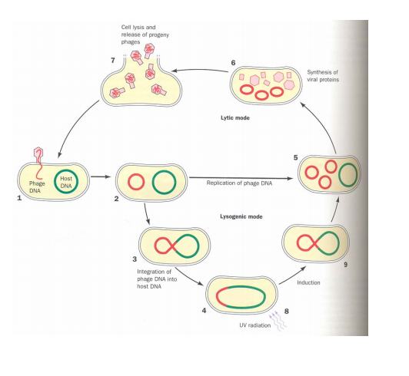
Phage lambda
Après l’intégration de l’ADN du phage dans E. coli, il se circularise puis s’intègre dans le chromosome de la cellule c’est la phase lysogène. Si il reste dans la cellule il peut se répliquer de façon autonome. La phase lytique est déclenchéee quand le phage est exposé aux rayons UV

Slide 2
Phage lambda
Bacteriophage vectors:
-la tete du phage lambda capable d’accepter 20kb length et la partie centrale du genome du phage n’est pas requise pour la replication ou l’empaquetage du virus. On peut donc la remplacer par le gène d’intérêt.
-vecteur recombinant est empaquté naturellement dans la tête du phage.
-la presence du vecteur recombinant peut être sélectionné à cause du mécanisme lytique.
- grande efficacité.

Slide 3
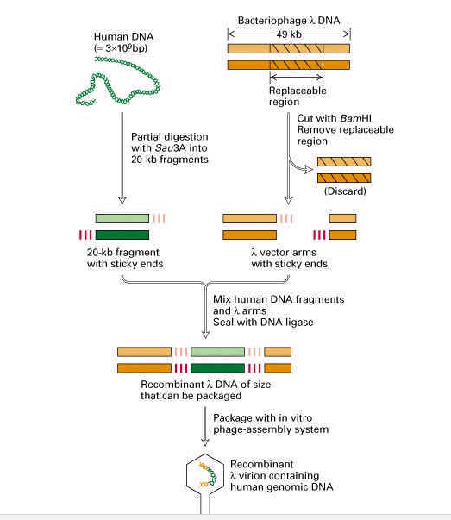

Slide 5
Adenoviral vectors:
• Double-stranded DNA viruses, usually cause benign respiratory disease; serotypes 2 and 5 are used as vectors.
• Can infect dividing and non-dividing cells, can be produced at high titers.
• Replication-deficient adenovirus vectors can be generated by replacing the E1 or E3 gene, which is essential for replication.
• The recombinant vectors are then replicated in cells that express the products of the E1 or E3 gene and can be generated in very high concentrations.
• Cells infected with recombinant adenovirus can express the therapeutic gene, but because essential genes for replication are deleted, the vector can’t replicate.

Slide 7
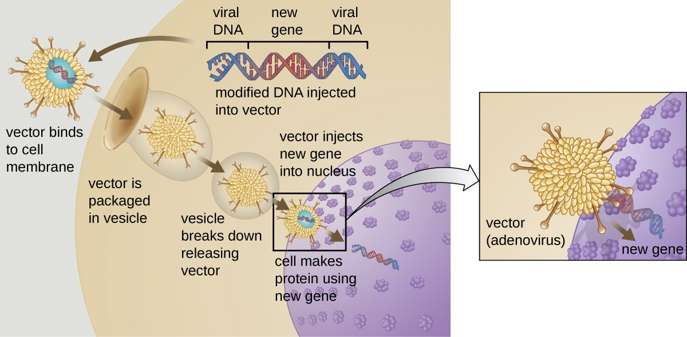

Slide 8
Adenoviral vectors
Non-enveloped ds DNA, 36 kilobases
Early proteins (E1A, E1B, E2,E3 and E4), late proteins (L1-L5)
Causes a benign respiratory infections in human

Slide 9
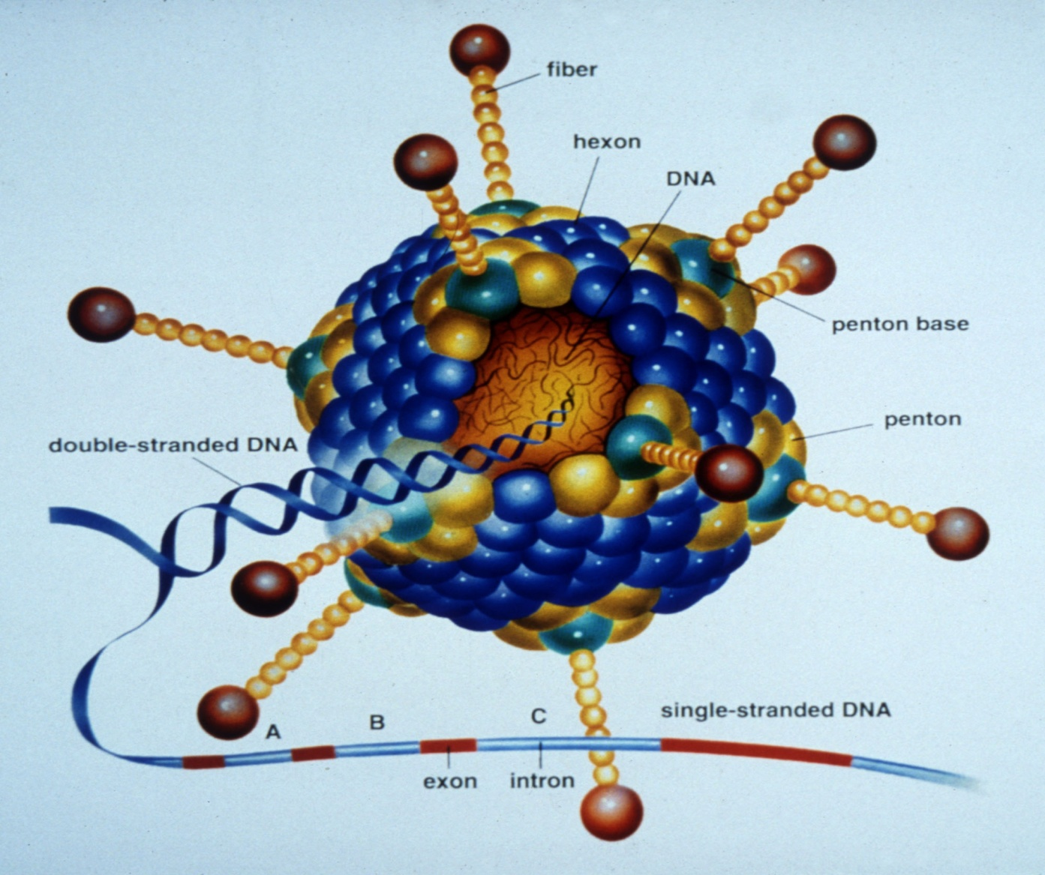
Adenovirus particle structure:
• Nonenveloped particle
• Contains linear double stranded DNA
• Does not integrate into the host genome
• Replicates as an episomal element in the nucleus

Slide 10
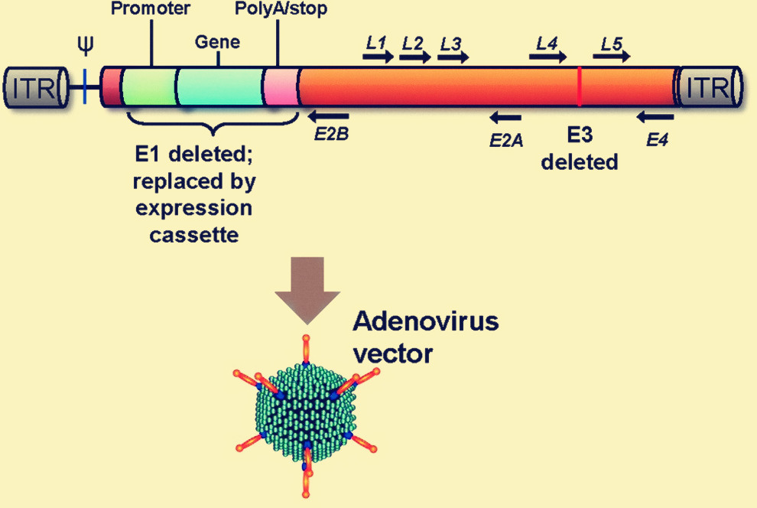

Slide 11
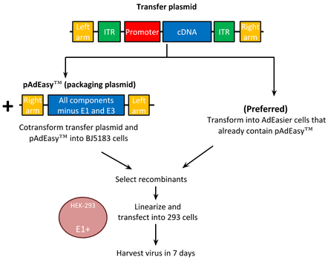

Slide 12
Death of 18-year old Jesse Gelsinger
Liver disease: OTC deficiency (genetic disease)
Ornithine transcarbamylase deficiency is an inherited disorder that causes ammonia to accumulate in the blood. Ammonia, which is formed when proteins are broken down in the body, is toxic if the levels become too high. The nervous system is especially sensitive to the effects of excess ammonia.
University of Pennsylvania
High dose of adenoviral vector (E1 and E4 genes
deleted ) carrying the normal copy of OTC gene was administered
Suspected cause of death
Toxicity of high titer adenoviral vector
High immunogenicity of adenoviral vector (an immune revolt)

Slide 13
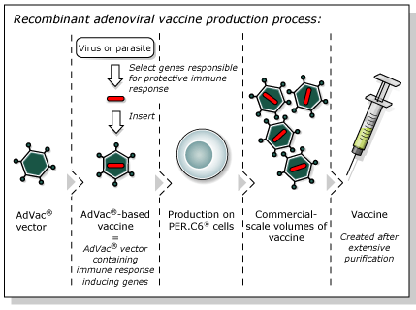

Slide 14
Adeno-associated virus vectors
Non-pathogenic human parvovirus, non-enveloped ss DNA virus, 4.6 kilobases
Dependent on a helper virus ( adenovirus or herpesvirus) for replication (dependovirus)
AAV-2 mostly used for vector

Slide 15
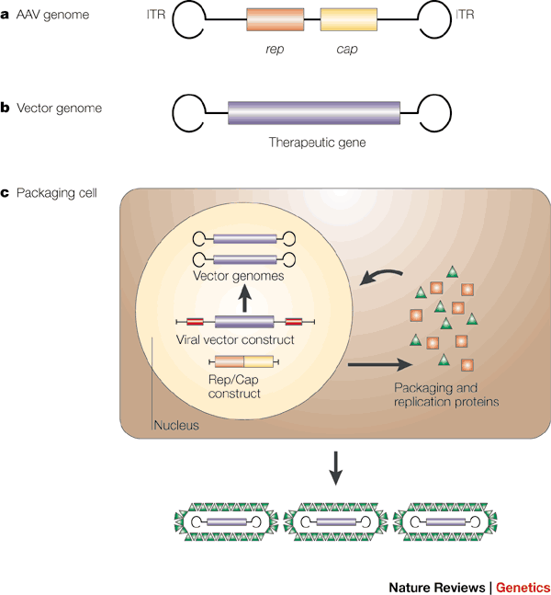
AAV vectors:

Slide 16
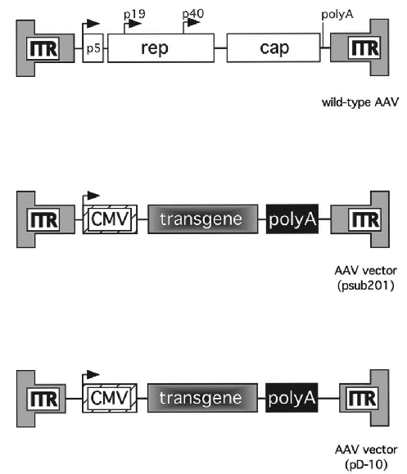
Generation of adeno-associated virus vector

Slide 17
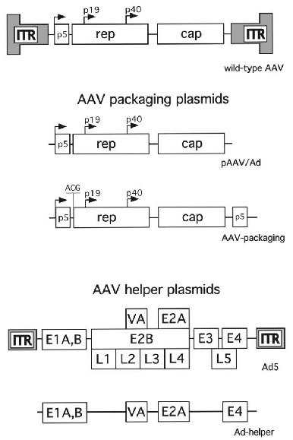

Slide 18
Characteristics of AAV vector
Advantages
Integration and persistent expression
No insertional mutagenesis
Infecting dividing and nondividing cells
Safe
Disadvantages
Size limitation, 4.9 kb
Low titer of virus, low level of gene expression

Slide 19
Selected clinical trials using AAV-based vectors[24]
Indication | Gene | Route of administration | Phase | Subject number | Status
Cystic fibrosis | CFTR | Lung, via aerosol | I | 12 | Complete
 | CFTR | Lung, via aerosol | II | 38 | Complete
 | CFTR | Lung, via aerosol | II | 100 | Complete
Hemophilia B | FIX | Intramuscular | I | 9 | Complete
 | FIX | Hepatic artery | I | 6 | Ended
Arthritis | TNFR:Fc | Intraarticular | I | 1 | Ongoing
Hereditary emphysema | AAT | Intramuscular | I | 12 | Ongoing
Leber's congenital amaurosis | RPE65 | Subretinal | I–II | Multiple | Several ongoing and complete (voretigene neparvovec)
Age-related macular degeneration | sFlt-1 | Subretinal | I–II | 24 | Ongoing
Duchenne muscular dystrophy | SGCA | Intramuscular | I | 10 | Ongoing
Parkinson's disease | GAD65, GAD67 | Intracranial | I | 12 | Complete^{[25]}
Canavan disease | AAC | Intracranial | I | 21 | Ongoing
Batten disease | CLN2 | Intracranial | I | 10 | Ongoing
Alzheimer's disease | NGF | Intracranial | I | 6 | Ongoing
Spinal muscular atrophy | SMN1 | Intravenous, intrathecal | I–III | 150+ | Several ongoing and complete (onasemnogene abeparvovec)
Congestive heart failure | SERCA2a | Intra-coronary | IIb | 250 | Ongoing

Slide 22
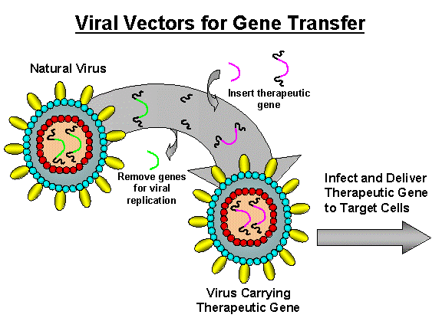

Slide 23
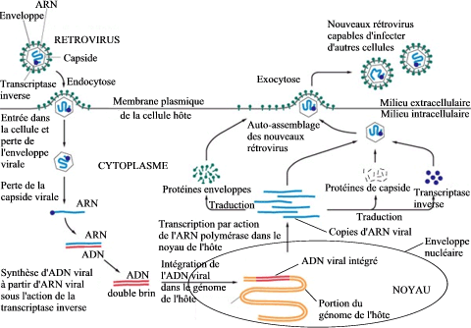
Cycle de vie

Slide 24
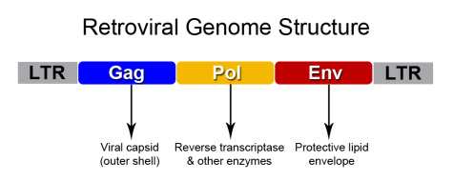

Slide 25
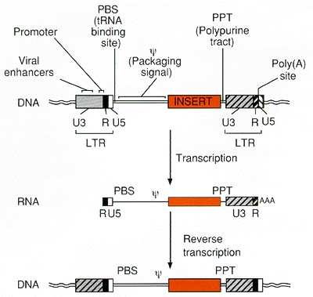
promoteur et signal de polyadenylation
(2) signal d’encapdidation (ψ or E) pour diriger l’incorporation du vecteur RNA dans les virions;
(3) signaux requis pour la transcription inverse, incluant un transfer RNA-binding site (PBS) et polypurine tract (PPT) pour l’initiation de la synthèse du 1er et 2ème brin d’AND et une region repetée (R) aux deux extrémités de l’ARN viral requis pour le transfert de synthèse d’AND entre les matrices (4) répétitions courtes inversées localisés aux termini des LTRs viraux requis pour l’integration.

Slide 26
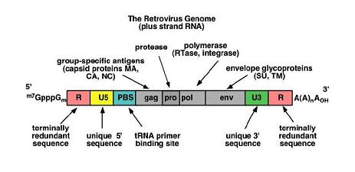

Slide 27
Efficient gene transduction and integration depend on the inclusion in the retroviral vector of a number of cis-acting viral elements These include (1) a promoter and polyadenylation signal in the viral genome; (2) a viral packaging signal (ψ or E) to direct incorporation of vector RNA into virions; (3) signals required for reverse transcription, including a transfer RNA-binding site (PBS) and polypurine tract (PPT) for initiation of first- and second-strand DNA synthesis, and a repeated (R) region at both ends of the viral RNA required for transfer of DNA synthesis between templates; and (4) short, partially inverted repeats located at the termini of the viral LTRs required for integration.

Slide 29
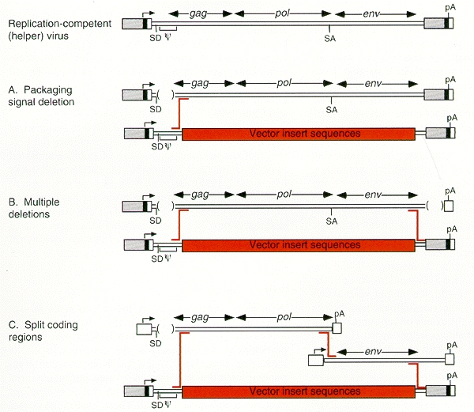
Strategies for packaging cell line construction. A generic helper virus modeled on Moloney murine leukemia virus (Mo-MLV) is shown at top.

Slide 30
A case of leukemia in a SCID child treated with a retroviral vector
SCID disease or ‘Bubble boy disease’ ( T cell deficiency)
Overall quite successful, over 1000 peoples received retroviral gene therapy
A French baby’s treated with retroviral vector 3 years ago
A leukemia-like illness.
Nine other children treated same time show no sign of leukemia
But the side effect isn’t a big enough risk yet that genetic experiments for children with an often fatal immune disease should stop
People receiving retroviral gene therapy should be warned about the risk of developing leukemia

Slide 31
Characteristics of retroviral vector
Advantages
Integration: permanent expression
Disadvantages
Only infecting dividing cells
Insertional mutagenesis (tumor formation)
Activate oncogenes
Inhibit tumor suppressor genes
Most replication-defective retroviral vectors have been derived from the murine and avian retroviruses, but vectors have also been derived from bovine leukemia virus

Slide 32
Replication Deficient Viral Vectors: Genetically Engineered So The Viral Infection Cannot Spread
The viral DNA does not contain the viral genes needed to make more viruses.
Viral DNA
Gene of Interest
Virus
Target Cell Infected With Viral DNA Containing The Gene of Interest
Cell’s DNA
Target Cell
No New Viral Particles are Created
Infection dose not spread

Slide 33
Rescue of Replication Deficient Viruses by superinfection with Wild Viruses
Wild
Virus
Viral DNA
Gene of Interest
Virus
Target Cell
Cell’s DNA
Complementation:
The genome from the wild virus provides the missing proteins needed for the viral vector to replicate. The superinfected cell functions similarly to a packaging line.

Slide 34
Rescue of Replication Deficient Viruses
by superinfection with Wild Viruses
Wild
Virus
Viral DNA
Gene of Interest
Virus
Target Cell
Cell’s DNA
Recombination:
The genome from the wild virus randomly recombines with the viral vector, providing sufficient genetic material for the viral vector to replicate. The resulting rescued virus may possess pieces of the original insert gene. The viral genome is impossible to predict due to random recombination. The virus may exhibit altered virulence.

Slide 35
Risks Associated with Retroviruses: Insertional Mutagenesis
Viral DNA
Gene of Interest
Virus
Target Cell
Host Cell DNA
Oncogene
Proto-Oncogene
Random integration of viral genome may
disrupt endogenous host genes. Of special concern
Is disruption of proto-oncogenes, which can lead
to increased cancer risk.

Slide 36
Risks Associated with Retroviral Vectors: Viral Transduction
Viral DNA
Gene of Interest
Virus
Target Cell Infected With Viral DNA Containing The Gene of Interest
Target Cell
Cell’s DNA
Individuals infected with the viral vector may express the insert gene at the site of infection.

Slide 37
Lentivirus (du latin lenti, signifiant « lent ») est un genre de la famille des retroviridae ayant pour caractéristiques essentielles d'avoir une longue période d'incubation et d'être cytopathogène, c'est-à-dire de tuer les cellules qu'ils infectent.

Slide 38
Lentiviral vectors
Infection of non-dividing cells (hepatocytes, neurons)
HIV, a human lethal pathogen
Delete accessory genes
Provide an envelope from a non-retrovirus (VSV)
Develop vectors from lentiviruses of non-human pathogens
FIV, Feline Immunodeficiency Virus
• Low cellular immune response, thus good possibility for in vivo gene delivery with sustained expression over six months.
No potent antibody response
•.

Slide 39
Design of Replication Incompetent Lentiviral Vectors (3rd Generation)
The viral vector is “gutted” as much as possible to create room for the insert gene and to divide the viral genome into cis- and trans- acting regions
∆
Promoter and Insert Gene
∆
LTR Ψ LTR
gag pol env
Modified LTR
To impede the
Virus from
Performing more
Than one round
Of reverse
Transcription
“self inactivating”
Transfer Vector
Packaging
Vector
Envelope
Vector
Regulatory Signals (LTR and ψ), promoter and Insert Gene
Structural & Packaging Genes (may already be present in packaging line)
Viral envelope protein alters host range of the viral vector

Slide 40
1) a multiple cloning site for the insertion of various expression cassettes and 2) flanking long-terminal repeats (LTR) that have several distinct functions. First, the 5-LTR can act like an RNA pol II promoter. Second, the 3-LTR acts to terminate transcription and promote polyadenylation. Third, the LTR has recognition sequences necessary for integration into the genome. The RNA vector genome is ultimately reverse transcribed and integrated into the genomic DNA as a provirus using viral proteins obtained from the structural and packaging plasmids in trans during vector production

Slide 41
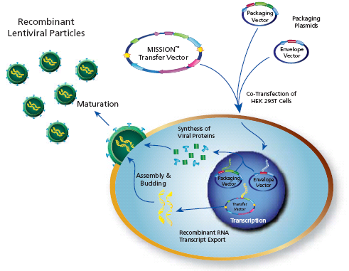
Packaging Recombinant Lentiviral Particles
The three plasmids containing the viral genome components are transfected into the packaging line to create the infectious viral particles.
Multiple plasmids are used so multiple recombination events would be required to reconstitute a replication competent virus.
www.sigma.com/RNAI

Slide 42
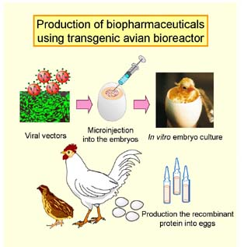

Slide 43
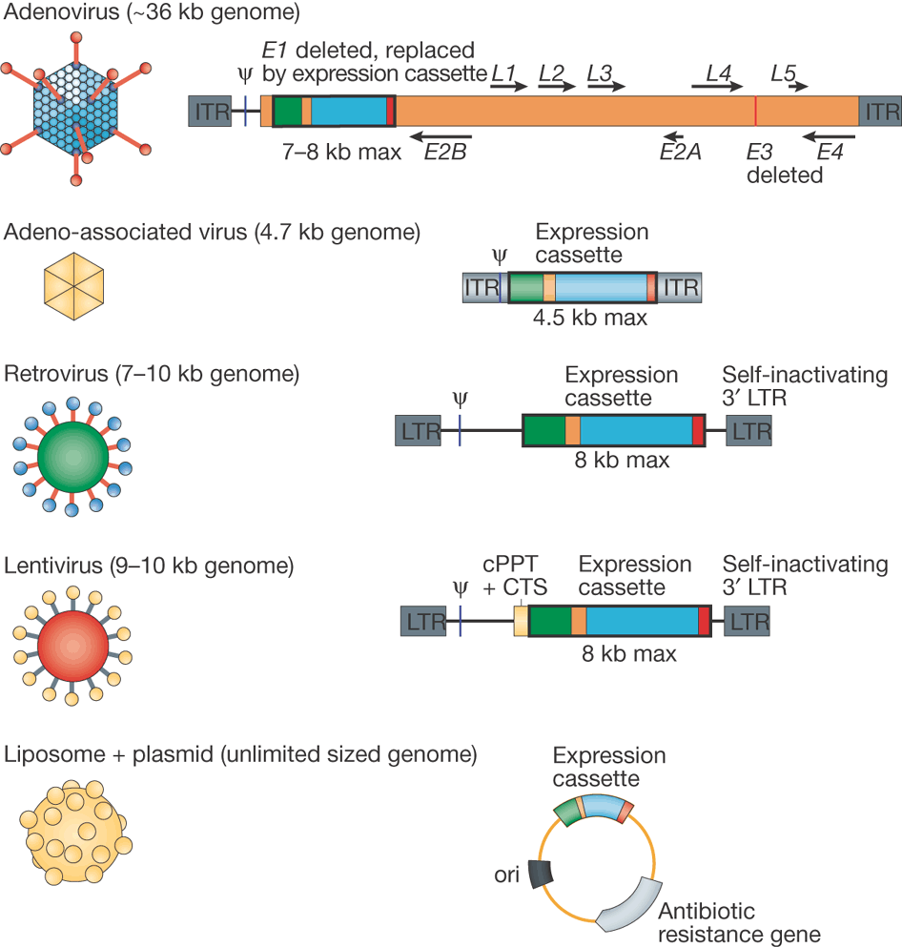

Slide 45
Adeno-associated virus vectors:
Advantages:
All viral genes removed
Safe
Transduction of nondividing cells
Stable expression
Disadvantages:
Small genome limits size of foreign DNA
Labor intensive production
Status of genome not fully elucidated

Slide 46
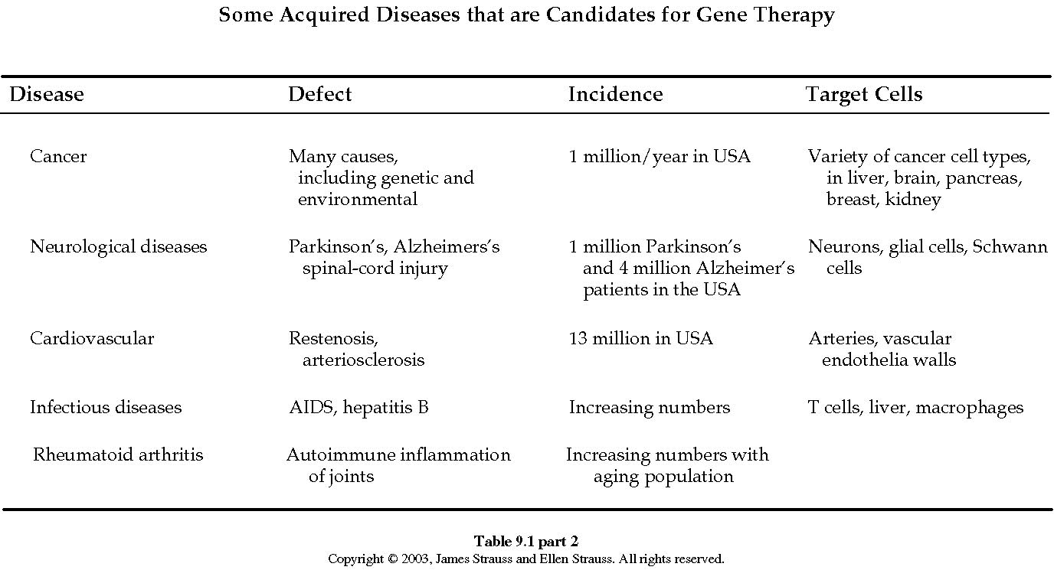

Slide 47
