Slide 1


Lectures 1& 2: Overview of the Financial System
Ninth Edition
Copyright © 2018, 2015, 2012 Pearson Education, Inc. All Rights Reserved
Notes:
If this PowerPoint presentation contains mathematical equations, you may need to check that your computer has the following installed:
1) MathType Plugin
2) Math Player (free versions available)
3) NVDA Reader (free versions available)
Slides in this presentation contain hyperlinks. JAWS users should be able to get a list of links by using INSERT+F7

Slide 2
Overview of Financial Markets and Institutions
Ninth Edition
Part 1: Why Study Financial Markets and Institutions?
Notes:
If this PowerPoint presentation contains mathematical equations, you may need to check that your computer has the following installed:
1) MathType Plugin
2) Math Player (free versions available)
3) NVDA Reader (free versions available)
Slides in this presentation contain hyperlinks. JAWS users should be able to get a list of links by using INSERT+F7

Slide 3
Lecture 1: Why study financial markets and institutions?
Outline:
Why study financial markets and institutions?
Debt markets and interest rates
The stock markets
The foreign exchange markets
Why study financial institutions
Summary and conclusion

Slide 4
Why Study Financial Markets?
Financial markets are crucial in our economy.
Channel funds from savers to investors, promoting economic efficiency.
Market activity affects: personal wealth, business firms, and economy
Well functioning financial markets are key factors in producing high economic growth.

Slide 5
Debt Markets & Interest Rates
Debt markets allow governments, corporations, and individuals to borrow.
Borrowers issue a security, called a bond, offering interest and principal over time.
The interest rate is the cost of borrowing.
Many types of market interest rates: mortgage rates, car loan rates, credit card rates, etc.
The level of these rates are important. For example, mortgage rates in the early part of 1983 exceeded 13%.

Slide 6
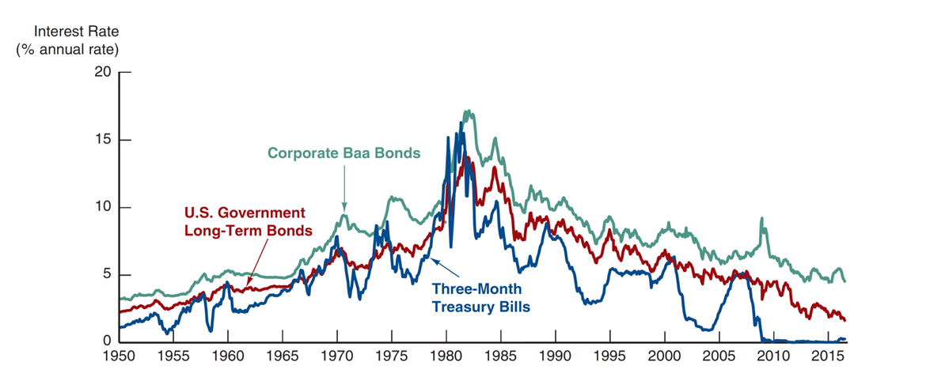
Figure 1.1 Interest Rates on Selected Bonds, 1950–2016
Source: Federal Reserve Bank of St. Louis, F R E D database:
https://fred.stlouisfed.org/series/TB3MS
;
https://fred.stlouisfed.org/series/GS10
;
https://fred.stlouisfed.org/series/BAA
.
Notes:
The vertical axis is labeled, Interest Rate in percent annual rate ranging from 0 to 20 in increments of 5. The horizontal axis lists dates from 19 50 to 20 15 in increments of 5. Three lines are plotted on the graph. The data shown in the graph are as follows. All values are approximate. Interest Rate for Three-Month Treasury Bills are 19 50, 1. 19 55, 0.75, 19 60, 2.5. 19 65, 4. 19 70, 7. 19 75, 5.5. 19 80, 15. 19 85, 7.5. 19 90, 7.5. 19 95, 6. 2000, 7. 2005, 2. 20 10, 0. 20 15, 0. Interest rate for U S Government Long Term Bonds are 19 50, 2. 19 55, 2.5, 19 60, 3.5. 19 65, 4. 19 70, 7. 19 75, 7.5. 19 80, 12. 19 85, 11. 19 90, 8.5. 19 95, 7.5. 2000, 7. 2005, 6. 20 10, 5. 20 15, 2. Interest rate for Corporate Baa Bonds are 19 50, 3.5. 19 55, 3.5, 19 60, 5. 19 65, 4.75. 19 70, 9. 19 75, 11. 19 80, 12.5. 19 85, 12. 19 90, 10. 19 95, 10. 2000, 9.5. 2005, 6.5. 20 10, 7. 20 15, 5.

Slide 7
The Stock Market
The stock market is the market where common stock (or just stock) are traded.
Companies initially sell stock (in the primary market) to raise money. After that, the stock is traded among investors.
The stock market receives the most attention from the media.

Slide 8
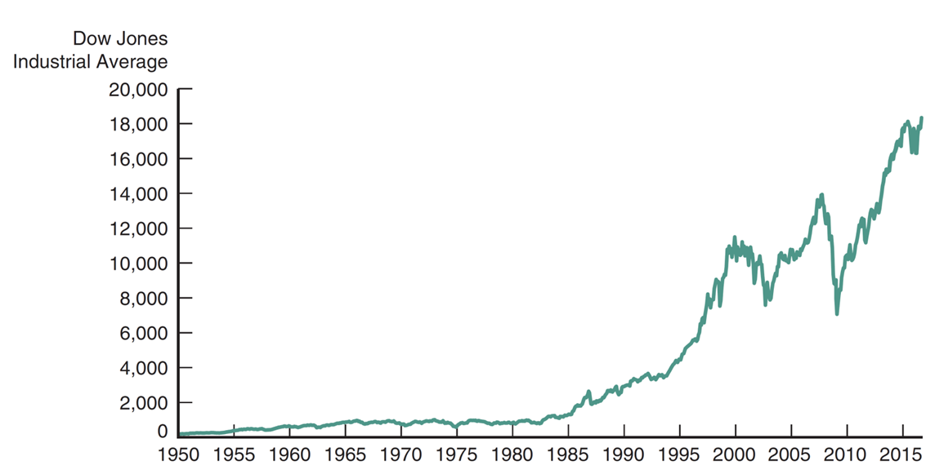
Figure 1.2 Stock Prices as Measured by the Dow Jones Industrial Average, 1950–2016
Source: Federal Reserve Bank of St. Louis, F R E D database:
https://fred.stlouisfed.org/series/DJIA
.
Notes:
The vertical axis is labeled, Dow Jones Industrial Average and ranges from 0 to 20,000 in increments of 2,000. The horizontal axis lists dates from 19 50 to 20 15 in increments of 5. The data shown in the graph are as follows. 19 50, 100. 19 55, 200. 19 60, 500. 19 65, 600. 19 70, 500. 19 75, 500. 19 80, 500. 19 85, 1400. 19 90, 3000. 19 95, 4500. 2000, 11,000. 2005, 11,000. 20 10, 10,000. 20 15, 18,000. All values are approximate.

Slide 9
The Stock Market
Companies, not just individuals, also watch the market.
Often seeking additional funding
The success of S E O s is dependent on the company’s stock

Slide 10
The Foreign Exchange Market
The foreign exchange market is where international currencies trade and exchange rates are set.
Although most people know little about this market, it has a daily volume around $5 trillion!

Slide 11
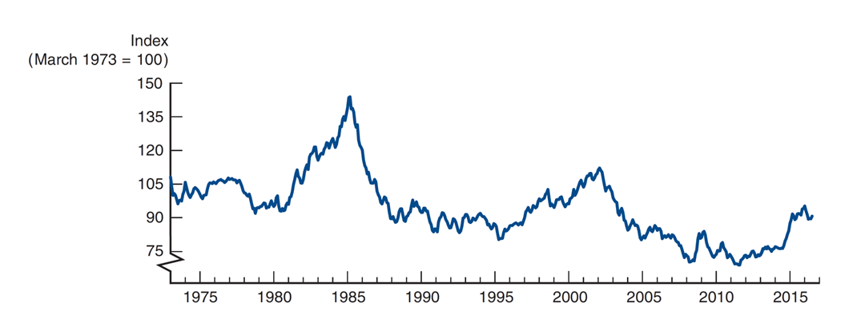
Figure 1.3 Exchange Rate of the U.S. Dollar, 1970–2016
Source: Federal Reserve Bank of St. Louis, F R E D database:
https://fred.stlouisfed.org/series/TWEXMMTH
.
Notes:
The vertical axis is labeled, Index, March 19 73 = 100 and ranges from 75 to 150 in increments of 15, with a kink at the origin. The horizontal axis lists years from 19 75 to 20 15 in increments of 5. The data shown in the graph are as follows. 19 75, 100. 19 80, 95. 19 85, 145. 19 90, 90. 19 95, 80. 2000, 95. 2005, 80. 20 10, 75. 20 15, 75. All values are approximate.

Slide 12
The Foreign Exchange Market (2 of 3)
These fluctuations matter!
  In recent years, consumers have found that vacationing in Europe is expensive, due to a weakening dollar relative to the Euro.
  When the dollar strengthens, foreign purchase of domestic goods falls.

Slide 13
Why Study Financial Institutions?
We will also spend considerable time discussing financial institutions - the corporations, organizations, and networks that operate the so-called “marketplaces.” We will look at:
Structure of the Financial System
  Helps funds move from savers to investors, typically through financial intermediaries
Financial Crises
  The “Great Recession” of 2007–2009 was the worst financial crisis since the Great Depression. Why did it happen?

Slide 14
Why Study Financial Institutions?
Central Banks and the Conduit of Monetary Policy
  The role of the Fed, and foreign counterparts, in the management of interest rates and the money supply
The International Financial System
  Capital flows between countries impacts domestic economies
  Need to understand exchange rates, capital controls, and the role of agencies such as the I M F

Slide 15
Why Study Financial Institutions?
Banks and Other Financial Institutions
  Includes the role of insurance companies, mutual funds, pension funds, etc.
Financial Innovation
  Focusing on improvements in technology and the impact on financial product delivery
Managing Risk in Financial Institutions
  Focusing on risk management in the financial institution

Slide 16
Applied Managerial Perspective
Financial institutions are among the largest employers in the U.S. and often pay high salaries.
Knowing how financial institutions are managed may help you better deal with them.

Slide 17
Concluding Remarks
This field is an exciting one, and this course will help you develop skills to further your career and your understanding of financial events.
You will also have a better understanding of the controversies to hotly debated in the political arena.

Slide 18
Summary
Why Study Financial Markets?: the three primary markets (bond, stock, and foreign exchange) were briefly introduced.
Why Study Financial Institutions?: the market, institutions, and key changes affecting these were outlined.

Slide 19
Lecture 2: Overview of the financial system
Outline:
  Overview
  Function of financial markets
  Segments of financial markets
  Importance of financial markets
  Internationalisation of financial markets
  Functions of financial intermediaries
  Types of financial intermediaries
  Regulations of financial markets and institutions

Slide 20
Overview
Suppose you want to start a business manufacturing a household cleaning robot, but you have no funds.
At the same time, Walter has money he wishes to invest for his retirement.
If the two of you could get together, perhaps both of your needs can be met. But how does that happen?
As simple as this example is, it highlights the importance of financial markets and financial intermediaries in our economy.
We need to acquire an understanding of their general structure and operation before we can appreciate their role in our economy.

Slide 21
Overview (cont.)
In this lecture, we examine the role of the financial system in an advanced economy. We study the effects of financial markets and institutions on the economy, and look at their general structure and operations. Topics include:
  Function of Financial Markets
  Structure of Financial Markets
  Internationalization of Financial Markets
  Function of Financial Intermediaries: Indirect Finance
  Types of Financial Intermediaries
  Regulation of the Financial System

Slide 22
Function of Financial Markets
Channels funds from person or business without investment opportunities (i.e., “Lender-Savers”) to one who has them (i.e., “Borrower-Spenders”)
Improves economic efficiency

Slide 23
Segments of Financial Markets
Direct Finance
  Borrowers borrow directly from lenders in financial markets by selling financial instruments which are claims on the borrower’s future income or assets
Indirect Finance
  Borrowers borrow indirectly from lenders via financial intermediaries (established to source both loanable funds and loan opportunities) by issuing financial instruments which are claims on the borrower’s future income or assets

Slide 24
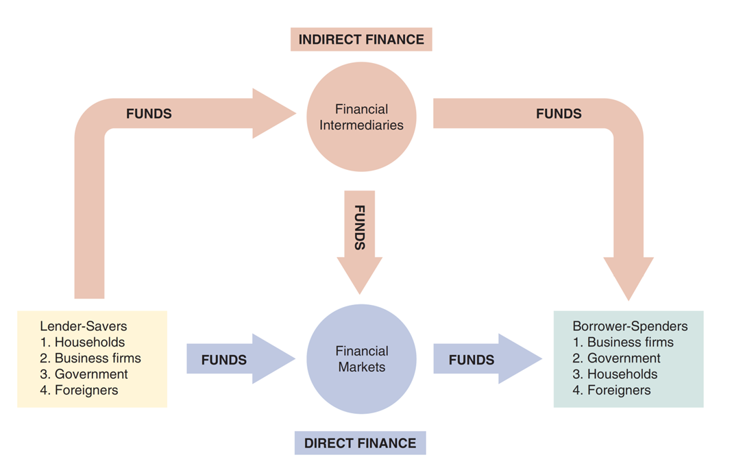
Figure 2.1 Flows of Funds Through the Financial System
Notes:
The diagram shows that in direct finance financial market gets funds from lender savers such as households, business firms, government, and foreigners and from financial intermediaries and provides funds to borrower spenders such as business firms, government, households, and foreigners. In case of indirect finance, financial intermediaries get funds from lender savers such as households, business firms, government, and foreigners and provide funds to borrower spenders such as business firms, government, households, and foreigners and to the financial markets.

Slide 25
Importance of Financial Markets
This is important. For example, if you save $1,000, but there are no financial markets, then you can earn no return on this - might as well put the money under your mattress.
However, if a carpenter could use that money to buy a new saw (increasing her productivity), then she is willing to pay you some interest for the use of the funds.
Financial markets are critical for producing an efficient allocation of capital, allowing funds to move from people who lack productive investment opportunities to people who have them.
Financial markets also improve the well-being of consumers, allowing them to time their purchases better.

Slide 26
Structure of Financial Markets
Debt Markets
  Short-Term (maturity < 1 year)
  Long-Term (maturity > 10 year)
  Intermediate term (maturity in-between)
  Represented $39.7 trillion at the end of 2015.
Equity Markets
  Pay dividends, in theory forever
  Represents an ownership claim in the firm
  Total value of all U.S. equity was $35.7 trillion at the end of 2015.

Slide 27
Structure of Financial Markets (cont.)
Primary Market
  New security issues sold to initial buyers
  Typically involves an investment bank who underwrites the offering
Secondary Market
  Securities previously issued are bought and sold
  Examples include the N Y S E and Nasdaq
  Involves both brokers and dealers (do you know the difference?)

Slide 28
Structure of Financial Markets (cont.)
Even though firms don’t get any money, per se, from the secondary market, it serves two important functions:
Provides liquidity, making it easy to buy and sell the securities of the companies
Establishes a price for the securities (useful for company valuation)

Slide 29
Structure of Financial Markets (cont.)
We can further classify secondary markets as follows:
Exchanges
  Trades conducted in central locations (e.g., New York Stock Exchange, C B T)
Over-the-Counter Markets
  Dealers at different locations buy and sell
  Best example is the market for Treasury Securities

Slide 30
Classifications of Financial Markets
We can also classify markets by the maturity of the securities:
Money Market: Short-Term (maturity < 1 year)
Capital Market: Long-Term (maturity > 1 year) plus equities (no maturity)

Slide 31
Internationalization of Financial Markets
The internationalization of markets is an important trend. The U.S. no longer dominates the world stage.
International Bond Market & Eurobonds
  Foreign bonds
    Denominated in a foreign currency
    Targeted at a foreign market
  Eurobonds
    Denominated in one currency, but sold in a different market
    Now larger than U.S. corporate bond market
    Over 80% of new bonds are Eurobonds

Slide 32
Internationalization of Financial Markets (cont.)
Eurocurrency Market
  Foreign currency deposited outside of home country
  Eurodollars are U.S. dollars deposited, say, London.
  Gives U.S. borrows an alternative source for dollars.
World Stock Markets
  U.S. stock markets are no longer always the largest—at one point, Japan’s was larger

Slide 33
Internationalization of Financial Markets (cont.)
As the next slide shows, the number of international stock market indexes is quite large. For many of us, the level of the Dow or the S&P 500 is known. How about the Nikkei 225? Or the F T S E 100? Do you know what countries these represent?

Slide 34
Internationalization of Financial Markets (cont.)
> Following the Financial News
Foreign Stock Market Indexes | Blank
Foreign stock market indexes are published daily in newspapers and Internet sites such as http://www.finance.yahoo.com/ . The most important of these stock market indices are: Dow Jones Industrial Average (D J I A) An index of the 30 largest publicly traded corporations in the United States maintained by the Dow Jones Corporation. S&P 500 An index of 500 of the largest companies traded in the United States maintained by Standard & Poor’s. Nasdaq Composite An index for all the stocks that trade on the Nasdaq stock market, where most of the technology stocks in the United States are traded. | F T S E 100 An index of the 100 most highly capitalized U K companies listed on the London Stock Exchange. D A X An index of the 30 largest German companies trading on the Frankfurt Stock Exchange. C A C 40 An index of the largest 40 French companies traded on Euronext Paris. Hang Seng An index of the largest companies traded on the Hong Kong stock markets. Strait Times An index of the largest 30 companies traded on the Singapore Exchange.

Slide 35
Global Perspective: Relative Decline of U.S. Capital Markets
The U.S. has lost its dominance in many industries: automobiles and consumer electronics, to name a few.
A similar trend appears at work for U.S. financial markets, as London and Hong Kong compete. Indeed, many U.S. firms use these markets over the U.S.
Why?
New technology in foreign exchanges
9–11 made U.S. regulations tighter
Greater risk of lawsuit in the U.S.
Sarbanes-Oxley has increased the cost of being a U.S.-listed public company

Slide 36
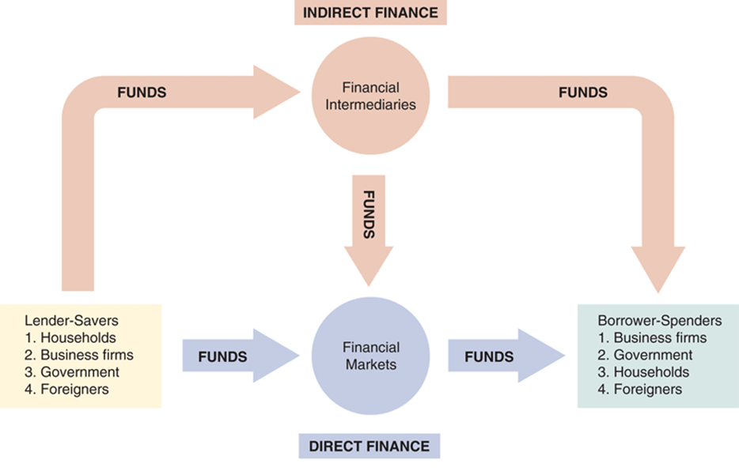
The Top Part of Figure 2.1—Indirect Finance
The arrows show that funds flow from lender-savers to borrower-spenders via two routes: direct finance, in which borrowers borrow funds directly from financial markets by selling securities, and indirect finance, in which a financial intermediary borrows funds from lender-savers and then uses these funds to make loans to borrower-spenders.
Notes:
The diagram shows that in direct finance, financial market gets funds from lender-savers such as households, business firms, government, and foreigners and from financial intermediaries and provides funds to borrower spenders such as business firms, government, households, and foreigners. In case of indirect finance, financial intermediaries get funds from lender savers such as households, business firms, government, and foreigners and provide funds to borrower spenders such as business firms, government, households, and foreigners and to the financial markets.

Slide 37
Function of Financial Intermediaries: Indirect Finance
Instead of savers lending/investing directly with borrowers, a financial intermediary (such as a bank) plays as the middleman:
  the intermediary obtains funds from savers
  the intermediary then makes loans/investments with borrowers
This process, called financial intermediation, is actually the primary means of moving funds from lenders to borrowers.
More important source of finance than securities markets (such as stocks)
Needed because of transactions costs, risk sharing, and asymmetric information

Slide 38
Function of Financial Intermediaries: Indirect Finance (cont.)
Transactions Costs
  Financial intermediaries make profits by reducing transactions costs
  Reduce transactions costs by developing expertise and taking advantage of economies of scale

Slide 39
Function of Financial Intermediaries: Indirect Finance (cont.)
A financial intermediary’s low transaction costs mean that it can provide its customers with liquidity services, services that make it easier for customers to conduct transactions
  Banks provide depositors with checking accounts that enable them to pay their bills easily
  Depositors can earn interest on checking and savings accounts and yet still convert them into goods and services whenever necessary

Slide 40
Global: The Importance of Financial Intermediaries Relative to Securities Markets
Studies show that firms in the U.S., Canada, the U.K., and other developed nations usually obtain funds from financial intermediaries, not directly from capital markets.
In Germany and Japan, financing from financial intermediaries exceeds capital market financing 10-fold.
However, the relative use of bonds versus equity does differ by country.

Slide 41
Function of Financial Intermediaries: Indirect Finance (cont.)
Another benefit made possible by the FI’s low transaction costs is that they can help reduce the exposure of investors to risk, through a process known as risk sharing
  FIs create and sell assets with lesser risk to one
  party in order to buy assets with greater risk from another party
  This process is referred to as asset transformation, because in a sense risky assets are turned into safer assets for investors

Slide 42
Function of Financial Intermediaries: Indirect Finance (cont.)
Financial intermediaries also help by providing the means for individuals and businesses to diversify their asset holdings.
Low transaction costs allow them to buy a range of assets, pool them, and then sell rights to the diversified pool to individuals.
Another reason FIs exist is to reduce the impact of asymmetric information.
One party lacks crucial information about another party, impacting decision-making.
We usually discuss this problem along two fronts: adverse selection and moral hazard.

Slide 43
Asymmetric Information: Adverse Selection and Moral Hazard
Adverse Selection
  Before transaction occurs
  Potential borrowers most likely to produce adverse outcome are ones most likely to seek a loan
  Similar problems occur with insurance where unhealthy people want their known medical problems covered

Slide 44
Asymmetric Information: Adverse Selection and Moral Hazard (cont.)
Moral Hazard
  After transaction occurs
  Hazard that borrower has incentives to engage in undesirable (immoral) activities making it more likely that won’t pay loan back
  Again, with insurance, people may engage in risky activities only after being insured
  Another view is a conflict of interest

Slide 45
Economies of Scope and Conflicts of Interest
FIs are able to lower the production cost of information by using the information for multiple services: bank accounts, loans, auto insurance, retirement savings, etc. This is called economies of scope.
But, providing multiple services may lead to conflicts of interest, perhaps causing one area of the FI to hide or conceal information from another area (or the economy as a whole). This may actually make financial markets less efficient!

Slide 46
Types of Financial Intermediaries
Depository Institutions (Banks): accept deposits and make loans. These include commercial banks and thrifts.
Commercial banks (about 5,000 at end of 2015)
  Raise funds primarily by issuing checkable, savings, and time deposits which are used to make commercial, consumer and mortgage loans
  Collectively, these banks comprise the largest financial intermediary and have the most diversified asset portfolios

Slide 47
Types of Financial Intermediaries (cont.)
Thrifts: S&Ls & Mutual Savings Banks and Credit Unions (around 900 of each)
  Raise funds primarily by issuing savings, time, and checkable deposits which are most often used to make mortgage and consumer loans, with commercial loans also becoming more prevalent at S&Ls and Mutual Savings Banks
  Mutual savings banks and credit unions issue deposits as shares and are owned collectively by their depositors, most of which at credit unions belong to a particular group, e.g., a company’s workers

Slide 48
Contractual Savings Institutions (C S I s)
All C S I s acquire funds from clients at periodic intervals on a contractual basis and have fairly predictable future payout requirements.
  Life Insurance Companies receive funds from policy premiums, can invest in less liquid corporate securities and mortgages, since actual benefit pay outs are close to those predicted by actuarial analysis
  Fire and Casualty Insurance Companies receive funds from policy premiums, must invest most in liquid government and corporate securities, since loss events are harder to predict

Slide 49
Contractual Savings Institutions (C S I s) (cont.)
All C S I s acquire funds from clients at periodic intervals on a contractual basis and have fairly predictable future payout requirements.
  Pension and Government Retirement Funds hosted by corporations and state and local governments acquire funds through employee and employer payroll contributions, invest in corporate securities, and provide retirement income via annuities

Slide 50
Types of Financial Intermediaries (cont.)
Finance Companies sell commercial paper
(a short-term debt instrument) and issue bonds and stocks to raise funds to lend to consumers to buy durable goods, and to small businesses for operations.
Mutual Funds acquire funds by selling shares to individual investors (many of whose shares are held in retirement accounts) and use the proceeds to purchase large, diversified portfolios of stocks and bonds.

Slide 51
Types of Financial Intermediaries (cont.)
Money Market Mutual Funds acquire funds by selling checkable deposit-like shares to individual investors and use the proceeds to purchase highly liquid and safe short-term money market instruments.
Hedge Funds are a type of mutual fund requiring large investments ($100,000 or more), long holding periods, and are subject to few regulations. These funds invest across almost all asset classes.
Investment Banks advise companies on securities to issue, underwriting security offerings, offer M&A assistance, and act as dealers in security markets.

Slide 52
Principal Regulatory Agencies of the U.S. Financial System
Regulatory Agency | Subject of Regulation | Nature of Regulations
Securities and Exchange Commission (S E C) | Organized exchanges and financial markets | Requires disclosure of information; restricts insider trading
Commodities Futures Trading Commission (C F T C) | Futures market exchanges | Regulates procedures for trading in futures markets
Office of the Comptroller of the Currency | Federally chartered commercial banks and thrift institutions | Charters and examines the books of federally chartered commercial banks and thrift institutions; imposes restrictions on assets they can hold

Slide 53
Table 2.3 Principal Regulatory Agencies of the U.S. Financial System (2 of 3)
Regulatory Agency | Subject of Regulation | Nature of Regulations
National Credit Union Administration (N C U A) | Federally chartered credit unions | Charters and examines the books of federally chartered credit unions and imposes restrictions on assets they can hold
State banking and insurance commissions | State-chartered depository institutions | Charter and examine the books of state-chartered banks and insurance companies; impose restrictions on assets they can hold; and impose restrictions on branching

Slide 54
Table 2.3 Principal Regulatory Agencies of the U.S. Financial System (3 of 3)
Regulatory Agency | Subject of Regulation | Nature of Regulations
Federal Deposit Insurance Corporation (F D I C) | Commercial banks, mutual savings banks, savings and loan associations | Provides insurance of up to $250,000 for each depositor at a bank; examines the books of insured banks; and imposes restrictions on assets they can hold
Federal Reserve System | All depository institutions | Examines the books of commercial banks that are members of the system; sets reserve requirements for all banks

Slide 55
Regulation of Financial Markets
Main Reasons for Regulation
Increase Information to Investors
Ensure the Soundness of Financial Intermediaries

Slide 56
Regulation Reason: Increase Investor Information
Asymmetric information in financial markets means that investors may be subject to adverse selection and moral hazard problems that may hinder the efficient operation of financial markets and may also keep investors away from financial markets.
The Securities and Exchange Commission (S E C) requires corporations issuing securities to disclose certain information about their sales, assets, and earnings to the public and restricts trading by the largest stockholders (known as insiders) in the corporation.

Slide 57
Regulation Reason: Increase Investor Information (cont.)
Such government regulation can reduce adverse selection and moral hazard problems in financial markets and increase their efficiency by increasing the amount of information available to investors. Indeed, the S E C has been particularly active recently in pursuing illegal insider trading.

Slide 58
Regulation Reason: Ensure Soundness of Financial Intermediaries (cont.)
Providers of funds (depositors, like you) to financial intermediaries may not be able to assess whether the institutions holding their funds are sound or not.
If they have doubts about the overall health of financial intermediaries, they may want to pull their funds out of both sound and unsound institutions, which can lead to a financial panic.
Such panics produces large losses for the public and causes serious damage to the economy.

Slide 59
Regulation Reason: Ensure Soundness of Financial Intermediaries (cont.)
To protect the public and the economy from financial panics, the government has implemented six types of regulations:
  Restrictions on Entry
  Disclosure
  Restrictions on Assets and Activities
  Deposit Insurance
  Limits on Competition
  Restrictions on Interest Rates

Slide 60
Regulation: Restriction on Entry
Restrictions on Entry
  Regulators have created tight regulations as to who is allowed to set up a financial intermediary
  Individuals or groups that want to establish a
  financial intermediary, such as a bank or an insurance company, must obtain a charter from the state or the federal government
  Only if they are upstanding citizens with impeccable credentials and a large amount of initial funds will they be given a charter

Slide 61
Regulation: Disclosure
There are stringent reporting requirements for financial intermediaries
  Their bookkeeping must follow certain strict principles
  Their books are subject to periodic inspection
  They must make certain information available to
  the public

Slide 62
Regulation: Restriction on Assets and Activities
There are restrictions on what financial intermediaries are allowed to do and what assets they can hold
Before you put your funds into a bank or some other similar institution, you want to know that your funds are safe and that the financial intermediary will be able to meet its obligations to you
One way of doing this is to restrict the financial intermediary from engaging in certain risky activities
Another way is to restrict financial intermediaries from holding certain risky assets, or at least from holding a greater quantity of these risky assets than is prudent

Slide 63
Regulation: Deposit Insurance
The government can insure people’s deposits to a financial intermediary from any financial loss if the financial intermediary should fail
The Federal Deposit Insurance Corporation (F D I C) insures each depositor at a commercial bank or mutual savings bank up to a loss of $250,000 per account
Similar government agencies exist for other
depository institutions:
  The National Credit Union Share Insurance Fund (N C U S I F) provides insurance for credit unions

Slide 64
Regulation: Limits on Competition
Evidence is weak showing that competition among financial intermediaries promotes failures that will harm the public. However, such evidence has not stopped the state and federal governments from imposing many restrictive regulations.
In the past, banks were not allowed to open branches in other states, and in some states banks were restricted from opening additional locations.

Slide 65
Regulation: Restrictions on Interest Rates
Competition has also been inhibited by regulations that impose restrictions on interest rates that can be paid on deposits
These regulations were instituted because of the widespread belief that unrestricted interest-rate competition helped encourage bank failures during the Great Depression
Later evidence did not support this view, and restrictions on interest rates have been abolished

Slide 66
Regulation Reason: Improve Monetary Control
Because banks play a very important role in determining the supply of money (which in turn affects many aspects of the economy), regulation of these financial intermediaries is intended to improve control over the money supply
One example is reserve requirements, which make it obligatory for all depository institutions to keep a certain fraction of their deposits in accounts with the Federal Reserve System (the Fed), the central bank in the United States
Reserve requirements help the Fed exercise more precise control over the money supply

Slide 67
Financial Regulation Abroad
Those countries with similar economic systems also implement financial regulation consistent with the U.S. model: Japan, Canada, and Western Europe
  Financial reporting for corporations is required
  Financial intermediaries are heavily regulated
However, U.S. banks are more regulated along dimensions of branching and services than their foreign counterparts

Slide 68
Summary of Part 2
Function of Financial Markets: We examined the flow of funds through the financial system and the role of intermediaries in this process.
Structure of Financial Markets: We examined market structure from several perspectives, including types of instruments, purpose, organization, and time horizon.
Internationalization of Financial Markets: We briefly examined how debt and equity markets have expanded in the international setting.
Function of Financial Intermediaries: We examined the roles of intermediaries in reducing transaction costs, sharing risk, and reducing information problems. Types of Financial Intermediaries: We outlined the numerous types of financial intermediaries to be further examined in later chapters.
Regulation of the Financial System: We outlined some of the agencies charged with the oversight of various institutions and markets.

