Slide 1
PRESENT SIMPLE REVIEW
ADVERBS OF FREQUENCY

Slide 2
Structure
Affirmative Statements :
With I - you - we – they, the simple present tense has the same form as the infinitive:
With she – he – it, we add “s” to the infinitive:
Negative Statements:
I - you - we – they + DO NOT (don’t) + stem + rest of the sentence.
She – he – it + DOES NOT (doesn’t) + stem + + rest of the sentence.
P.S: Be careful in negative statements with does not (doesn’t), do not add “s” to the base form of the verb.
Interrogative Statements
DO/DOES + Subject + Stem + + rest of the sentence?

Slide 3
Spelling of the third form singular forms (he/she/it)
Add “s” to most verbs.
Add “es” to verbs ending in sh - ch – s - x and o.
Change “y” to “i” and “es” to verbs ending in a consonant + “y”.

Slide 4
Present Tense Uses
Routines and Habits
Things that are true in general
To talk about the future when we are discussing a timetable or a Fixed plan
to talk about the future after words like ' 'when', 'until', 'After', 'before' and 'as soon as'
In the first and the zero conditionals

Slide 5
The ending of third-person singular verbs has three sounds:/S/ /Z/ /IZ/
The final “s” after voiceless consonants : t, p, k, f, th is pronounced /s/
The final “s” after voiced consonants : d, b, g, m, n, l, r, v, w, and vowels is pronounced /z/
The final “s” : sh, ch, x, s, z, ge/dge is pronounced /IZ/
Final “s” Pronunciation:

Slide 6
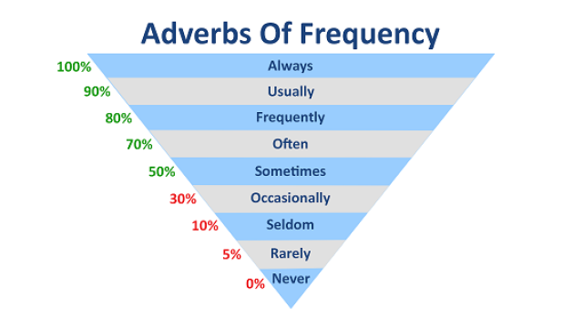
ADVERBS OF FREQUENCY
Adverbs of frequency are words that tell how often something happens : always, usually, frequently, often, sometimes, occasionally, rarely, seldom, never.

Slide 7
Some Rules
In a sentence, an adverb of frequency usually comes after the auxiliary “to be” but before other verbs.
When a verb has two parts (has bought), the adverb of frequency occurs between two parts (has bought).
To ask about the frequency of an action, use “ever” or “how often”.
Negative adverbs of frequency such as rarely, seldom, and never, should be used with an affirmative verb.

